Slide 1
Disable is a Verb
Using the Social Model of Disability to Improve Library Service
John Buckmaster – ALC 2018

Slide 2
CONTENT/TRIGGER WARNING:
This presentation focuses on Disability. Discussion will focus on ableism, involve examples thereof (including Nazis), and may stray into areas involving abuse, sexuality, politics, and religion.
Also, this topic is important to me and I may get a bit “enthusiastic.” I apologize in advance if my filters drop and some colourful language escapes.
Notes:
People should be doing these things. It’s simply a “movie rating” for your page/presentation/et, and gives some control back to your audience.

Slide 3
About John:
I’m an Autistic IT guy (there’s a stereotype) and have a number of co-morbid conditions, including but not limited to: Dyspraxia, Dysgraphia, Hyperlexia, Sensory Processing Disorder(s), Oral Allergy Syndrome, and other allergies. I’ve been disabled since birth, but a disability activist for the past 5 years.
For Library-related enquiries, please email: jbuckmaster@chinookarch.ca
You can find me and my rampant profanity on twitter: @theAutistech or email me at: theautistech@gmail.com
Notes:
Not for pity, but to give context to the discussion. Talk to people in your community, I am not a wheelchair user. I can identify some issues, but it is best to consult people who have those disabilities..
Dyspraxia: also include executive functioning issues

Slide 4
Disability: any restriction or lack (resulting from an impairment) of ability to perform an activity in the manner or within the range considered normal for a human being.
World Health Organisation’s (WHO) International Classification of Impairments Disabilities and Handicaps (ICIDH),1980.
Notes:
Pulled from a medical firm’s website. Not naming them, because ew.

Slide 5
It’s outdated, but the ideals that formed it are still in place, and many medical organizations still use this definition.
And there are problems with it.

Slide 6
It encapsulates the medical model of disability:
It suggests there is something wrong with the person (impairment).
It relies on ambiguous and highly subjective ideals (normal).
It implies that disabled persons aren’t actually real humans because of the above.
It relies on three common themes of discrimination:
Condemnation, Objectification, and Pathologization

Slide 7
Discrimination or prejudice against individuals with disabilities is called Ableism
Or disableism if you prefer the British way of things.

Slide 8
While the origins are much older, most of our current biases are based in Eugenics.
And we do it to almost everyone we meet.

Slide 9
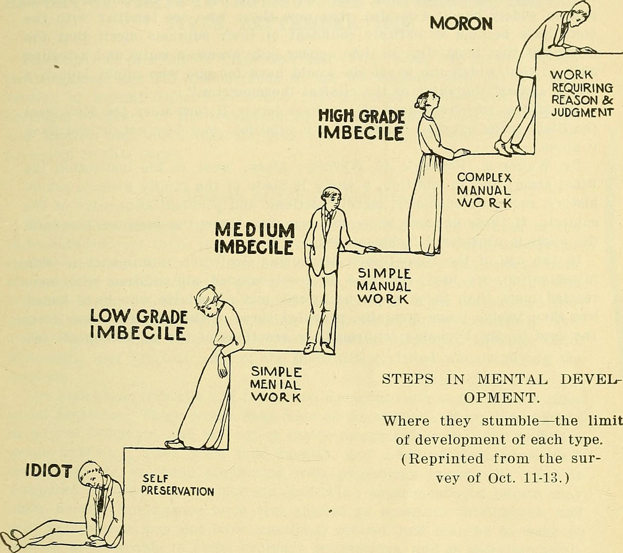
Eugenics:
The idea that racial purity can be measured and quantified. Letting people discriminate “scientifically.” Most of our ideas on intelligence and disability, and many of our views on health come from this.
Image Source: https://www.linkedin.com/pulse/early-chequered-history-iq-keith-mcnulty/

Slide 10
Ableism never fell out of favour:
10-20,000 disabled persons (mostly children) turned in by their families and then tortured and murdered as part of Aktion T4. This led directly to the Gas Chambers and the ability to enact “the final solution.”
275,000 disabled persons killed in the German Concentration Camps.
Sterilizations of intellectually disabled persons continued until 1971 in AB, and they are still institutionalized.
Doctors in Canada are telling parents of intellectually disabled minors that they should be Euthanized under the “right to die” legislation.
Children in AB have died because parents are afraid of children becoming Autistic through vaccinations. (This is literally impossible, BTW).
Abuse of Autistics is funded by many health plans as “treatment.”
Each year, countless assaults and murders are perpetrated against disabled people. Offenders are given slaps on the wrist, and often make money/gain fame because of it.
Notes:
AB Parents who let their children die are making $2500+ per appearance at anti-vax events. ID people are 3-7 times more likely to be abused sexually or otherwise.

Slide 11
But Ableism affects everyone:
What lengths do we go to in order seem more intelligent? To not show “weakness?” How do we feel when someone calls us an “idiot?”
How often do we make things more difficult for ourselves and others, or dismiss actual needs because of that?
Why do we repeatedly dismiss actions we don’t agree with as being mental illness?
How many of our negative words are about disability? Stupid, Crippled, Crazy, Retarded, Insane, Dumb, etc?
How often do we assume something is inherently wrong with someone who is disabled, or that it’s their fault somehow?
How often do we exclude disabled people without realizing it?
Notes:
Weakness/difficult: How many people avoid mobility aids and similar when it would simplify their lives?

Slide 12
How do we change this?
An Action plan for what you can do.

Slide 13
Step 1: Reframing our Perspectives
Understanding the Social model of Disability

Slide 14
The Social Model of Disability:
Basic concept is people don’t “have disabilities,” they’ve “been disabled.”
If you don’t want your Wi-Fi on, or your car alarm going… You disable them. And if you don’t want someone to function in society... You disable them.
Common example: Are we disabled because we wear corrective eyewear, or when we can’t?
Would you build a road made of boulders and then claim it’s a car’s fault for not being able to drive along it?
Is a person in a wheelchair disabled because of the wheelchair, or because we as a society don’t build things they can use?
Notes:
Glasses: The disabling happens when something necessary breaks or costs too much.

Slide 15
Reframing your mindset:
Almost everything we “know” about disability is wrong, and contrary to most evidence.
Disability is an Intersection.
Most of the time, the issue is our mindset, or something we can fix. When called out on behaviour: acknowledge, LISTEN, and do better.
Think: “what are we doing that is disabling them?” rather than “what’s wrong with them?’
Presume Competence. People will let you know when you need help, either verbally, visually, or by action.
Treat people with dignity.
Notes:
Everything we “know:” We’ve been taught and absorbed biased information since birth. Yoda/unlearn.
Disability: not constant (just because you can lift 50 pounds doesn’t mean you can hold it forever)
Intersection: 20% of North Americans are disabled, 100% will be. (Temporarily Abled) It literally crosses all boundaries. Society is built on the assumption that temporary ability is permanent.

Slide 16
Step 2: Changing our Language
Language is how we take thoughts and make them real.
Changing language changes our thinking.

Slide 17
Language Matters:
Changing language changes how we see and react to things.
  Example: “Alt-right” was a deliberate rebranding by “upscale” White Nationalists and Neo-Nazis. How many people do we know who accept “alt-right” ideology, but don’t call themselves Nazis?
Many words we use on a daily basis are derogatory or discriminatory, and affect the way we think.
These words have always been discriminatory or derogatory. Marginalized groups now have the ability to get their message out, unlike before, when it was easier to silence them.
Notes:
Silencing: we are still silenced routinely, but we are making a difference now.

Slide 18

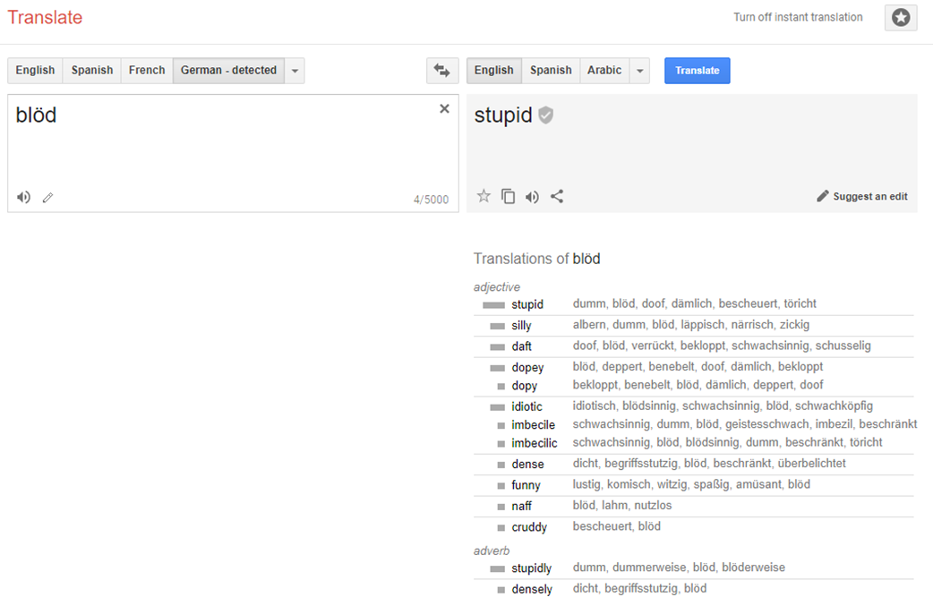
And it has real consequences:
Photo from:
http://davehingsburger.blogspot.ca/2009/02/from-pink-to-black-exclusion-and-death.html
Notes:
Deliberately chose things from the past here because current ones are very horrific. Ref: kids lighting an Autistic boy on fire.

Slide 19
When speaking and writing:
Pay attention to your own language. Understand what you’re actually saying, and correct when you notice.
Don’t actively correct others unless you’re in an appropriate situation. Respond with correct words, instead.
Respect the identities and descriptions marginalized people use for themselves.
Avoid “blaming,” put the onus on the acting person/organization instead.
Presume Competence. “Dumbing down” insults everyone involved. Not only is the term Ableist, doing so erects barriers and actively disables people.
Remember that Language is not the only way to communicate.
Notes:
Watch for warning signs in other people’s language: language is a sign of attitudes and often a precursor to actions.
Active correction: If they don’t get it after a while, you have a pattern you can refer to and ask about when bringing it up.
Blaming: People don’t bully someone because of a disability. People bully because they are dillholes. The disability is an excuse. Similarly, being disabled doesn’t excuse sexual misconduct .
Dumbing down: you erected a barrier by altering language and tone, they erect because they assume you think they’re stupid, and the changed language is another barrier as it is no longer correct terminology.

Slide 20
Step 3: Active Inclusiveness
Stopping Exclusionary processes.

Slide 21
Our Society is obsessed with “Normal:”
We base our rules, structures, and plans on our perception of “normal.”
Problem is, “normal”…isn’t. Normal means “like me.” And our perceptions do not align with reality, they’re shaped by our circumstances, the media, and our desires.
When we base things on “normal,” we exclude people, and this reinforces our perception of “normality.”
Often, we try to use marginalization as a shield or a false equivalency for actions unrelated to said marginalization. This is done primarily to reinforce stereotypes and the false sense of “normality.”
Notes:
Think how many times “the board” wants something that is wholly out of touch with your reality in the library.
Excuse/shield: Being in a wheelchair doesn’t excuse/forgive sexual harassment.
Marginalization in one area does not mean you understand others: Being autistic doesn’t mean I inherently understand the Native experience.

Slide 22
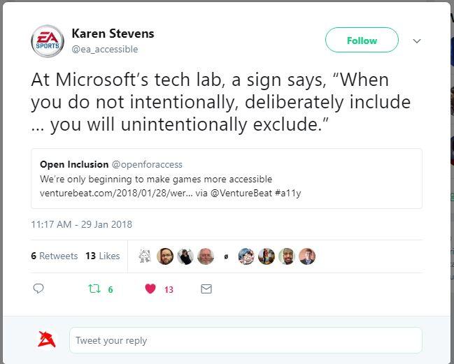
Even Microsoft gets it:
Notes:
They don’t always succeed, but they do better than most.

Slide 23
Actively Include People:
If everyone else gets to do something, except one or two… it’s discrimination.
Unless somehow regular people don’t need to eat, bathe, go to the bathroom, or otherwise exist in society, there are no “special needs.”
We plan a huge amount in our services for lots of things. The only reason planning for marginalized/disabled people is seen as “extra work” is because we made it that way.
Everyone has different needs and abilities. It’s our job to stop disabling them.
Intent matters less than action.
Again, Presume Competence. Would you come to an event where you’re looked down upon?
Notes:
Intent: Not intending to step on my foot doesn’t mean you didn’t do it, or that my foot doesn’t hurt. Continuing to step on my foot implies you did intend to do so, or don’t care.
Made it that way: Building accessibility is easy…unless you didn't do it the first time. Retrofitting is expensive and hard (even if it really isn’t). Self-perpetuating myths and planning.

Slide 24
Involve the Community
Disabled or other marginalized people can, will, and likely have been telling you about problems and offering solutions.
If you aren’t getting suggestions, it’s because they already feel there’s no point, or you are re not listening.
The same goes for programs and events. If no-one from a particular group or community is showing up, there’s generally a reason.
Invite all communities you can.
Bring in these people to consult. Pay them when they do consultation work. And yet again, Presume Competence. We know our experiences.
Notes:
Don’t bring in those adjacent-to such as family, caretakers, etc.
Generally a reason: could be programs run too late, or the bus trip is too much hassle, or someone there was a jerk and not chastised. Anything.
We do the work of 3-4 people every day just to live in this world, expecting us to do more without pay is kindof absurd.

Slide 25
Action Plan Summary:
Integrate the Social Model of Disability.
Actively work on changing your own language.
Practice Active Inclusiveness.

Slide 26
Making this work in your Organization.
how the heck do we apply this?

Slide 27
Getting Things Going
We may want all of the change now, but many organizations and individuals are very reluctant. Be the point person when you can.
Trying to do everything yourself is impossible. You will break before society/your institution bends. Enlist help.
There will be naysayers, even among disabled people. Ableism is deeply internalized, and privilege will affect people’s views.
Remind yourself of the Social Model, Presume Competence, and remember you/your organization may be actively Disabling whomever you are dealing with.
Planning for and having accommodations provided, or at least available even when “not needed” will help normalize.
Notes:
Point person: larger organizations should have an inclusivity advisor.
Privilege: Just because you are marginalized doesn’t mean your privilege doesn’t affect you. I’m disabled, but I’m also a white “male.”
Normalize: the more often we do things, the more acceptable it becomes. But beware of giving the impression people are doing work for no reason. It’s always, always more work to adapt after the fact, and that almost always puts someone in a bad situation.

Slide 28
Active Change
You can’t be an expert on everything. Ask questions of the community Honest, serious questions will get honest responses. Be prepared to accommodate varying communication styles.
Follow up on those answers and take action on them. Involved affected people in the decision making process.
Frame institutional requests so you’re focusing on “how to meet patron needs” or “how we’re failing our stated goals.”
Focus on goals that are easy to reach (or can be done without approvals). Once some are in place, it’s easier to do more/get approvals.
Any time there’s a larger project (renovation, new grants, etc) make a point of inclusiveness and accessibility in official documents.
Be specific when you can!
Notes:
Asking questions: it’s okay if we don’t answer. Answering questions is a full-time job sometimes, and it’s frustrating.

Slide 29
Getting Political
Our role is inherently politicized, from offering services to at-risk youth, to having books on evolution. Pretending we’re somehow above politics does no-one any favours.
Silence and inaction always favour those in power and those discriminating. Public action not only tells the community what we stand for, but shows marginalized people they are welcome.
Involve the community in curating our collections. We already make choices as to what we carry. What message does it send when we choose to carry resources that promote harmful practices?
Promote programs and new features heavily. If people don’t know, they won’t attend/use/etc.
Write grant applications for your programs and renovations to help cover costs.
Notes:
Harmful: So many of our books on Autism promote the idea that we are broken, lay blame on provably wrong factors, or promote functioning labels. Most also suggest harmful “treatments” or promote the idea we should be sterilized (To Siri with love)
Grants: making things accessible is grant gold.

Slide 30
Disabled (and marginalized) people problems are the same problems everyone else has, but magnified.
By making things better for us, you make things better for everyone.

Slide 31
Helpful links and references
https://en.wikipedia.org/wiki/Social_model_of_disability
https://www.xojane.com/issues/i-am-not-a-person-with-a-disability-i-am-a-disabled-person
http://www.autistichoya.com/p/ableist-words-and-terms-to-avoid.html
https://butyoudontlooksick.com/articles/written-by-christine/the-spoon-theory/
https://en.wikipedia.org/wiki/Inspiration_porn
https://crippledscholar.com/
https://autismwomensnetwork.org/
http://autisticadvocacy.org/
http://adapt.org/

Slide 32
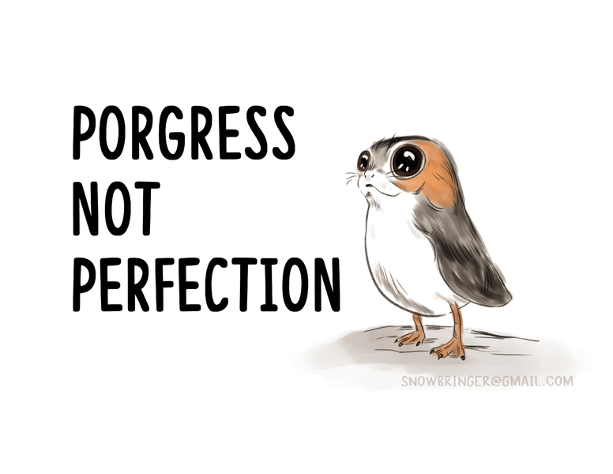
Remember!
No one expects you to get this right all the time.
But we do expect you to learn from problems and do better.

