Slide 1
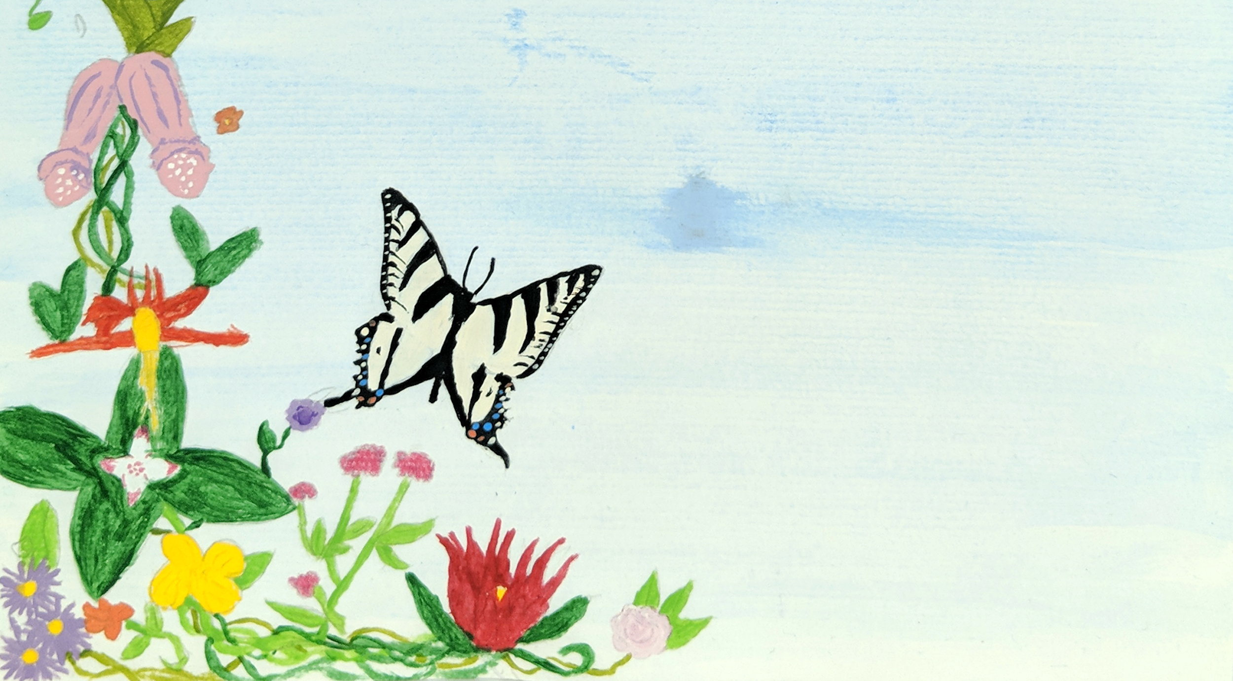
Dancing in the Library
Making Art, Building Community, and Empowering Girls
Caitlin Ottenbreit, Customer Services Librarian, Children and Youth Services
Vancouver Island Regional Library, Nanaimo Harbourfront Branch
Notes:
Hello! I’m Caitlin, and I’m so pleased to be here today to share this program with you all!
Before I go any further, I do want to respectfully acknowledge that we have gathered together today to learn and collaborate on the traditional territories of the Lekwungen-speaking peoples. I wish to acknowledge the Songhees, Esquimalt and WSÁNEĆ peoples, whose historical relationships with this land continue to this day.

Slide 2
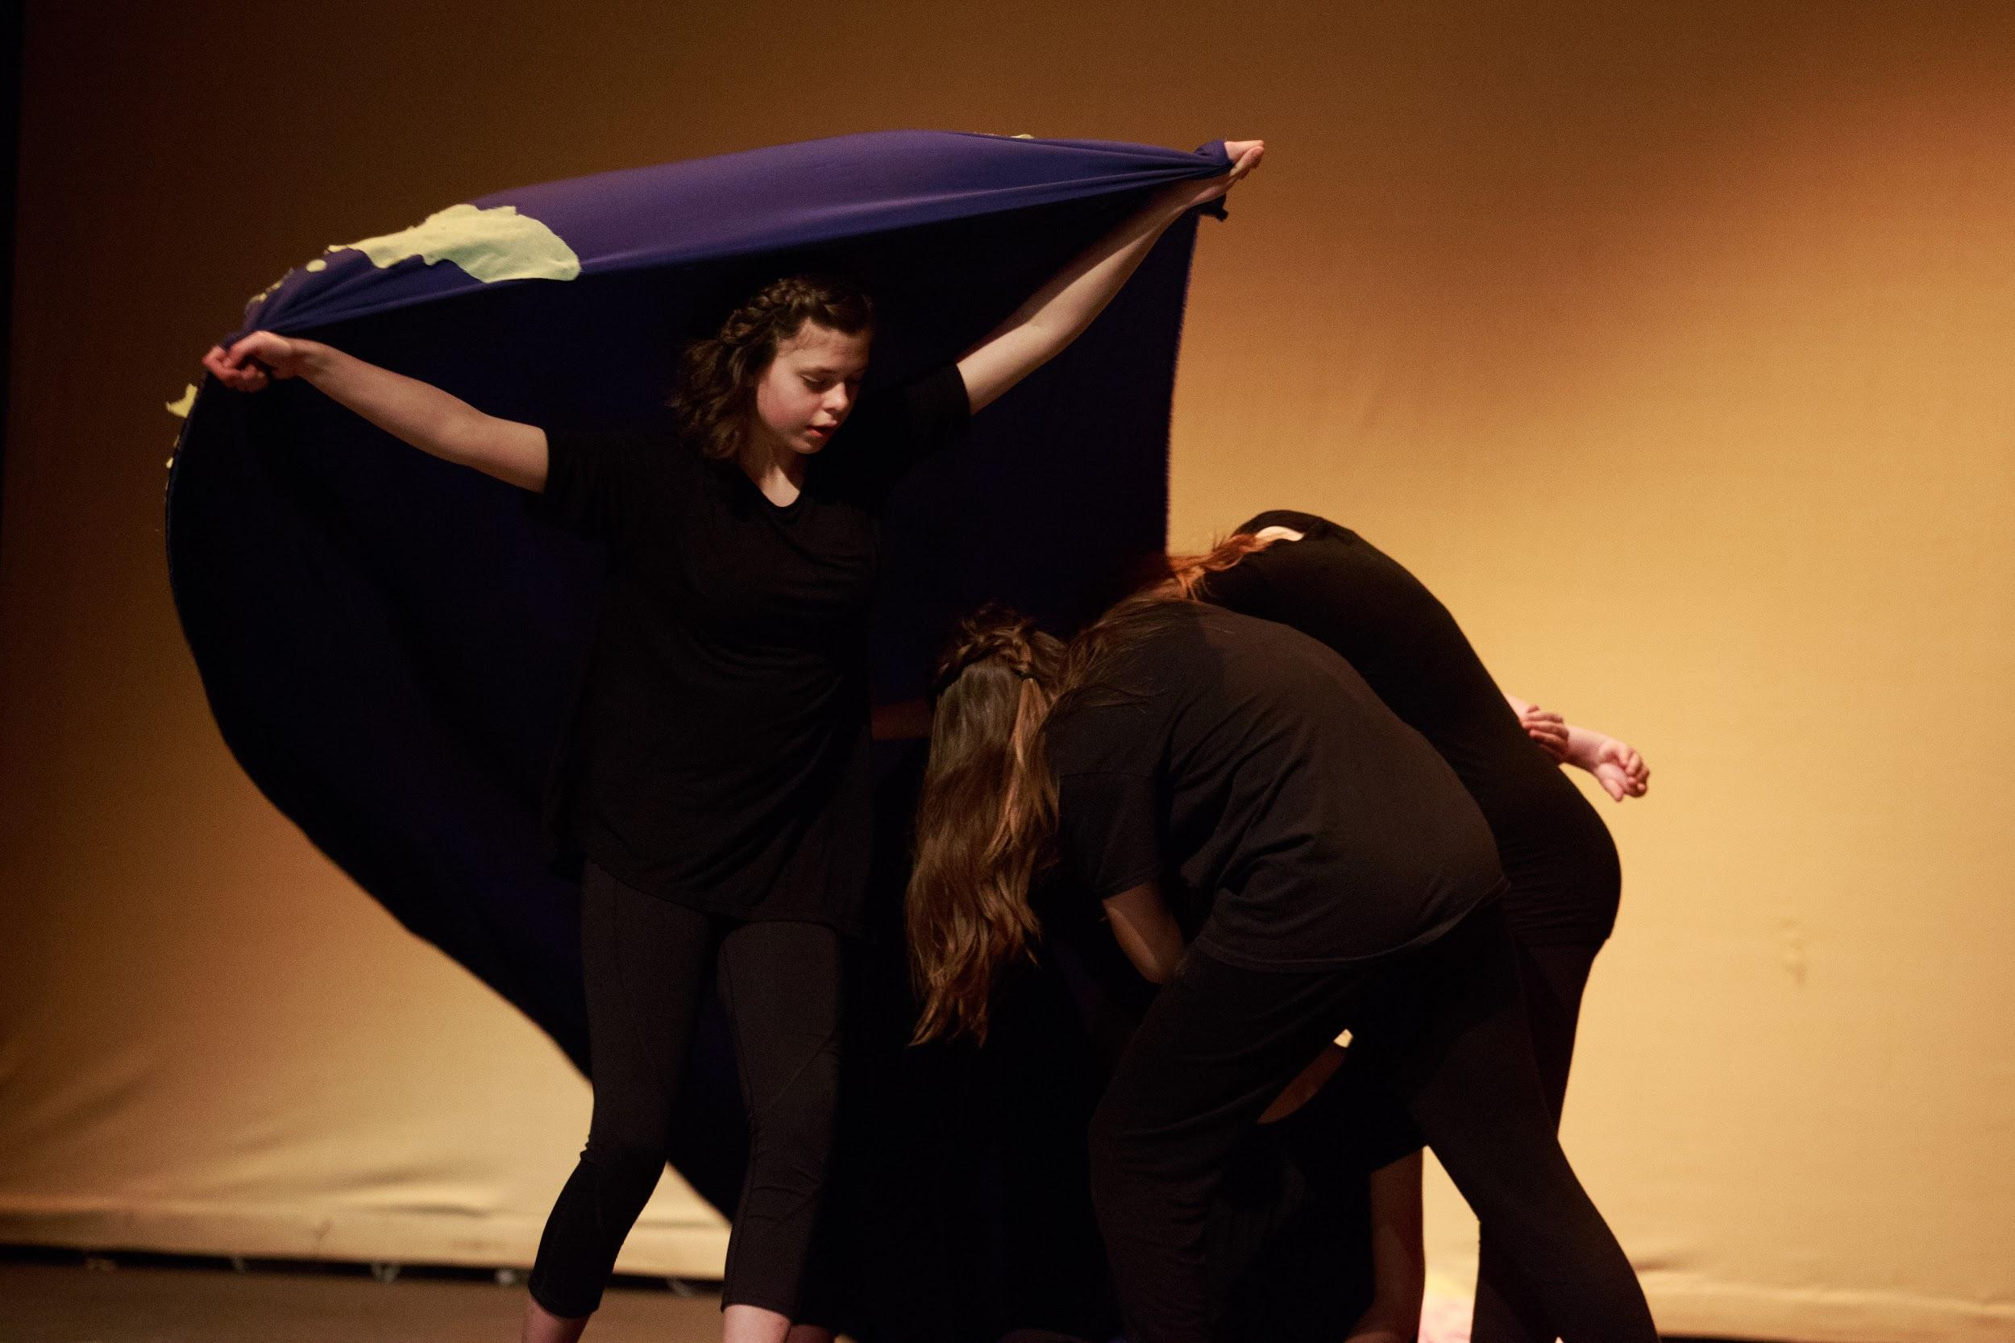
Overview
Celebrating Girls Celebrating Community program background
The program itself
Impacts at the library and on the girls
Notes:
So the usual “what will you see in the next 20 minutes”:
A little bit about Celebrating Girls Celebrating Community program background
where did it come from and why bother doing something like this in the library?
The program itself
Who were the girls
What did the classes look like
What did we do
Impacts at the library and on the girls
What have we all gotten out of our participation in this project?

Slide 3
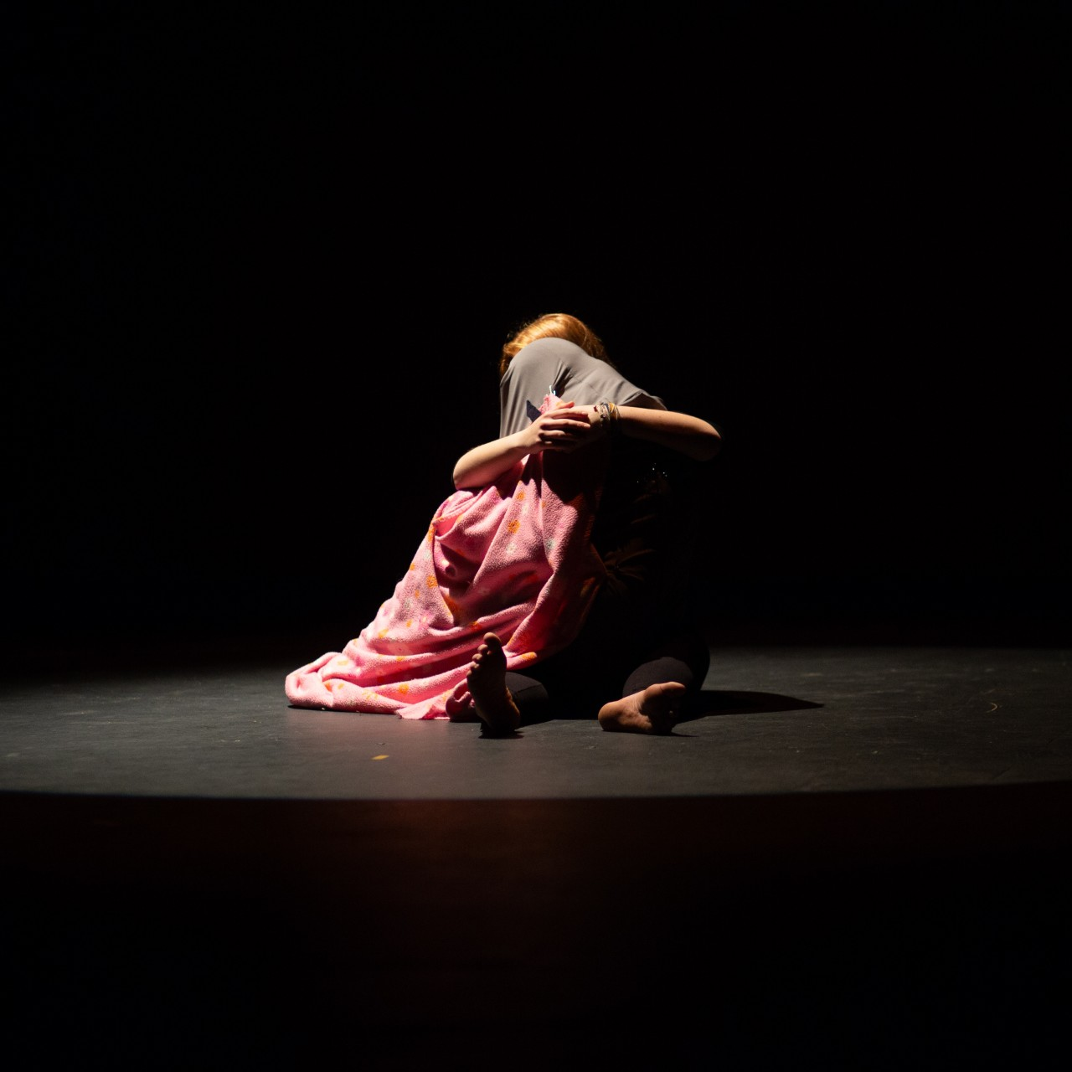
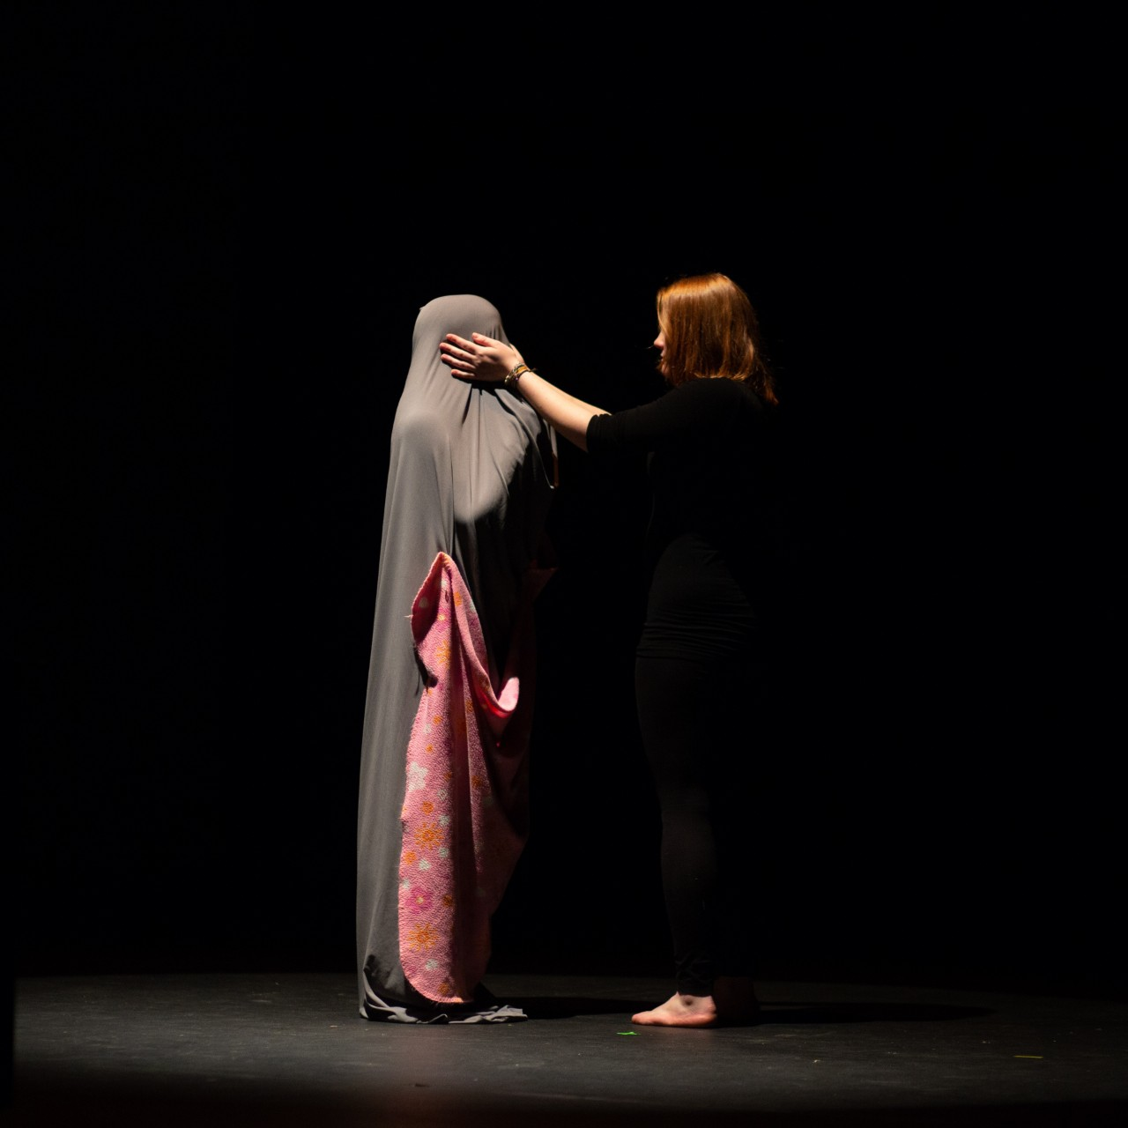
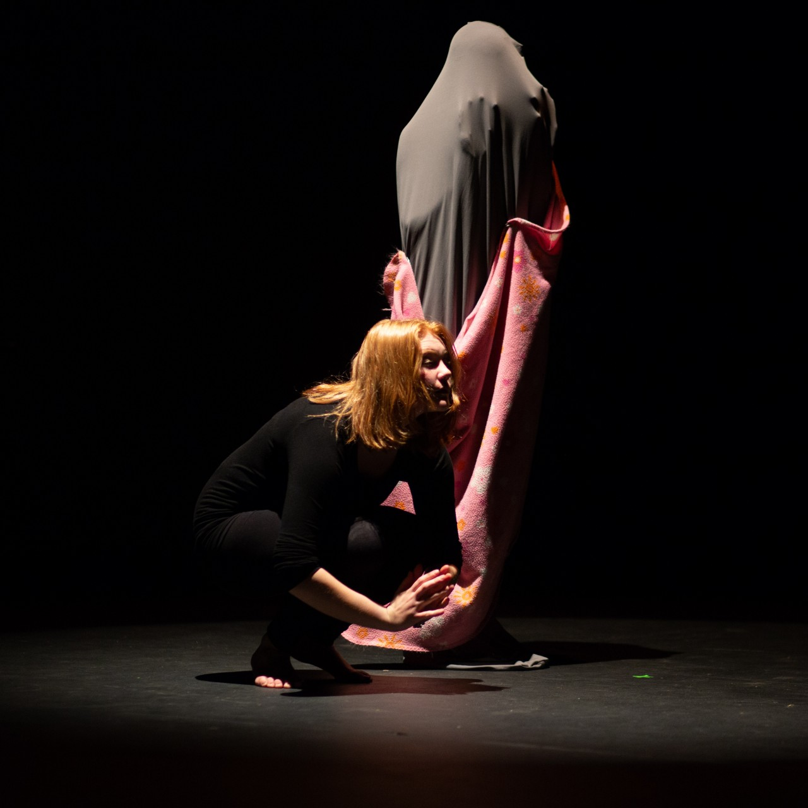
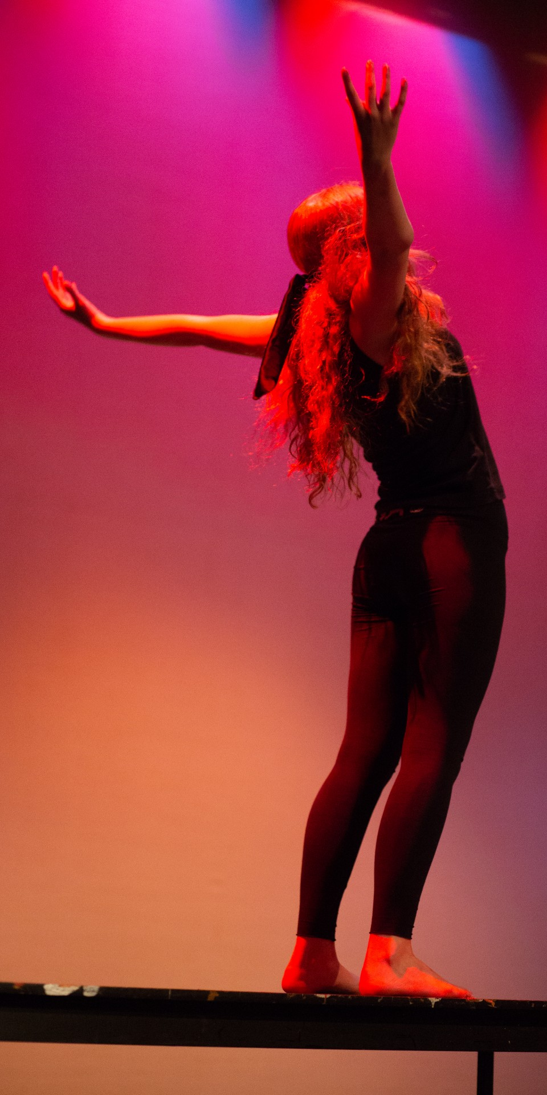
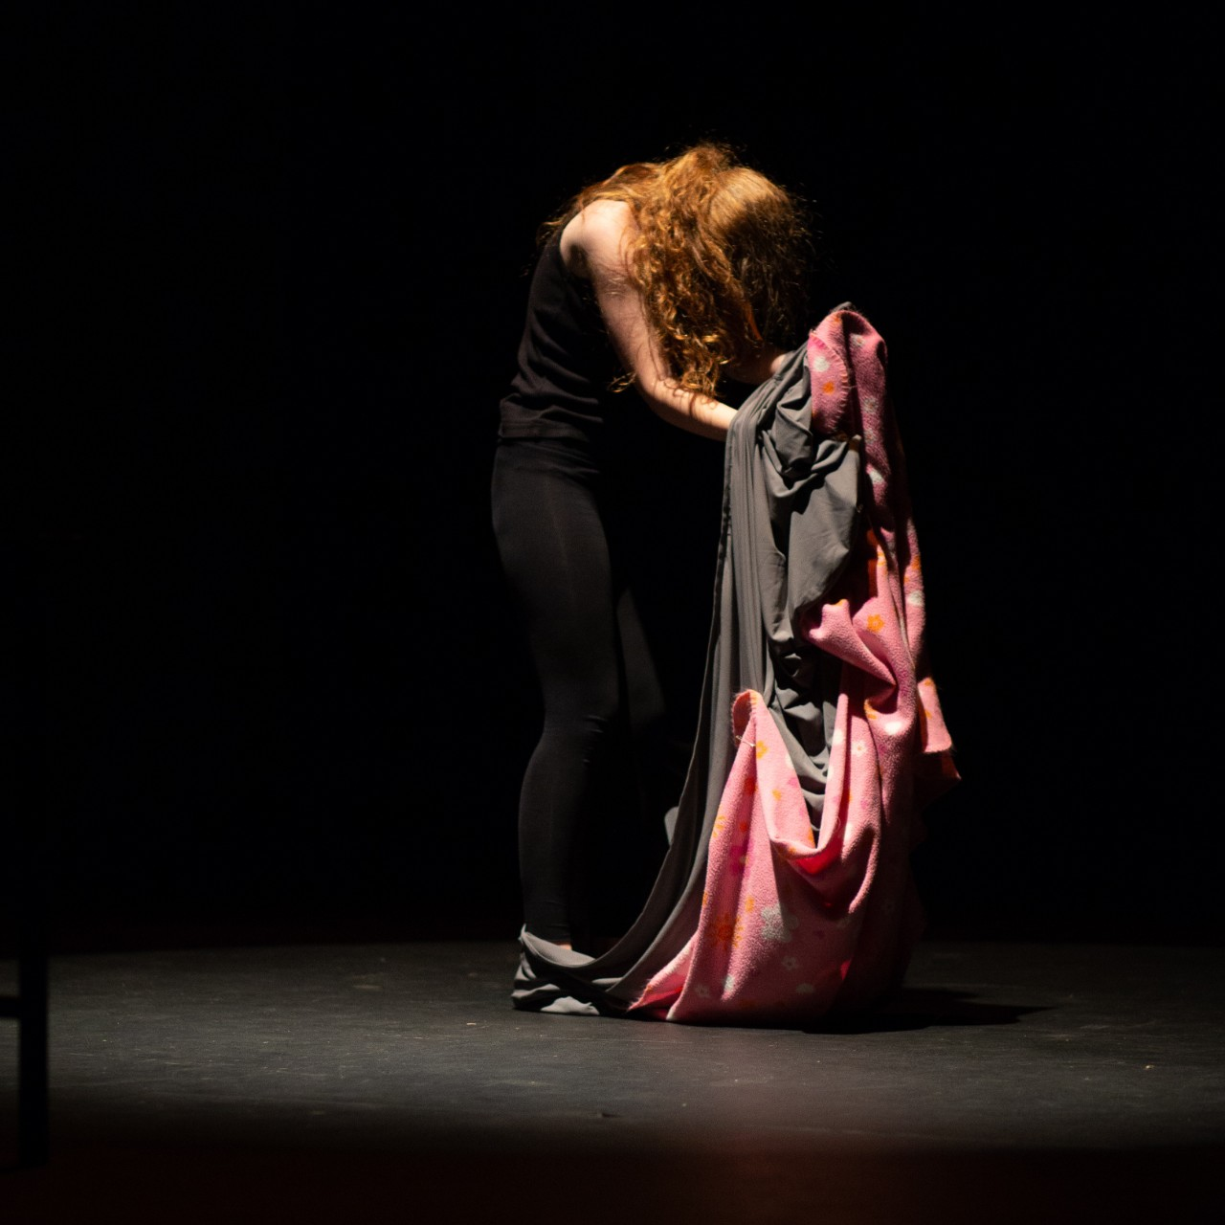
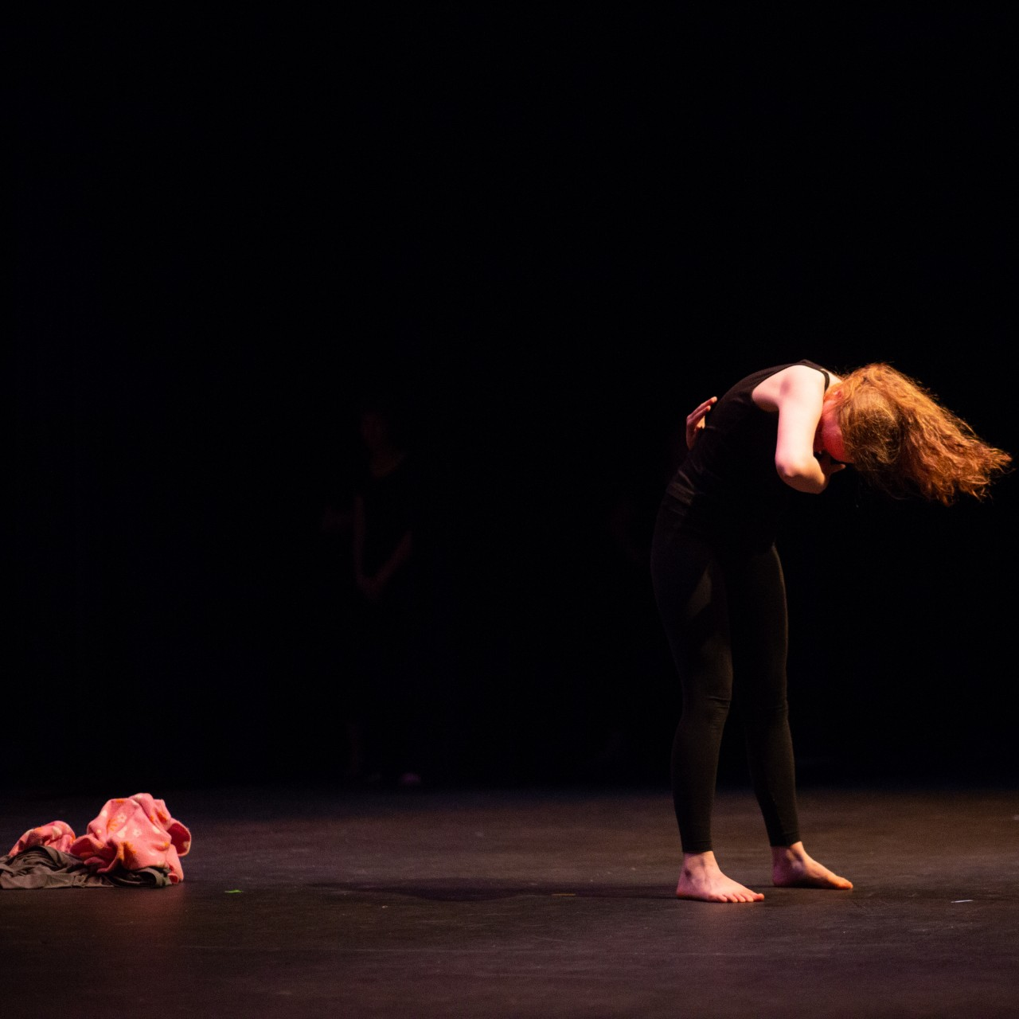
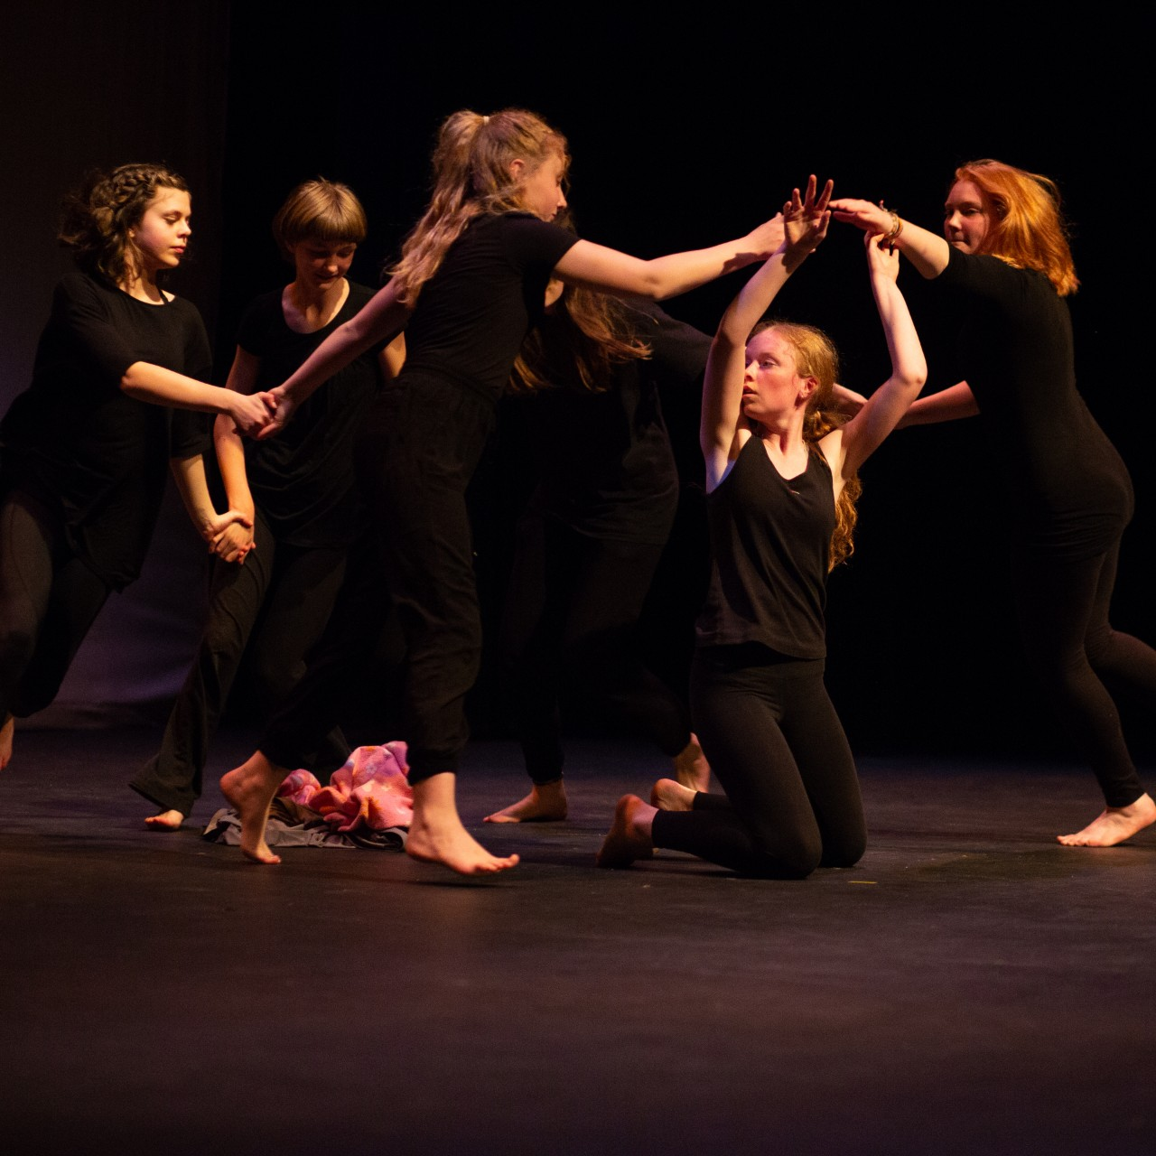
Program Background
Notes:
Quick overview:
Like all public libraries, Harbourfront Branch and VIRL more generally were looking for ways to connect with teens in the community.
Some of our librarians were asked to write an Island Health grant application, and one of our librarians, Sheila Hammond-Todd, saw a performance by the travelling group from the Dandelion School in Ottawa. When she found out that Hannah was moving to Nanaimo it seemed like a perfect way to get teens into the library, making art, and learning how to build up their community, so she and another colleague, Jason Kuffler, worked with Hannah to put the grant proposal together.
I got super lucky, and got to jump into this program as one of the first things I did when I started at Harbourfront back in summer 2017.
I took responsibility as the on the ground person for the program - I worked closely with Hannah to coordinate schedules, I facilitated various workshop sessions, coordinated the logistics for the performance, wrote the final report, and did whatever else I needed to do. And I got to build strong relationships with all the girls - we did a lot of laughing and crying together over the year they were working in the library.

Slide 4
dandeliondance.ca
Notes:
So just a little bit about Dandelion Dance and why Hannah was the right woman for the job:
From their website:
“Our Mission
We offer life changing programs that bring girls of all backgrounds and abilities together to use their unique experiences in the collective creation of dance works. Creating together allows the girls to have a voice, develop empathy, break stereotypes, discover and explore their creativity, and practice leadership.”
Dandelion was founded by Hannah Beach, who facilitated our program, and who has been working to empower girls to take an active role as leaders in their community through the arts for close to 20 years. Hannah has won many awards, including being featured in the Canadian Human Rights Commission’s 2017 Annual Report as one of five featured individuals creating change across the country.

Slide 5
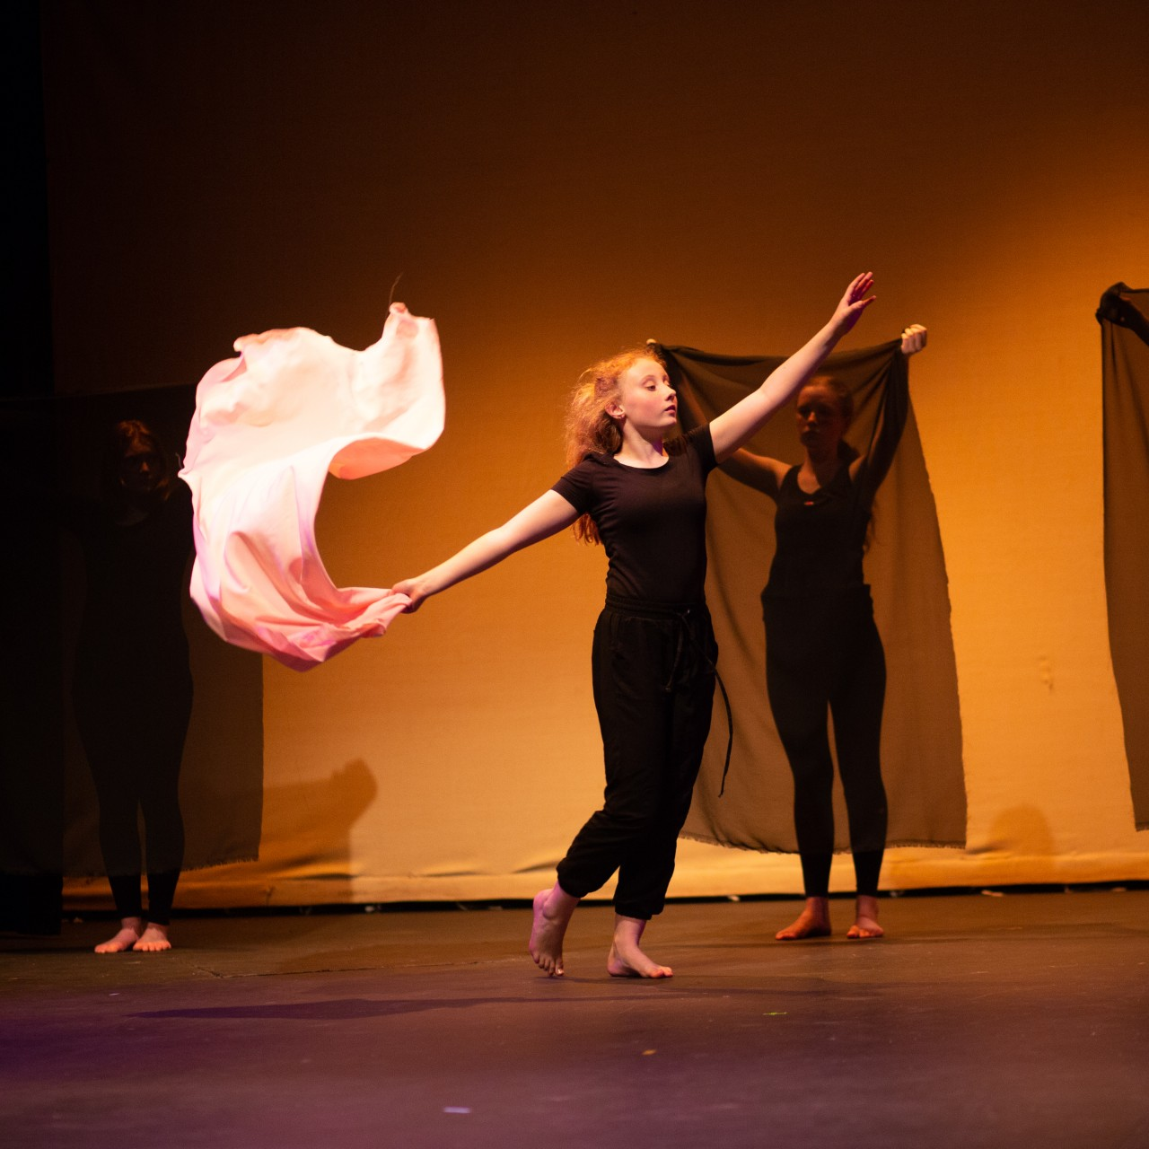
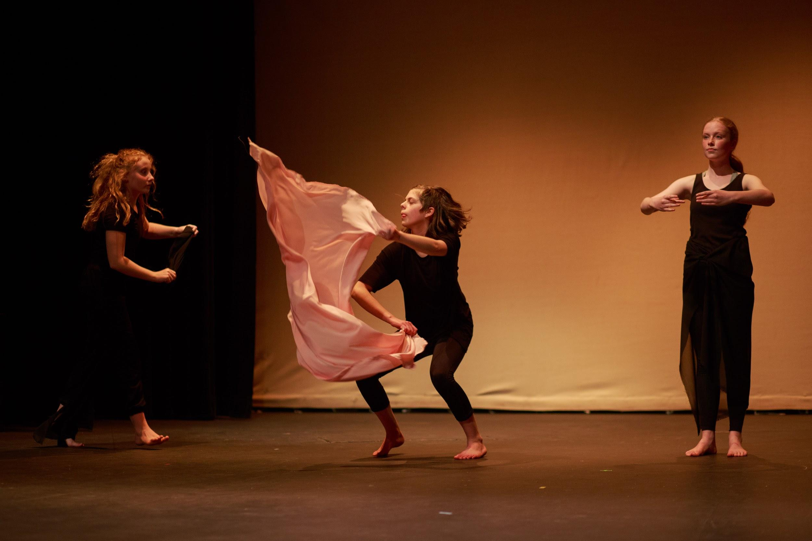
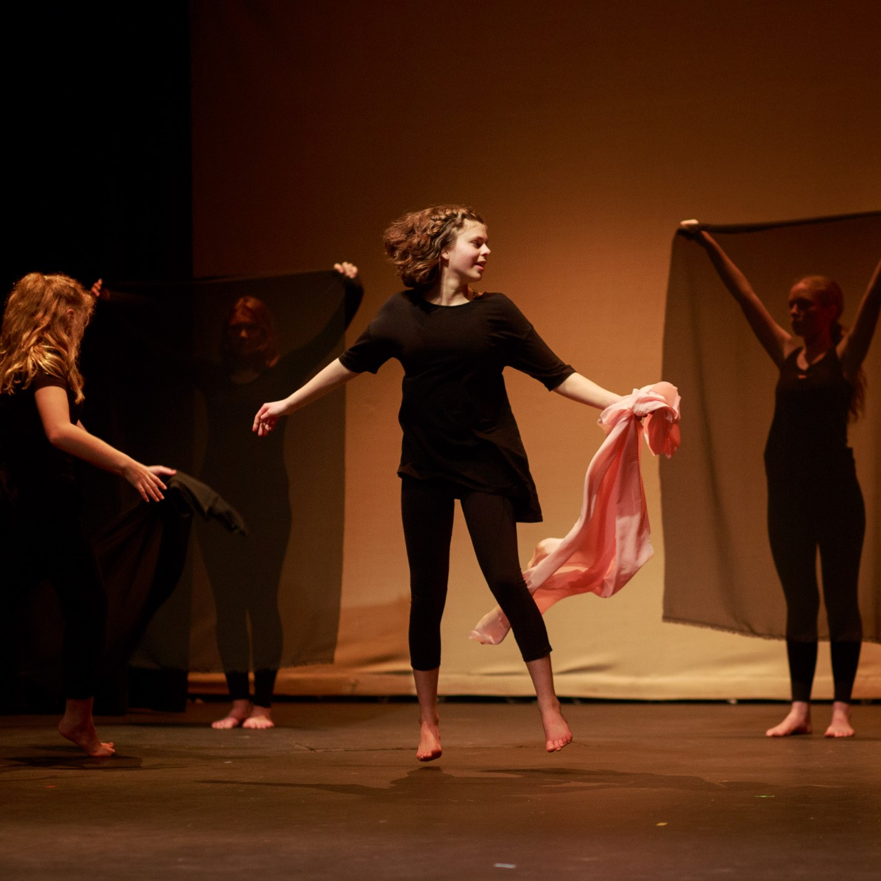
Goals
Notes:
What did we want out of the program at the library? Why bother, what were we expecting to see?
We wanted to end up with teen girls who had stronger
self confidence, self-esteem, and resilience
engagement with the arts
communication skills
sense of belonging and support in their community and with us at their public library

Slide 6
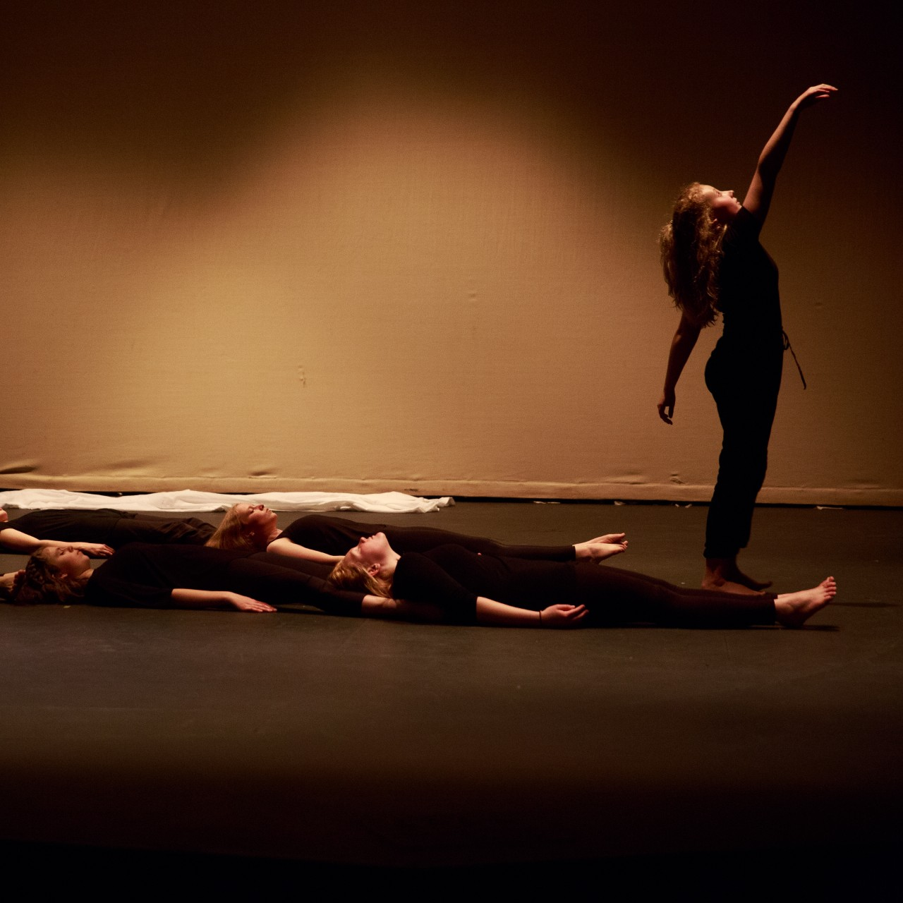
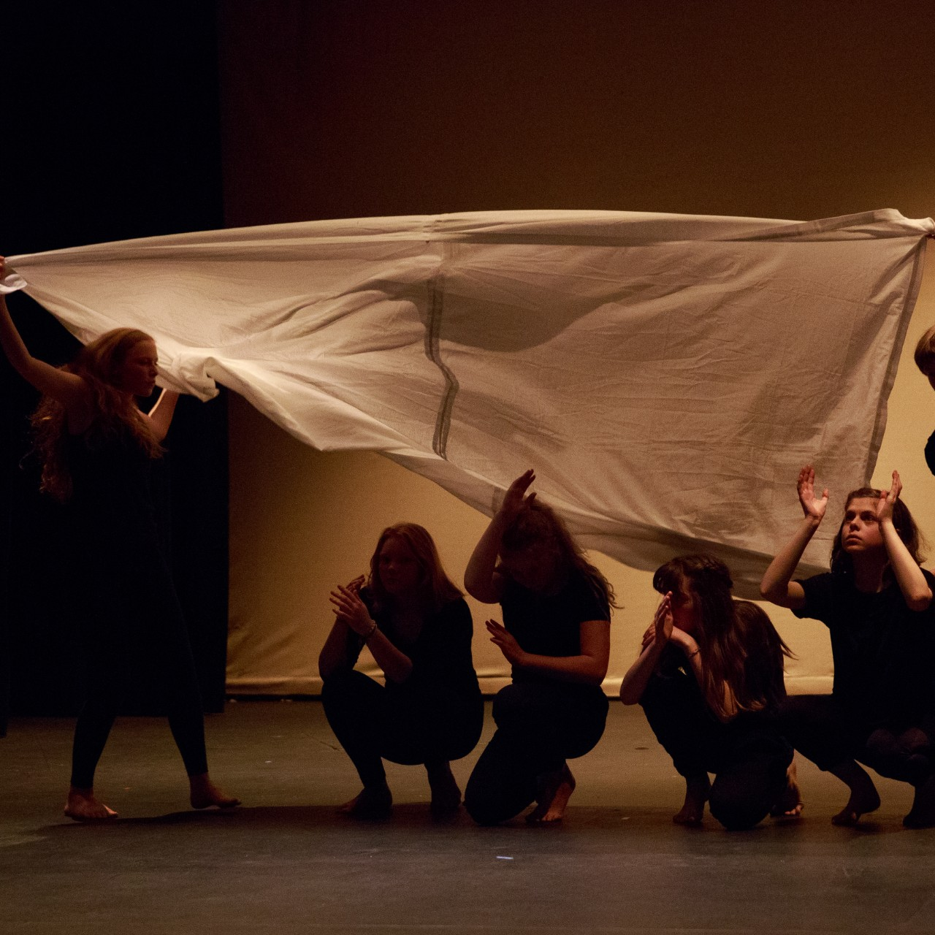
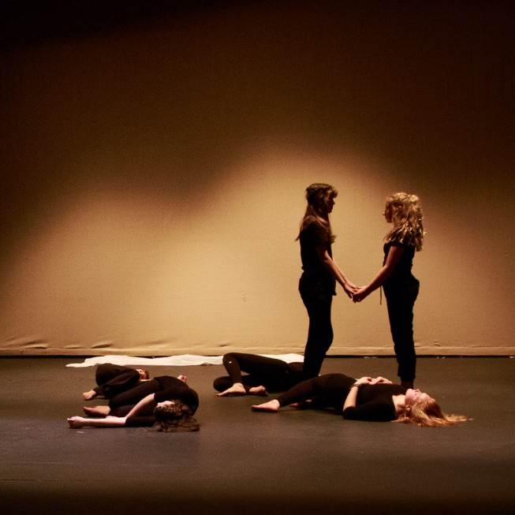
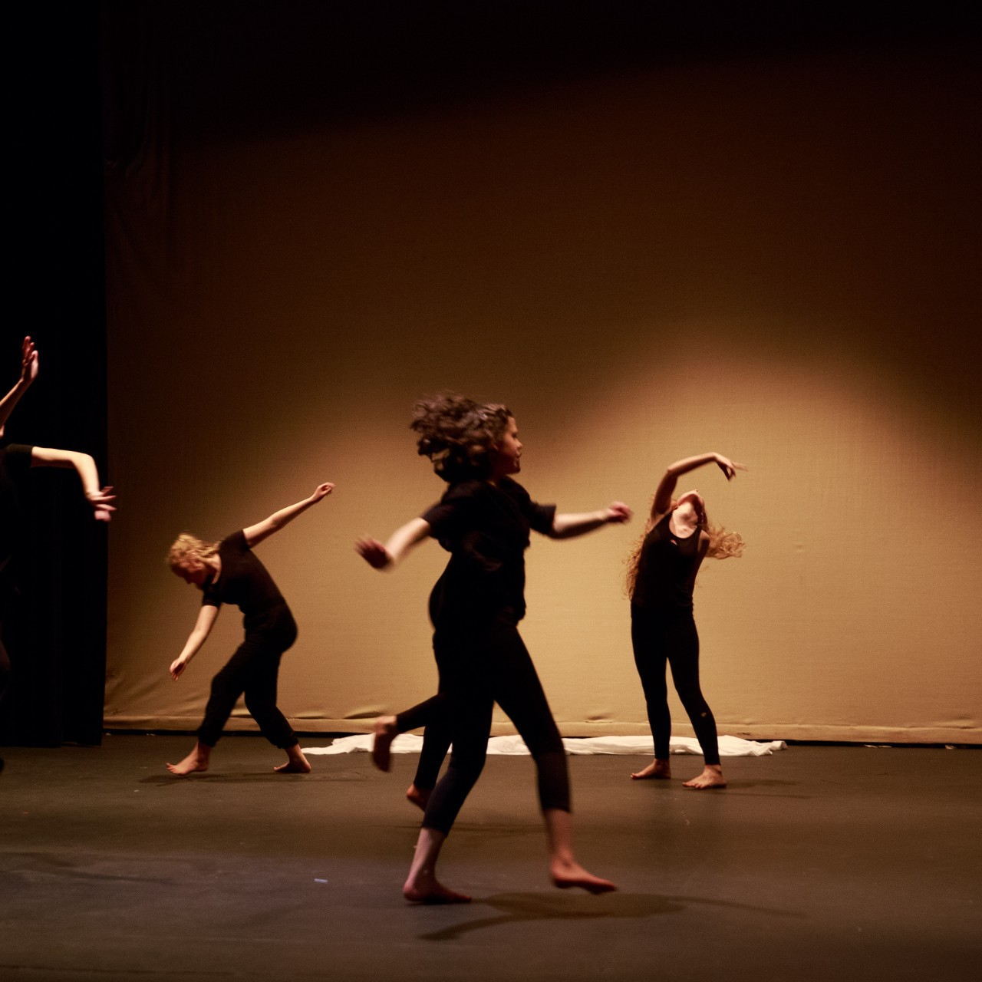
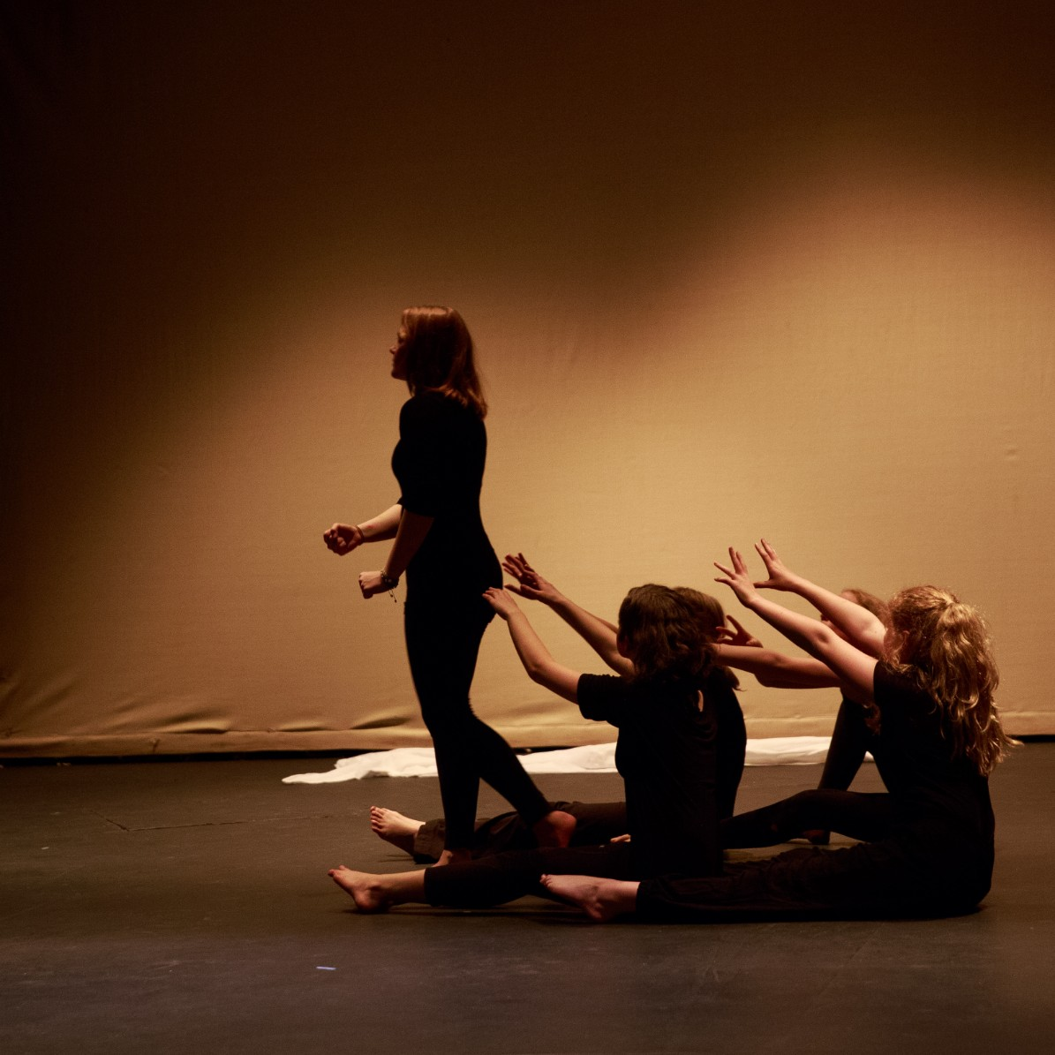
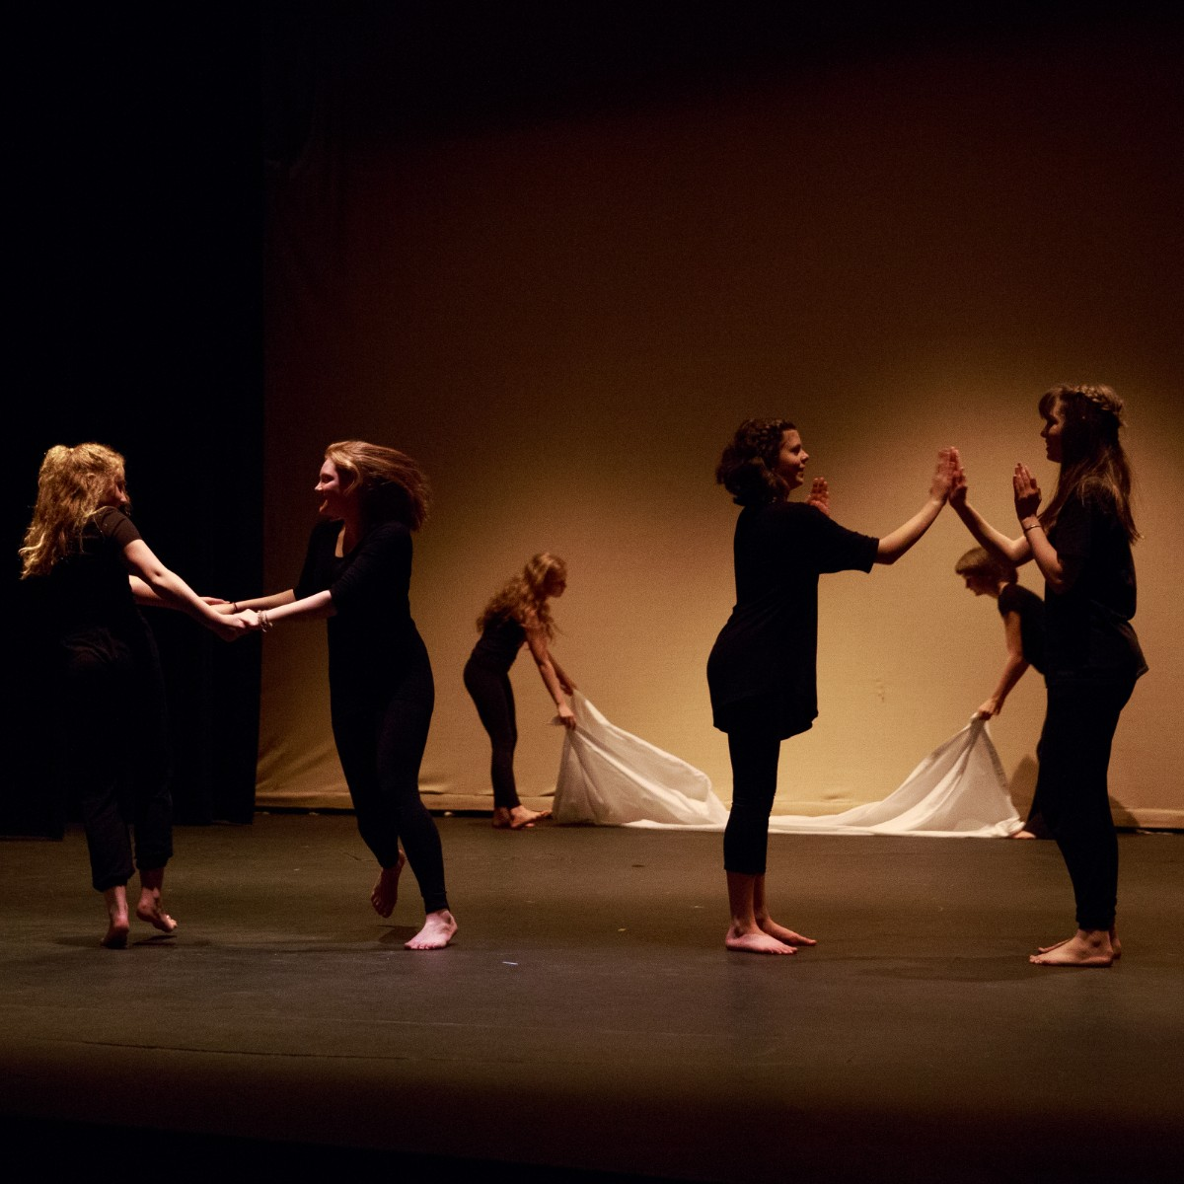
The Program
Notes:
Super rough outline of the overall program:
11 girls between 13 and 16 years old were involved with the program between September 2017 and May 2018.
Of these girls, 6 were able to stay with the program long enough to perform in the final show almost exactly a year ago on 5 May 2018.
Due to various cultural, socioeconomic, and other barriers, the remaining 5 young women were unable to follow through to the end.
Eg. Two of the girls were recent Syrian refugees and the rehearsals conflicted with their Arabic school so they weren’t able to continue
We did do some work administratively to see if we could lessen some of these barriers - for example, one young woman was living independently and needed to work Saturdays. So we looked into community grant money to pay her for her time. Unfortunately she felt unsafe turning down those shifts regardless because she felt she might lose her job if she did.
The girls took part in 19 formal classes plus a few one-on-one sessions to work on their individual performances with Hannah, an art/mindfulness workshop I facilitated, prop making sessions where we sewed, crafted, recorded a poetry recitation, and worked on the art used in the program (which I featured as the title slide), plus whatever miscellaneous things they wanted to work on
On 5 May 2018 the final performance was held at the Malaspina Theatre at Vancouver Island University. All elements of the performance, including choreography, music selection, theme, title, and props were created by the girls with support from Hannah, Jason, and me

Slide 7
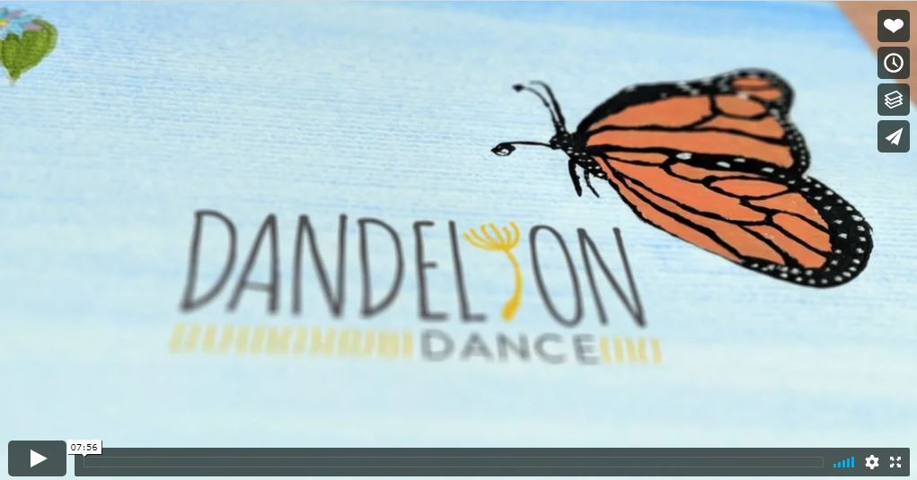
https://vimeo.com/304199833
Notes:
So since they program was all about our girls, I thought I’d share this video where they get to speak for themselves! Island Health produced this video so they could feature our program at their annual meeting, and I thank them for making it available to us to share.

Slide 8
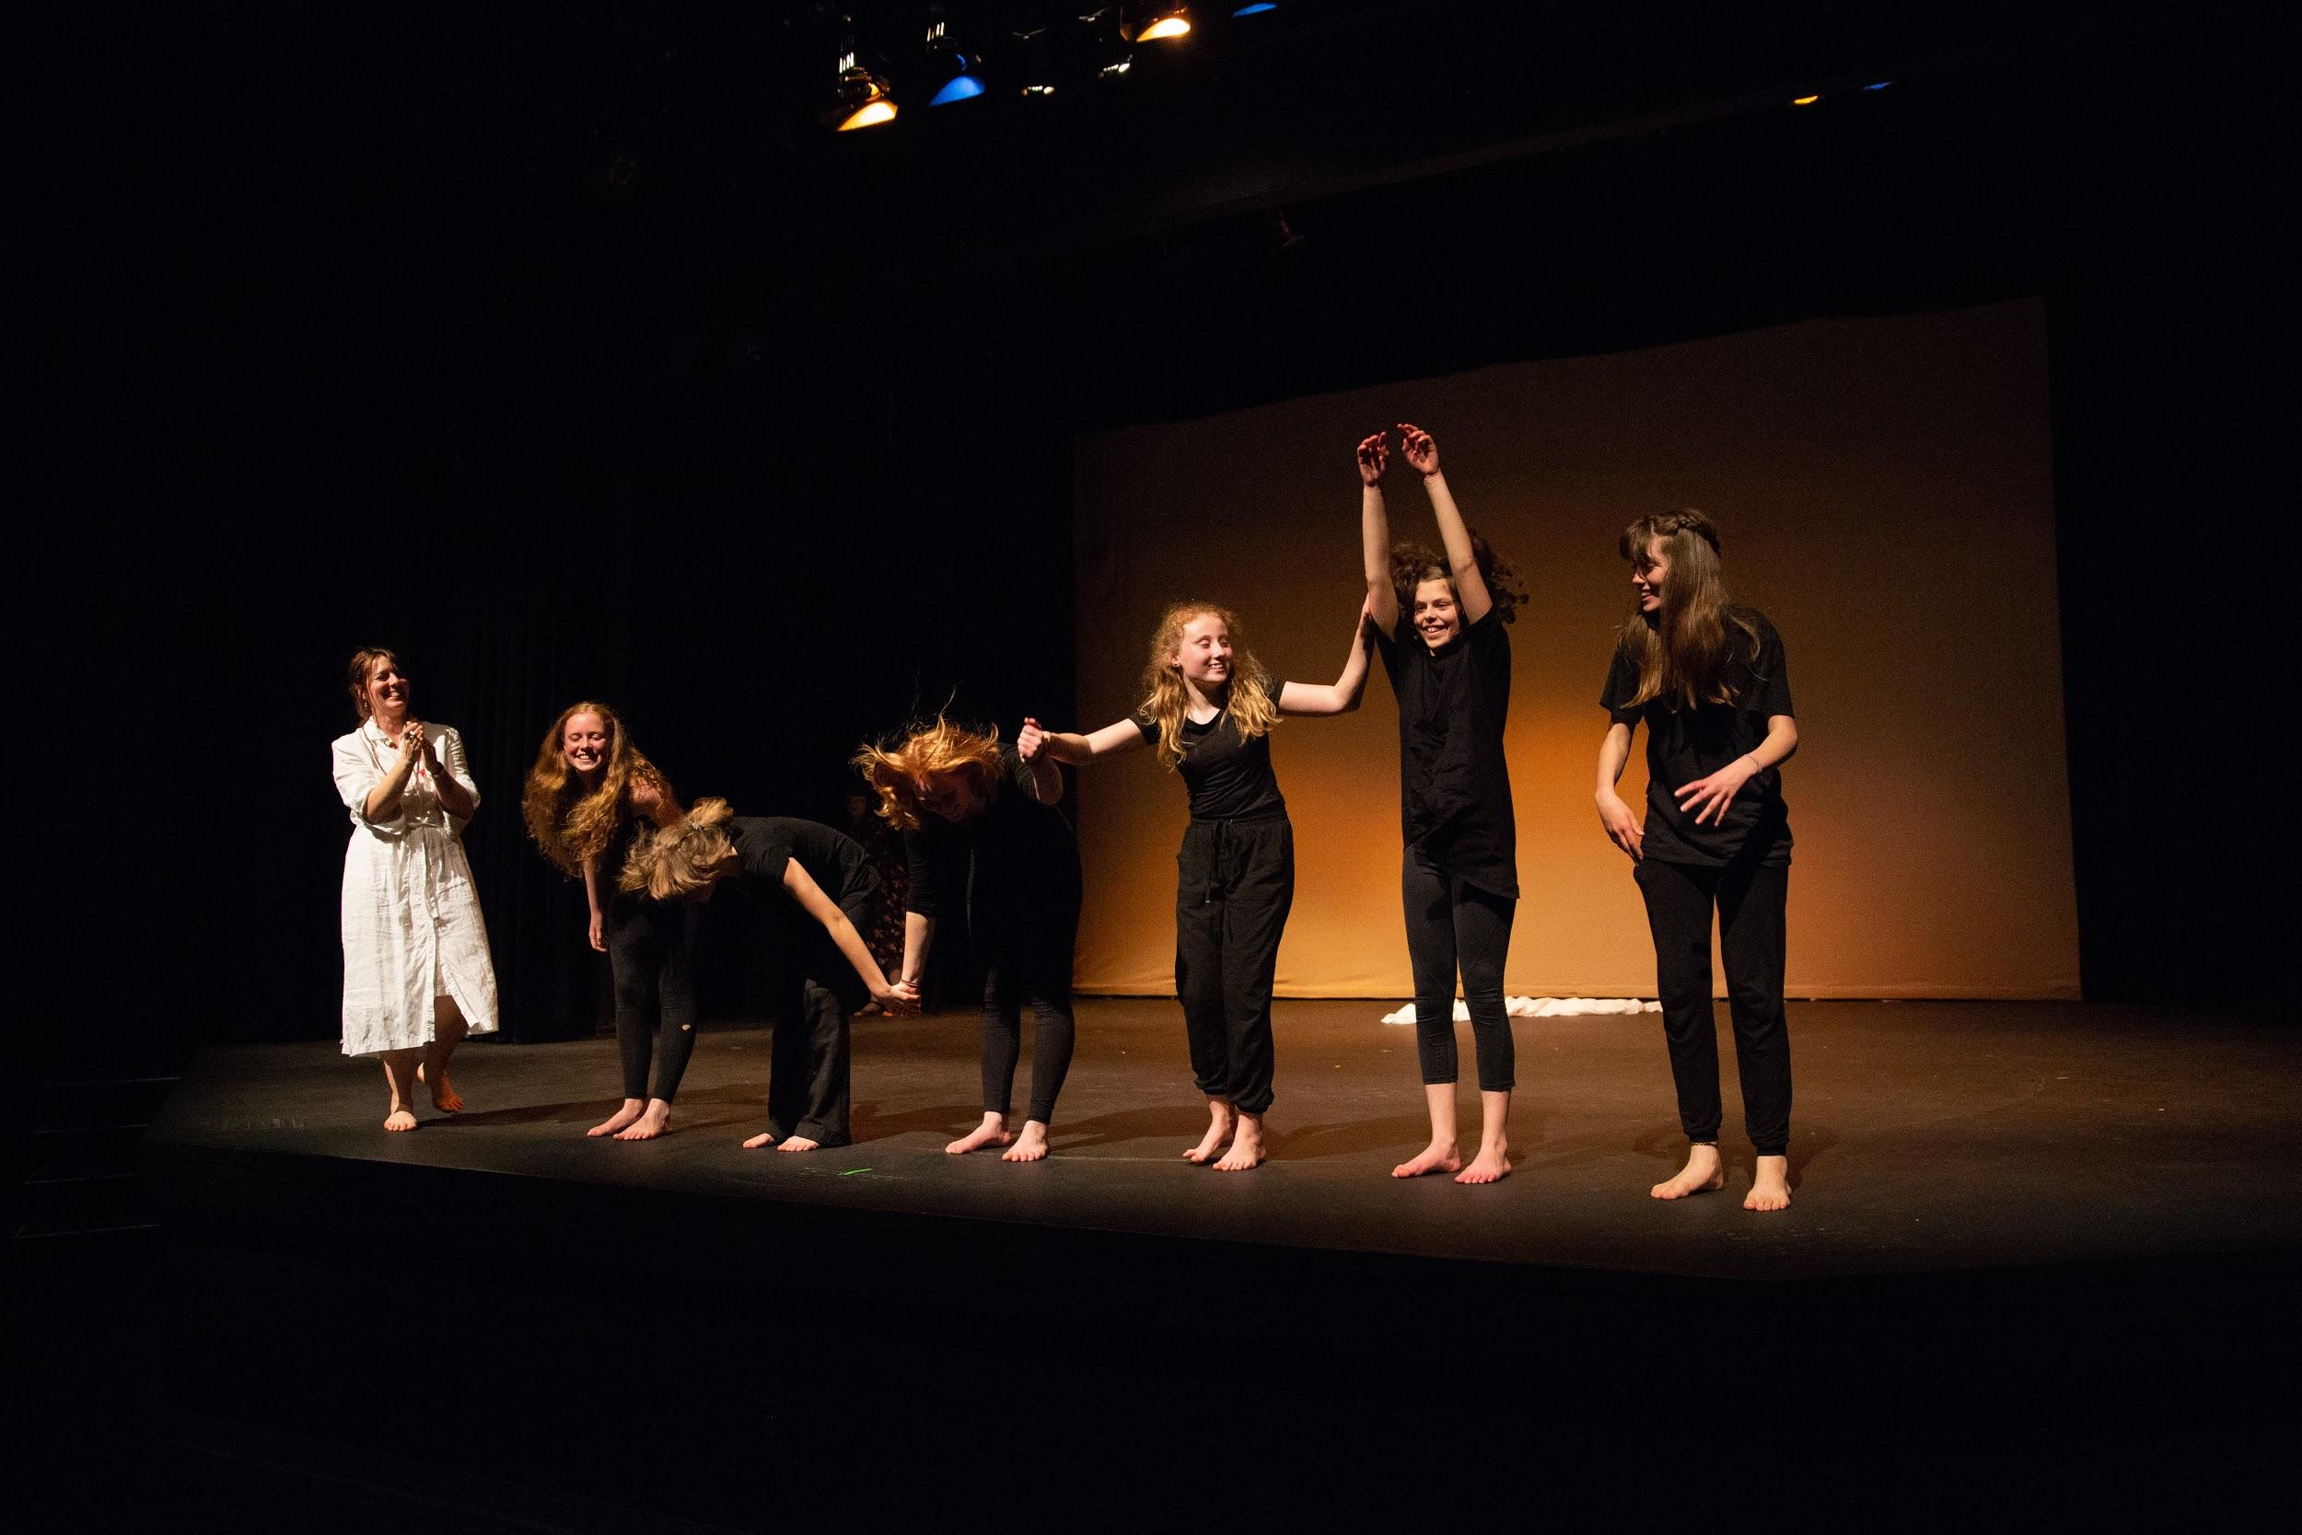
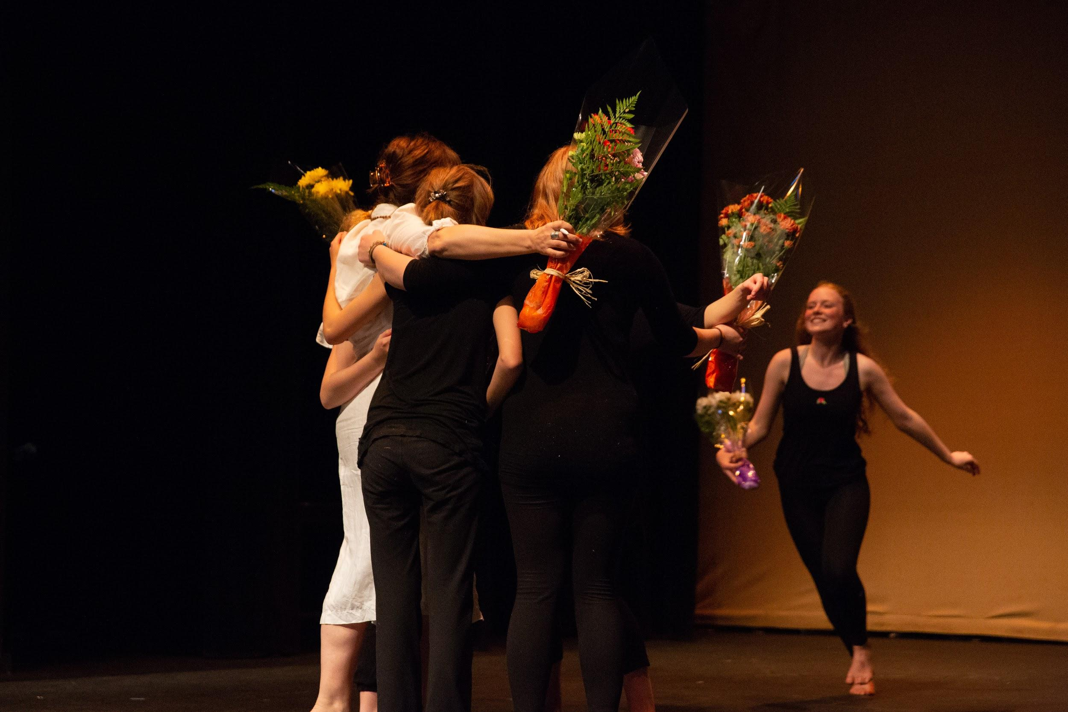
Impacts
Notes:
A couple points I want to draw out:
Our girls came into this program with no dance experience at all, and by the end of their time in the program they had designed, choreographed, and performed a 50 minute long presentation - so much artistic and personal growth!
Many of our girls came to the program so nervous they wouldn’t go into the rehearsal room without their parents, and by the end they were totally transformed into confident and engaging artists
The most important impact for me was how strong the bonds that the girls created with each other (and with Hannah and I, and by extension the library) were.
I invited them all back in July to watch a recording of their performance, all of them told me how much they missed coming to classes, and how much they grew throughout the program. They all asked if we would be offering the program again, and asked to be kept in mind if we ever could. They also talked about how strong their friendships with each other were, and how happy they were to know each other.
We are working with Hannah Beach on another grant proposal designed to support educators and other professionals working with at risk teens in the community - keep your eyes peeled if this grant gets approved because there will be opportunities for librarians to participate in these workshops

Slide 9
Thank you!
Questions?
Caitlin Ottenbreit, Customer Services Librarian, Children and Youth Services
Vancouver Island Regional Library, Nanaimo Harbourfront Branch
cottenbreit@virl.bc.ca
Notes:
So that’s Celebrating Girls Celebrating Community! I’m more than happy to answer any questions you might have now or later!

