Slide 1
Collection Matters: Establishing harmony in our relationships
Barbara Bourrier-Lacroix and Phil Bravo
Collections Librarians
Winnipeg Public Library

Slide 2
What do we mean by ‘harmony in our relationships’?
Notes:
Libraries, in our case public libraries, strive to meet the diverse expectations of the community it serves. Our patrons or customers want it all, books (print, audio and electronic) streaming music and music on cds, DVDs of the latest television series and movies and streaming video, electronic and print magazines, databases and more and it all has to be housed in a welcoming, open and comfortable environment that includes study space, room for programs, book clubs and events. So, collections are just one piece of a set of competing and diverse expectations that have to offer in an equitably.
Basic questions regarding collections are: How do we know if we have too many items in one collection or need to increase the number of items in another collection? To what extent are these collections meeting our patron’s expectations or demand? How do we know how much space to allocate to each collection? How much space should be devoted to nonfiction, fiction and children’s collection relative to space for programming etc.? When should a collection be reduced or expanded? Space is finite: when is enough, enough or too much? Collections budgets are always under pressure so we need to ensure that budget dollars are spent equitably and on materials that will be used. We need to reduce the guesswork as much as possible and to the extent that the data is accurate, we need to harness the power statistics to guide our decisions and provide a rational for our decisions to stakeholders.
One way to begin thinking about these competing expectations is to see them as part of a set of relationships that need to be in “harmony” relative to one another. By using data that any integrated library system can generate, exporting it into a spreadsheet and using basic arithmetic such using percentages and ratios to analyse collections and visualise charts with graphs and pie charts we began to have conversations that lead to decisions or solutions to questions about collections that helped to establish harmony between a diversity of expectations and collections.

Slide 3
Official(ish) Agenda
Data:
Collection Analysis
Turnover and Relative Use
“Goldilocks Challenge”
Next Steps:
Shelving Allocations & Weeding
More Data:
Age of Collection
Budget Allocations
Questions and Quiz ☺

Slide 4
Winnipeg Public Library
2 Central libraries, 18 branches + Outreach
Serves a population of 700,000

Slide 5
Centralized Selection
2006 study on selection and allocation processes
Biggest recommendation: centralized selection
3 Collections Librarians responsible for entire collection at 20 branches
Notes:
But now we’re getting ahead of ourselves so let’s rewind to talk about how selection and collection maintenance changed at WPL in 2008. Then we’ll talk about how we figured out how to work with data and key concepts such as turnover rates, relative use, average age to work towards “harmony” in our relationships between collections and branches. Finally, we’ll offer examples of reports that we use to help us talk about and problem solve for our collections that we hope will inevitably improve use.

Slide 7
Using Data & Statistics
“Data does not tell you what to do! It can tell you what you should look at and think about. Use data and statistics to help make your decisions, but remember, you make the decisions.” (Greiner & Cooper, p. 116)

Slide 8
2015 Percentage of Circulation at Winnipeg Public Library

Slide 9
2015 Adult Print Percentage of Circulation at Winnipeg Public Library

Slide 10
2015 Adult Print Materials – Percentage of Collection

Slide 11
Turnover Rate
Circulation
Number of books

Slide 12
Relative Use
% of Circulation
% of Collection Size

Slide 13
RU = 1
Collection is meeting demand
RU > 1
Collection needs expansion
RU < 1
Collection needs weeding

Slide 14
BRANCH | NUMBER OF ITEMS | 2015 CIRC | 2015 TURNOVER | % OF ITEMS | % OF CIRC | RU
A | 3,010 | 18,799 | 6.25 | 3.20% | 6.21% | 1.94
B | 2,472 | 9,388 | 3.80 | 2.63% | 3.10% | 1.18
C | 3,910 | 14,205 | 3.63 | 4.16% | 4.69% | 1.13
D | 6,709 | 24,427 | 3.64 | 7.14% | 8.07% | 1.13
E | 26,370 | 56,821 | 2.15 | 28.08% | 18.76% | 0.67
F | 3,179 | 6,911 | 2.17 | 3.38% | 2.28% | 0.67
G | 1,995 | 6,978 | 3.50 | 2.12% | 2.30% | 1.08
H | 5,610 | 21,427 | 3.82 | 5.97% | 7.07% | 1.18
I | 4,999 | 23,326 | 4.67 | 5.32% | 7.70% | 1.45
J | 4,875 | 27,201 | 5.58 | 5.19% | 8.98% | 1.73
K | 1,691 | 5,115 | 3.02 | 1.80% | 1.69% | 0.94
L | 5,231 | 13,164 | 2.52 | 5.57% | 4.35% | 0.78
M | 1,353 | 2,157 | 1.59 | 1.44% | 0.71% | 0.49
N | 3,730 | 13,679 | 3.67 | 3.97% | 4.52% | 1.14
O | 2,231 | 7,480 | 3.35 | 2.38% | 2.47% | 1.04
P | 3,585 | 9,720 | 2.71 | 3.82% | 3.21% | 0.84
Q | 4,849 | 13,292 | 2.74 | 5.16% | 4.39% | 0.85
R | 2,245 | 6,908 | 3.08 | 2.39% | 2.28% | 0.95
S | 2,006 | 6,538 | 3.26 | 2.14% | 2.16% | 1.01
T | 3,868 | 15,325 | 3.96 | 4.12% | 5.06% | 1.23
TOTALS | 93,918 | 302,861

Slide 16
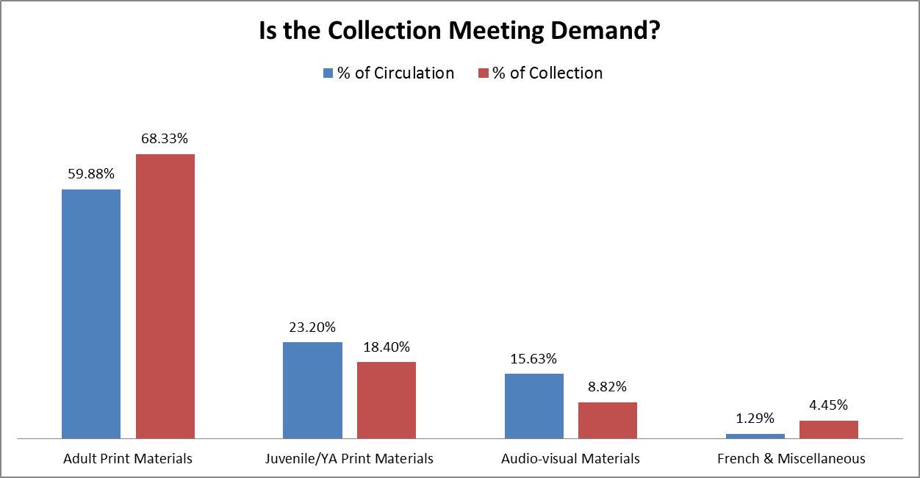
Branch Level Analysis Between Collections

Slide 17
Branch Level Analysis

Slide 18
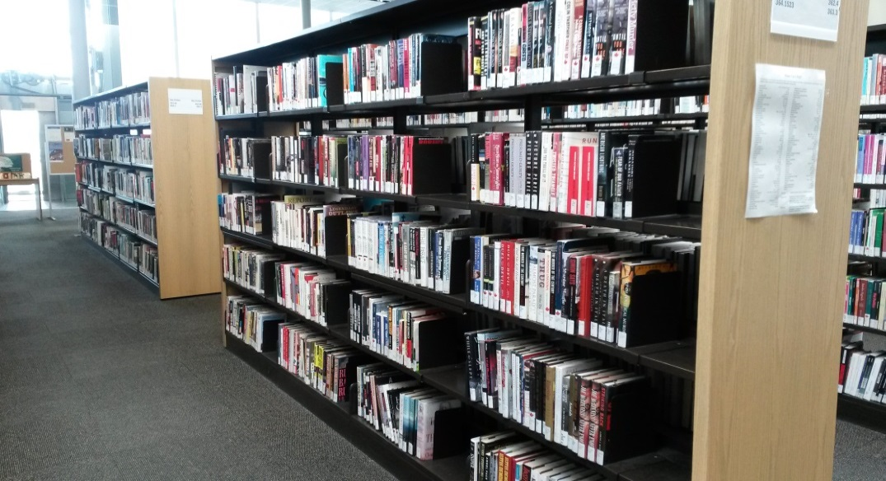
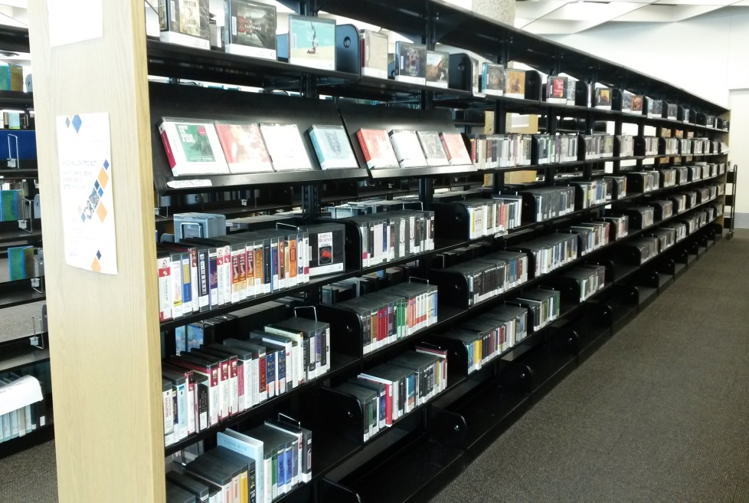
Next Steps: Shelving Allocation & Weeding

Slide 19
Adult Nonfiction - Shelving Allocations
Dewey Range | Subject | Circulation 24 months< | Collection Size | Percent of total circulation | Percent of total collection | Relative Use - Over 1 add/Under 1 weed | Turnover Rate | Proposed Shelf Allocations based on % of circulation
000-099 | Generalities | 9832 | 3407 | 3% | 2% | 1.38 | 2.89 | 70
100-199 | Philosophy & Psychology | 19199 | 5896 | 5% | 4% | 1.55 | 3.26 | 136
200-299 | Religion | 18112 | 7179 | 5% | 4% | 1.20 | 2.52 | 128
300-399 | Social Sciences | 50249 | 30069 | 14% | 18% | 0.80 | 1.67 | 356
400-499 | Languages | 15845 | 4703 | 4% | 3% | 1.61 | 3.37 | 112
500-599 | Natural Science and Mathematics | 13297 | 6914 | 4% | 4% | 0.92 | 1.92 | 94
600-699 | Technology | 86474 | 35864 | 24% | 21% | 1.15 | 2.41 | 612
700-799 | Arts | 51431 | 25677 | 15% | 15% | 0.95 | 2.00 | 364
800-899 | Literature | 22381 | 15662 | 6% | 9% | 0.68 | 1.43 | 158
900-999 | Geography, Biography, History | 66272 | 32921 | 19% | 20% | 0.96 | 2.01 | 469
 | Total | 353092 | 168292 | 100% | 100% | 1 | 2.10 | 2500

Slide 21
WINNIPEG PUBLIC LIBRARY - AGE OF FICTION COLLECTIONS
BRANCH | 0-10 Years | % of Collection | Benchmark | 11+ Years | % of Collection | Benchmark
A | 1604 | 64.89% | 80% | 868 | 35.11% | 20%
B | 1829 | 57.55% | 80% | 1349 | 42.45% | 20%
C | 1591 | 79.83% | 80% | 402 | 20.17% | 20%
D | 1371 | 81.17% | 80% | 318 | 18.83% | 20%
E | 1172 | 86.56% | 80% | 182 | 13.44% | 20%
F | 1703 | 75.99% | 80% | 538 | 24.01% | 20%
G | 1675 | 84.60% | 80% | 305 | 15.40% | 20%
H | 2759 | 91.81% | 75% | 246 | 8.19% | 25%
I | 3199 | 81.90% | 75% | 707 | 18.10% | 25%
J | 3934 | 80.93% | 75% | 927 | 19.07% | 25%
K | 3589 | 68.73% | 75% | 1633 | 31.27% | 25%
L | 4680 | 87.35% | 75% | 678 | 12.65% | 25%
M | 1941 | 87.08% | 75% | 288 | 12.92% | 25%
N | 2656 | 74.15% | 75% | 926 | 25.85% | 25%
O | 3298 | 68.11% | 75% | 1544 | 31.89% | 25%
P | 3258 | 84.38% | 75% | 603 | 15.62% | 25%
Q | 5508 | 82.17% | 70% | 1195 | 17.83% | 30%
R | 4061 | 72.47% | 70% | 1543 | 27.53% | 30%
S | 4096 | 81.99% | 70% | 900 | 18.01% | 30%
T | 14177 | 53.87% | 65% | 12138 | 46.13% | 35%

Slide 23
Relationship Between Percentages of Budget Allocation and Circulation

Slide 24
Patron/Staff Concerns
It will lead to an imbalanced collection
Users of popular parts of the collection have to put more books on hold and find fewer titles on the shelf than users of less popular parts of the collection.

Slide 25
I’m worried that the classics will be eliminated
Usually classics circulate well; but if you feel you should keep a few titles so that they’re always available, there’s plenty of room!

Slide 26
Bibliography
Ellenberg, J. (2014) How Not To Be Wrong: The power of mathematical thinking. New York: Penguin Press.
Greiner, T. “Collection Development and Shelf Space: A Proposal for Nonfiction Collections,” Public Libraries, 44(6), 347-50.
Greiner, T. and Cooper, B. (2007) Analyzing Library Collection Use With Excel. Chicago: American Library Association.
Hibner, H. and Kelly, M. (2013) Making a Collection Count: A Holistic Approach to Library Collection Management. 2nd Edition. Oxford, UK: Chandos Publishing.
Johnson, P. (2014) Fundamentals of Collection Development and Management. 3rd Edition. Chicago: American Library Association.
Wheelan, C. (2013) Naked Statistics: Stripping the dread from the data. New York: W. W. Norton.

Slide 27
Questions?
Barbara Bourrier-Lacroix
bbourrier-lacroix@winnipeg.ca
Phil Bravo
pbravo@winnipeg.ca
wpl.winnipeg.ca/library

