Slide 1
BYTE ME:
CODING IN
LIBRARIES
GRANT STEWART
KRISTINE DEN BOON

Slide 2
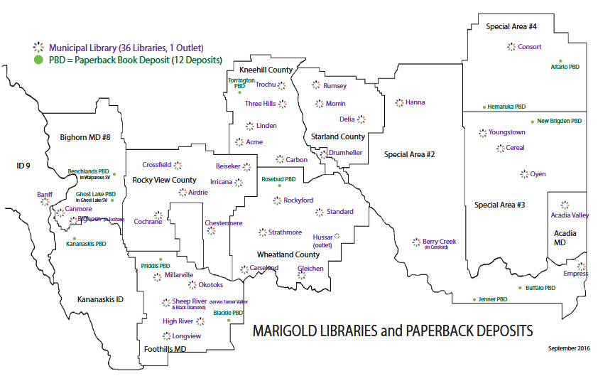
Notes:
Explain Marigold

Slide 3
Sharing Time
1. What do you think of when you hear the word “coding”?
2. Who has tried coding programs before? How did they go?
3. What are you hoping to learn today?

Slide 4
HTML & CSS
Algorithms
Sequencing
Computer
Language
If/Then
Scratch
Inputs & Outputs
JavaScript
Variables
Notes:
The words on the screen are just a few of the phrases and words involved in coding! We are here to give some insight into why coding for kids is important and dispel some myths around coding. We will discuss creating coding programs, including both online and offline activities and gadgets that can be used. We’ll also give suggestions on how to keep kids engaged and other ways to introduce coding to your community and library. We plan to have time at the end for questions as well as an opportunity for some hands on time with the coding resources we’ve brought with us.
If the session host didn’t introduce us, or we want to add more, this would be a good place to do so!
But first, who are we?
Grant Stewart is a University of Lethbridge graduate with a Management degree in Marketing. He has worked as a Summer Student for Marigold Library System for the past three summers, doing both Minecraft and Coding Programs for communities across the system.
Kristine den Boon is a Library Services Consultant with Marigold Library System. Prior to working at Marigold she worked at Edmonton Public Library as a Library Assistant, where she got to play with many coding toys to present coding programs.

Slide 5
Why Coding For Kids
“Some of the most important skills 3- to 7-year-olds can pick up now are social (like turn-taking and sharing) and psychological (experimentation and learning from mistakes).” (Heussner, 2015, p. 24)
“The constructive process of programming can be compared to building with blocks. Young children playing with blocks have access to a finite number of different shapes, but endless possibilities for what to make with those shapes. … These same practices can make computer programming developmentally appropriate for young children, keeping it a creative, open-ended, and constructive process.” (Geist, 2016, p. 299)
Notes:
So why host coding programs for kids?
Libraries are strong proponents of both early literacy and digital literacy, and tech literacy is becoming more and more important. Children as young as 3 can be taught some of the basic principles of coding, and are, in fact, learning some of the concepts already in their regular interactions with others, such as learning from mistakes, taking turns, and sharing. Coding is a creative process and involves problem solving, critical thinking, and collaboration, all of which are important skills in life. Concepts such as sequencing, which is the putting things in the proper order for an action to take place (like baking!), and if/then, which is understanding that if one thing is done then something else will follow, are not concepts unique to coding.

Slide 6
Why Coding For Kids
“Teaching children how to program with languages such as CHERP and Scratch gives them access to the tools to evaluate and create new technologies for themselves (Rushkoff, 2010) and to be producers of content (Bers, 2010; Resnick, 2001) not just passive consumers of technology created by others (Rushkoff, 2010).” (Kazakoff & Bers, 2014, p. 557).
Notes:
Coding also gives children a greater understanding of computers in this digital age. Computers are involved in all areas of our life, and it’s important to teach children this aspect of the world around them. Coding knowledge is becoming one of the most sought after skills in the job market. Some possible career options for those with coding skills include web design, gaming development, software development, artificial intelligence, robotics engineering, and data science. But as I mentioned in the previous slide, the soft skills such as problem solving and collaboration that are learned through coding serve children in other areas of life as well.

Slide 7
Coding Myths Dispelled
“You have to be good at math.”
“There’s no creativity involved. It’s boring!”
“It’s expensive!”
“It’s complicated.”
“It’s lonely.”
From Coding for Parents by Frazer Wilson
Notes:
There are a few coding myths out there that we would like to dispel before we go any further!
“You have to be good at math.” False! There might be numbers involved, but you really just have to be able to think logically and be able to problem-solve.
“There’s no creativity involved. It’s boring!” False! Coding can be used to create beautiful websites and fun, interactive games. And solving problems can often require imagination.
“It’s expensive!” False! Code is just text, so a simple text editor program is all that is needed. As we will show in a few minutes, there are also plenty of offline activities using books and other materials that can be used to learn the basics of coding.
“It’s complicated.” False! Code can be very complicated, but as with anything, if you start with the basics and move your way up, it will be easier to understand.
“It’s lonely.” False! Problem-solving code is often done with other people, and remember, the code you are building is usually meant to be used by others, so feedback is important!
Grant will now talk about a few unplugged/offline activities, some online coding websites, and some of the various gadgets you can use in a coding program.

Slide 8
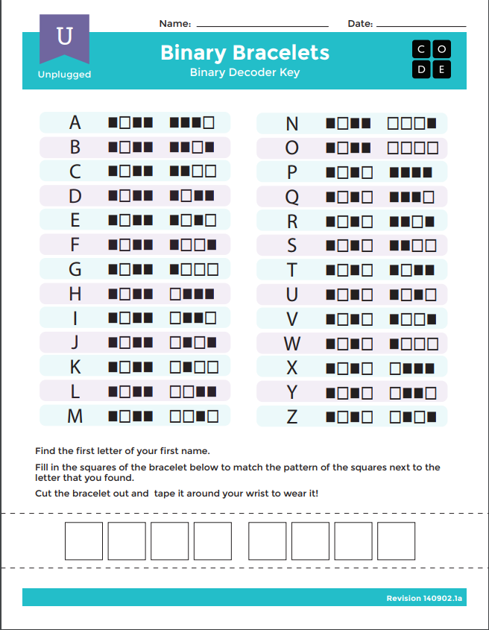
Binary Worksheets
Notes:
Binary Worksheets
This is the most simple activity for younger patrons. The bracelet activity works really well to show them how different it is to make letters on the computer than it is in plain English. This also shows that binary is a different way to express the same concepts as English. It creates a connection between what the children already speak and what computers use to communicate. The binary puzzle needs a bit of explanation because it is essentially halved, so the four boxes on the left side of the square on the first row have 8,4,2,1 and the same with the other side. So when it says 1 then 8, you colour in the two boxes in the middle on the first row. (Explain better with my hands and pointing)

Slide 9
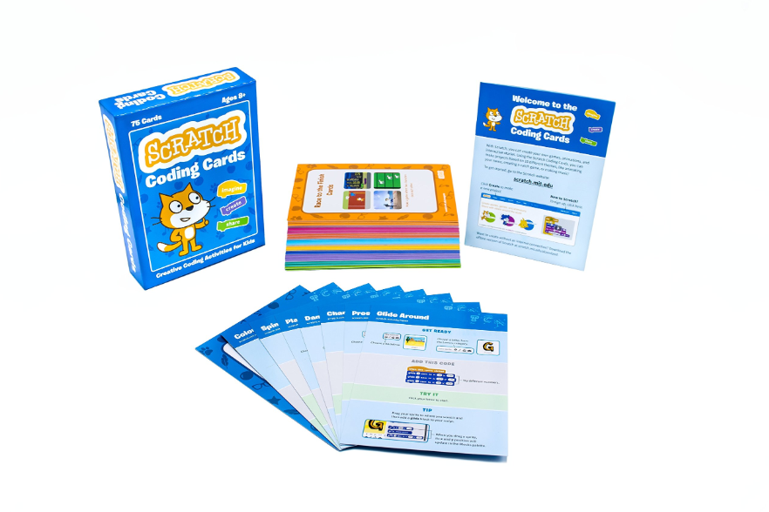
Scratch Coding Cards
Notes:
Scratch Cards
Scratch is a coding language built for beginners to start with when learning code, but using the computer can be too complicated for some younger learners so Scratch came out with these cards to make it easier for kids to understand the language before jumping in to the computer version.

Slide 10
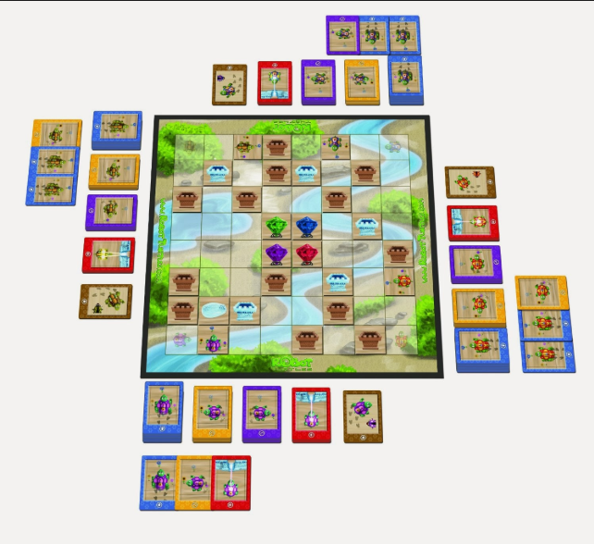
Robot Turtles
Notes:
Robot Turtles
Robot Turtles is another fun offline activity that helps kids become more interested in coding. The instructor sets up obstacles for the players and moves their turtles around the board exactly as the children say. The children have a set of cards with instructions for the turtle, the instructor follows the instructions to the letter and if they don’t get to the jewel then the next person goes. This is a good way to teach how literal computers are and to code you have to instruct the computer exactly as you want them to work.

Slide 11
OTHER UNPLUGGED ACTIVITIES
Sequencing activities
Dramatize a noncoding process
Computer Science Unplugged
https://csunplugged.org/en/topics/
Notes:
These activities are also great to do. Sequencing activities are ways to get kids to understand the literal nature of a computer and that you need to put your instructions in the right order or they will not work the way they were intended. By dramatizing a non-coding process you are showing that even though the name for the task may be simple, like taking out the garbage, it takes more steps, you need to get the garbage out of the trash, put a new bag in, bring the trash outside to the dumpster, and put the garbage can away. Computer science unplugged is also a great resource, it puts a lot of different activities similar to the ones we mentioned and puts them all into one easy to find place. Now we will move onto the online resources we can use to help kids learn how to code.

Slide 12
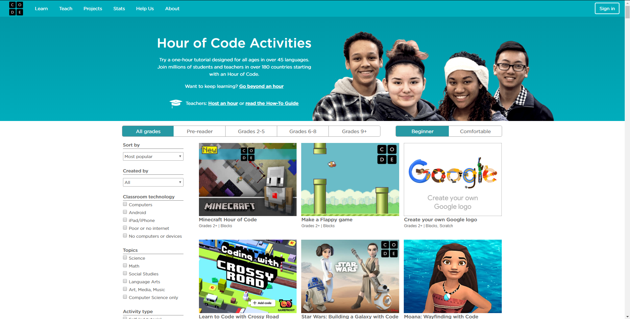
Code.org
Notes:
Code.org/learn
Great website with many games for any grade level, including pre-reader. This is my primary resource when creating a coding program for kids. It is perfect for any age that can use a keyboard. It has very simple games for children that can’t read yet and includes games built with scratch like we saw with the scratch cards. It’s a good entry point for beginners online.

Slide 13
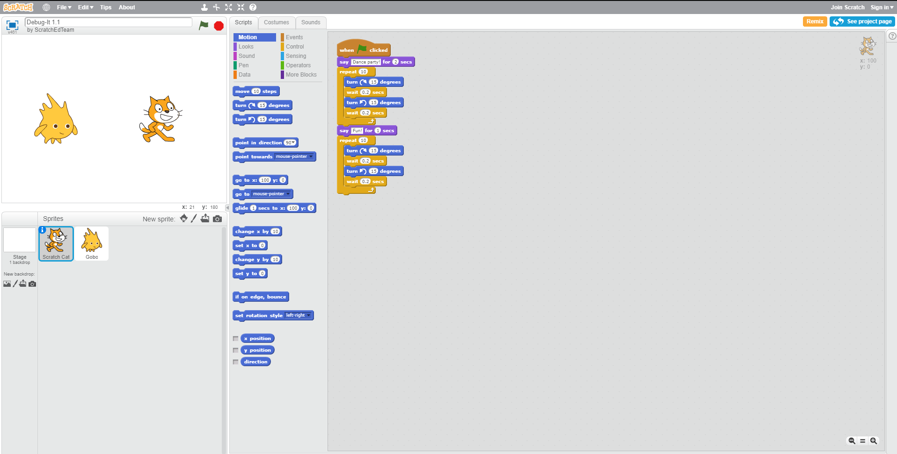
Scratch Debugging
Website: https://scratch.mit.edu/studios/475483/
Notes:
Scratch Debugging Units 1-5
Similar vein to code.org, helpful for getting the kids to look and think differently. This is a great option for kids that have used code.org because it makes kids look at a code that is already on the page and find out what is wrong with it. This helps their troubleshooting skills and forces them to think in a different way.

Slide 14
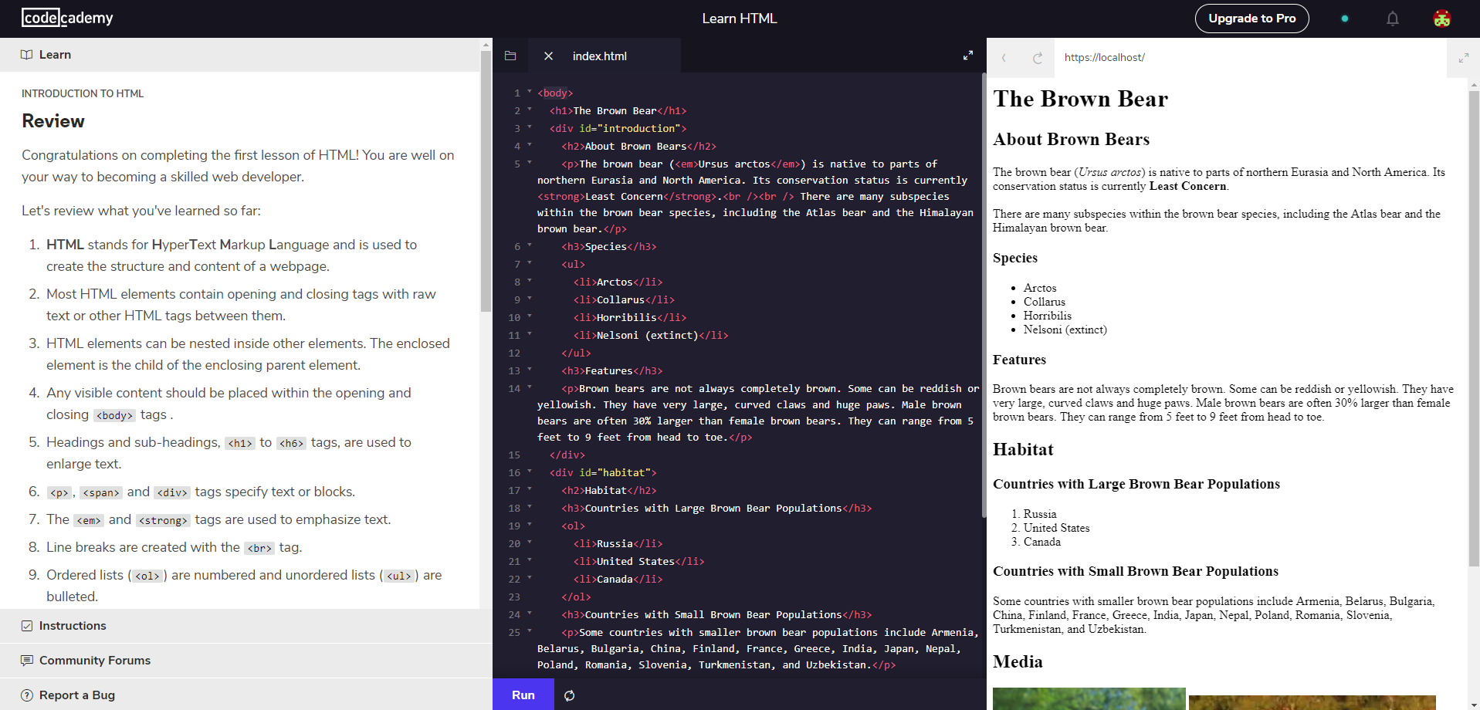
Codecademy.com
Notes:
Codecademy.com
If attendees are already experienced with coding on Code.org and scratch we can move them to codecademy.com, this website does require an email so keep that in mind with younger users but you could always create a few free gmail accounts and have them ready for your programs. This is a fantastic way to get kids into the actual coding languages. It has step by step tutorials for each major language and is great for kids that have already mastered code.org. On the left side of the page it has the instructions that the user puts into the middle box, after pressing “Run” it appears on the left box. If there is a mistake it tells you and marks it with a red mark beside where the code went wrong. This teaches both actual coding languages and how to troubleshoot your own code.
Now we will take a look at the various gadgets that we can also use to teach coding.

Slide 15
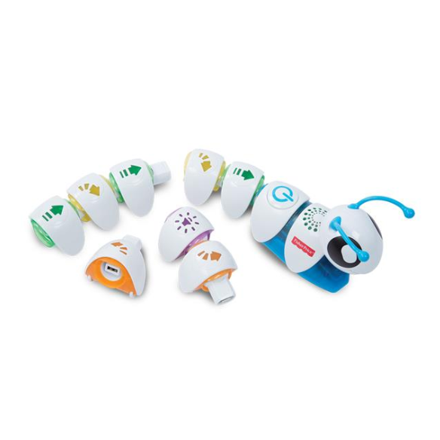
Code-a-Pillar
Notes:
Code-a-pillar
Meant for much smaller kids. The Code-a-pillar is a plastic toy that uses sections of its body with arrows on it to go in the direction indicated on the arrow in the order the arrows are placed in, it can also make sounds. The Code-a-pillar can teach kids about sequences and how to use code to get something to where they want it to go. The code-a-pillar app is a game on iOS devices that is themed with the code-a-pillar, it is a simple coding game that is pre reader so reading is not required. A great resource for kids that already really like the code-a-pillar.

Slide 16
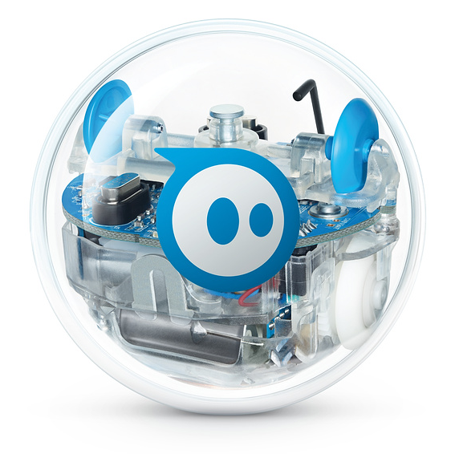
Sphero
Notes:
Sphero
The sphero is a small ball that uses code in order to move. It can also be used like a normal remote control device. The sphero is fun and interesting to look at, and the kids really like the ball shape. Also the sphero uses the Scratch coding language so it is an easy transition from Code.org games to real world interaction, and shows kids that the code can actually have a real life application. The sphero app is required in order to use this gadget and it makes it so you can control the sphero.

Slide 17
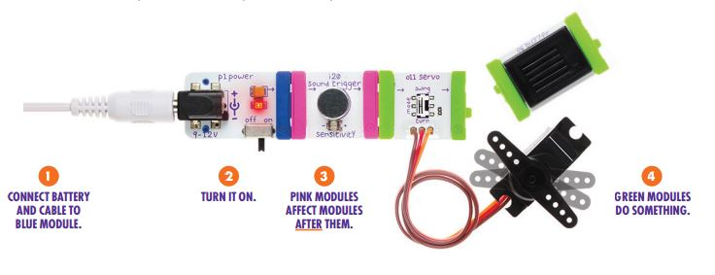
Little Bits
Notes:
Little bits are to show children how power and electricity works. This also helps with coding because everything happens in an order similar to coding. It is also a great way to get the basics of how electricity and electronics work before jumping into using a computer and learning how to code. Little bits has also recently revealed they are now combining the little bits with coding to create a program with little bits. It uses the real coding language Javascript that gives kids a real experience with the language.

Slide 18
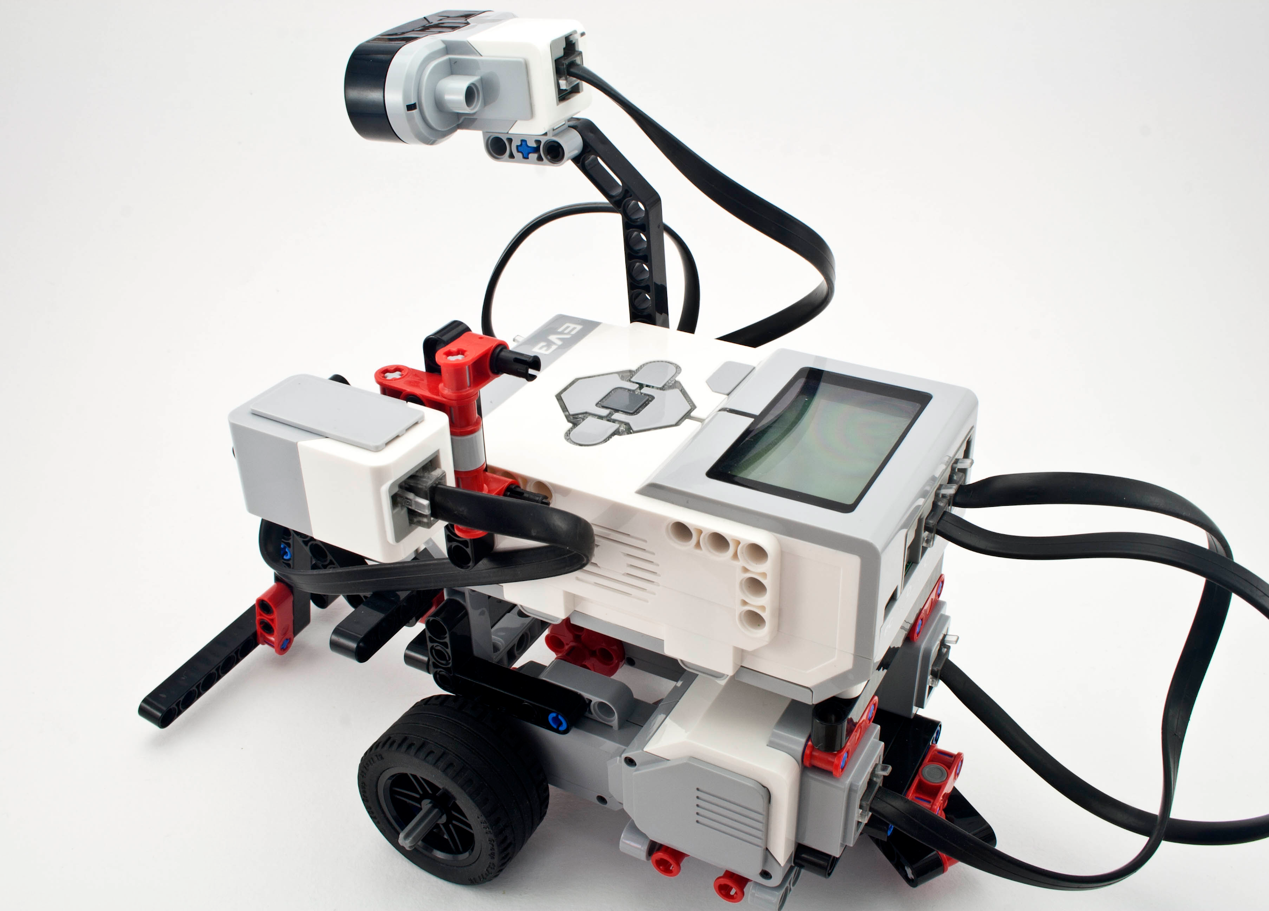
Lego Mindstorms
Notes:
Lego Mindstorms is a robot system that is built using lego that users can program themselves. Lego Mindstorms uses its own language that Lego has built specifically for beginners. This is a great way to meld the lessons learned in little bits with the coding they learned from the sphero to create a robot that they have told what to do themselves.

Slide 19
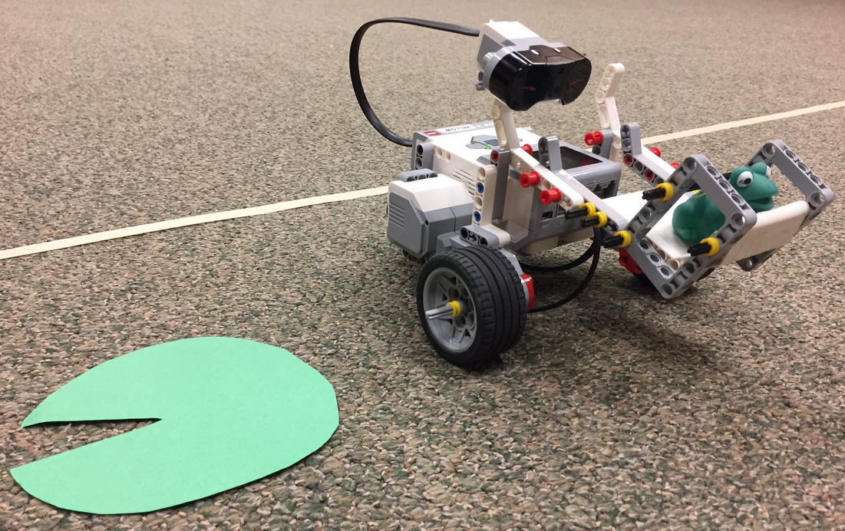
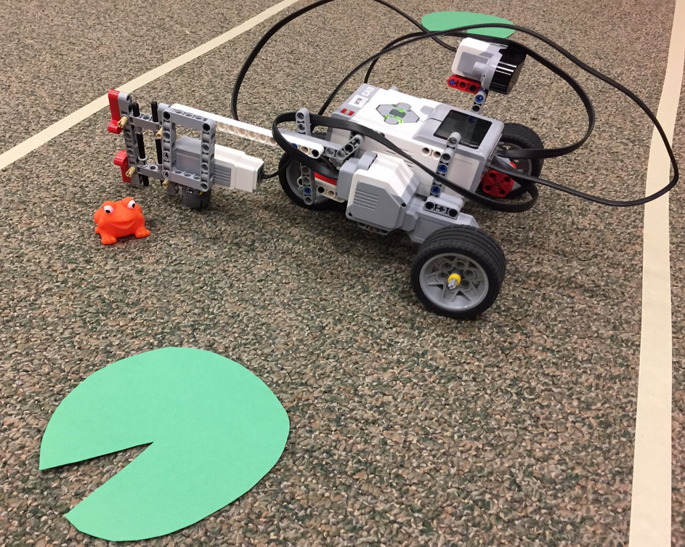
Notes:
Can you bring the frog to the lilypad? This was a challenge that Kristine did when she was learning about Lego Mindstorms at Edmonton Public Library.

Slide 20
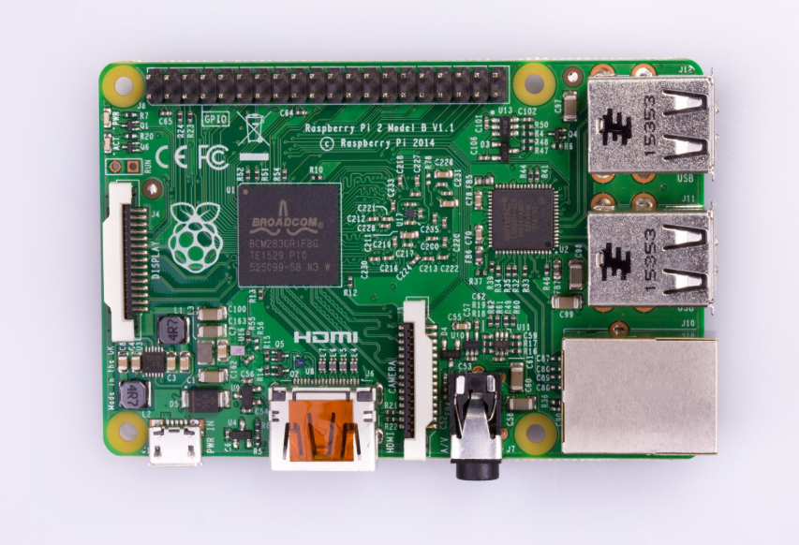
Raspberry Pi
Notes:
Raspberry Pi
The raspberry pi is a full computer that is the size of a credit card, and can be used in all the ways that a computer can be. It can be coded using its built in terminal and can be used for all kinds of different programs. This is a device that is aimed at users that already have some understanding of coding and what can be done with code. More for a teenage demographic say 12-17. A small computer that can be used to play with different programs.
Now we will look at what I do for my one-off programs when I go to a library.

Slide 21
STARTING THE PROGRAM
Two Worksheets
Binary Bracelets
Binary Puzzles
Both will need explanations especially if the group is fairly young
Notes:
To start I generally use the offline paper activities that teach binary. The basis of code and how computers send information. I first tell them to choose a game on code.org to load while we complete the worksheet. I then explain the worksheets and help out whenever needed.

Slide 22
Online Activity
Computer game
Kids read the instructions and play the game
Start this about 15 minutes into the program and let the kids play for about 20 minutes
Use the sites mentioned previously
Code.org
Scratch Debugging
Codecademy.com
Notes:
After we complete the worksheets, which normally takes about 10 minutes but can take as much as 20 minutes. We move to the computer game that has loaded up. The kids read the instructions and then play the game. My sessions are an hour long so this takes place from the 15 minute mark to the 40 minute mark.

Slide 23
MOVING TO THE GADGET ACTIVITY
40 minute mark
The Sphero is especially good, but any gadget could be used
Build a small obstacle course for Sphero
Good teamwork activity
Notes:
After the 40 minute mark I take the kids off of the computers and have them play with one of the gadgets. The Sphero is especially good for this because it uses the same coding style that is used in the computer games. As a group we build a small obstacle course that the kids will put the Sphero through. I line them up and each gets a chance using programming to get the Sphero through the obstacle course. Sometimes we go through the line 2 or 3 times before it finally gets cracked. This is a good teamwork activity as well since the kids are all discussing and building on each others work in the code.

Slide 24
PROGRAM CONCLUSION
If the group has been good I generally let them continue playing with the Sphero as I pack up
Give the kids a list of the sites so they can continue their learning at home
Notes:
After we play with the Sphero I tell them it’s time to go and that I hope they had a wonderful time. Some kids want to continue with the Sphero, so if the group has been good I generally let them continue playing with the Sphero as I pack up!
This is also a good opportunity to ask the kids what they’ve learned during the program

Slide 25
KEEPING KIDS ENGAGED
Alternate between activities and gadgets
I do an hour long program but it would be very easy to expand to a longer time frame
Notes:
To keep kids engaged it is essential that you switch activities regularly, this is because as the advanced kids start to get done with one portion you need to get them to the next activity quickly.
Now you can set up this program in many ways. I do one off programs because I only go to a specific library one or two times during the summer. But if this were to be a weekly program you could extend the offline activities for a longer period and give the kids more familiarity with how coding works. The online activity could be stretched over several sessions so that everyone is on codecademy and able to use scratch effectively and are learning more detailed coding. Then a final gadget day or two would be a lot of fun for the kids to put the skills they learned into practice.

Slide 26
Common Issues
More kids than computers
Kid advanced and bored
No internet
Kids acting out
Notes:
These are some very common issues that you will face when organizing your own coding program. First and foremost is the issue of more kids than computers, for this I normally move everyone to the computer portion right away and rotate them off while the person that is not currently on the computer is doing the binary worksheets or if everyone has done those potentially playing with the gadgets. Kids acting out is another common problem faced, I generally give them a warning and if they are still acting up I take them off their computer or out of the line for the Sphero for 5 minutes, if they continue to act up I will take them off for the remainder of the program. If a patron is too advanced for the normal program I move them to Codecademy and have them work on that, if they are still too advanced for that I may have them help me with assisting the children that are having issues. If there is no internet then I will have them all do the worksheets, and we will build more elaborate obstacle courses for the gadgets to go through

Slide 27
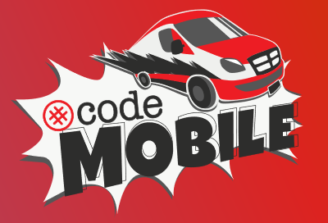
Other Ways to Introduce Coding to Your Community
www.canadalearningcode.ca
www.codemobile.ca
www.girlswhocode.com
Notes:
There are a few organizations within Canada who will also work with your library or community to introduce coding. The first is Canada Learning Code. This organization is primarily focused on working with women, girls, people with disabilities, Indigenous youth, and newcomers. They offer in-person workshops, courses, hackathons, camps, and more, and currently have chapters in Edmonton, Calgary, and Red Deer. On their website they also have lesson plans for teachers, which could easily be adapted to library program plans.
Code Mobile is another service offered by Canada Learning Code. With this program, any organization can request to have a Code Mobile come to them and put on 1-3 hour workshops including laptops, unplugged activities, and live coding activities.
Girls Who Code is a non-profit organization working to close the gender gap in technology by teaching girls between the ages of 11 and 18 computer science skills. Clubs are led by volunteer facilitators and anyone can apply to start a club - no technical experience is required, only a willingness to learn alongside the club members! They supply program plans free for clubs to use, but clubs do need to have access to the Internet and computers.

Slide 28
QUESTIONS?
Notes:
Once questions are over, move to next slide and open it up to being able to play with the gadgets and websites.

Slide 29
BIBLIOGRAPHY
Geist, Eugene. (2016). Robots, programming and coding, oh my! Childhood Education, 92(4), 298-304. DOI: 10.1080/00094056.2016.1208008
Heussner, K. M. (2015, May/June). We can code! Scholastic Parent & Child 22(7), 22-26.
Kazakoff, E. R., & Bers, M. U. (2014). Put your robot in, put your robot out: Sequencing through programming robots in early childhood. J. Educational Computing Research, 50(4), 553-573. DOI: 10.2190/EC.50.4.f
McCue, C., & Guthals, S. (2018). Helping kids with coding for dummies. Hoboken, New Jersey: John Wiley & Sons, Inc.
Missio, E. (2015, June 9). Why kids should learn to code (and how to get them started). Retrieved from https://www.cbc.ca/parents/learning/view/why-kids-should-learn-to-code-and-how-to-get-them-started
Prato, S. C. (2017, Spring). Beyond the computer age: A best practices intro for implementing library coding programs. Children & Libraries: The Journal of the Association for Library Service to Children 15(1), 19-21. DOI: 10.5860/cal.15n1.19
Wilson, F. (2017). Coding for parents. New York: Sterling Publishing Co.

Slide 30
CONTACT US:
Grant Stewart
grant@marigold.ab.ca
403-934-5334 ext. 259
Kristine den Boon
kristine@marigold.ab.ca
403-934-5334 ext. 256

