Slide 1
Under the Cover: Linking Books to the Lives of their Previous Owners
BookLives.ca

Slide 2
What is BookLives.ca?

Slide 3
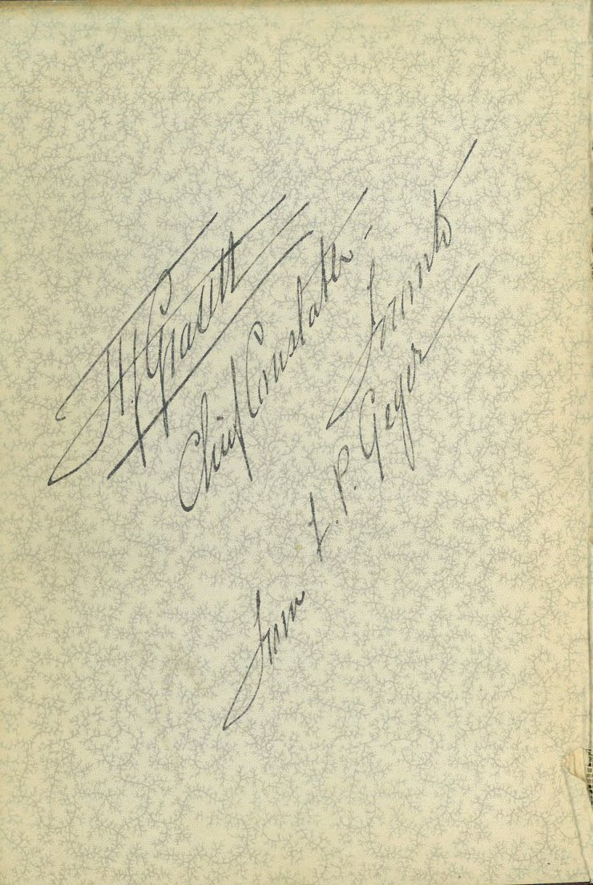
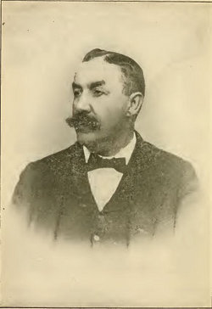
Signed by Author
From book: The Holmes-Pitezel Case, by Frank P. Geyer
Notes:
Each book has a “person history”… who held it? Who read it? On whose bookshelf did it rest? Did it travel? With whom did it start and how did it make its way to its present point (in our case, UPEI)?

Slide 4
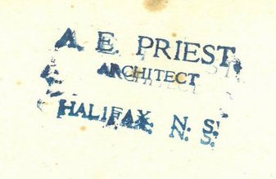
Signed by Gift Giver
From book: Blue Water, by Frederick William Wallace, 1920
Signed by Owner
(sometimes with an address!)
From book: A Lad of the O’Friels,
by Seumas MacManus, 1944
Notes:
PROVENANCE- ownership history. “An object’s earliest know history or origin”.

Slide 5
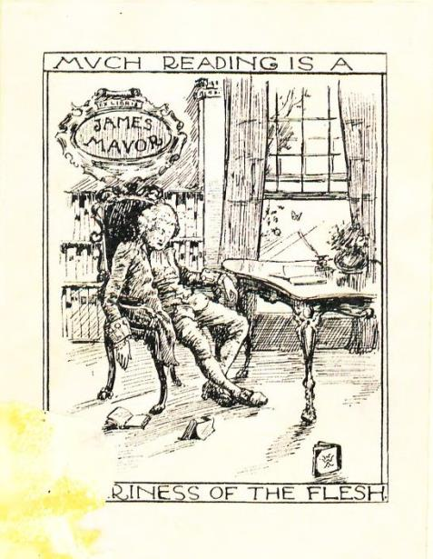
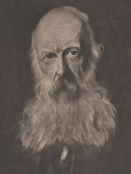
Includes Owner Book Plate

Slide 6
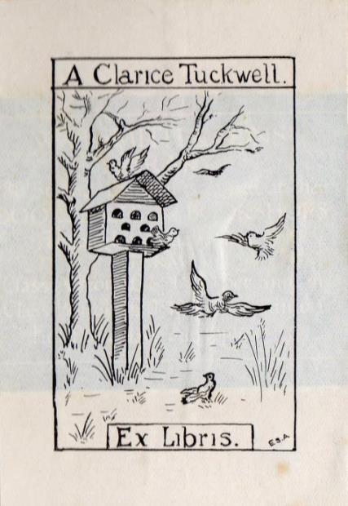
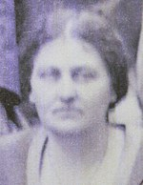
Includes Owner Book Plate

Slide 7
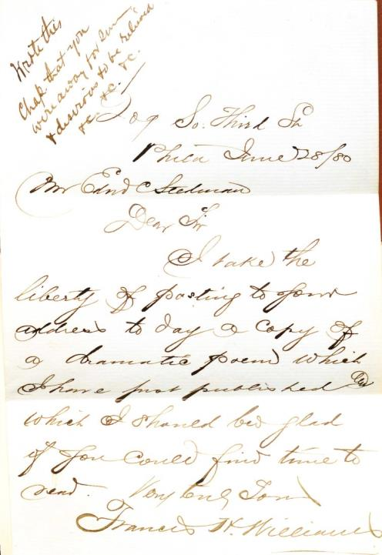
Primary Source
for Genealogists and Historians!
Letter written by author to friend Edmund C. Stedman, dated June 28, 1880.
Found in book, The Princess Elizabeth,
by Francis H. Williams, 1880.
Notes:
Primary Source- for genealogists and historians. Name searchable important.

Slide 8
Online Database that uses Sustainable Preservation
From the Preservation Alliance of Minnesota. http://www.mnpreservation.org/
Virtual Research Environment: ISLANDORA platform
Notes:
Islandora- “Open source software framework designed to help institutions and organizations and their audiences collaboratively manage, and discover digital assets using a best-practice framework. Islandora was orignally developed by the University of Prince Edward Island’s Robertson Library, but is now implemented and contributed to by and ever-growing international community.”
Uses Drupal, Fedora & Solr. Islandora operates under a GNU license.
Who uses Islandora? All public Universities in British Columbia , all public Universities in Florida, UCLA, the Smithsonian Institute, the State of Qatar…

Slide 9
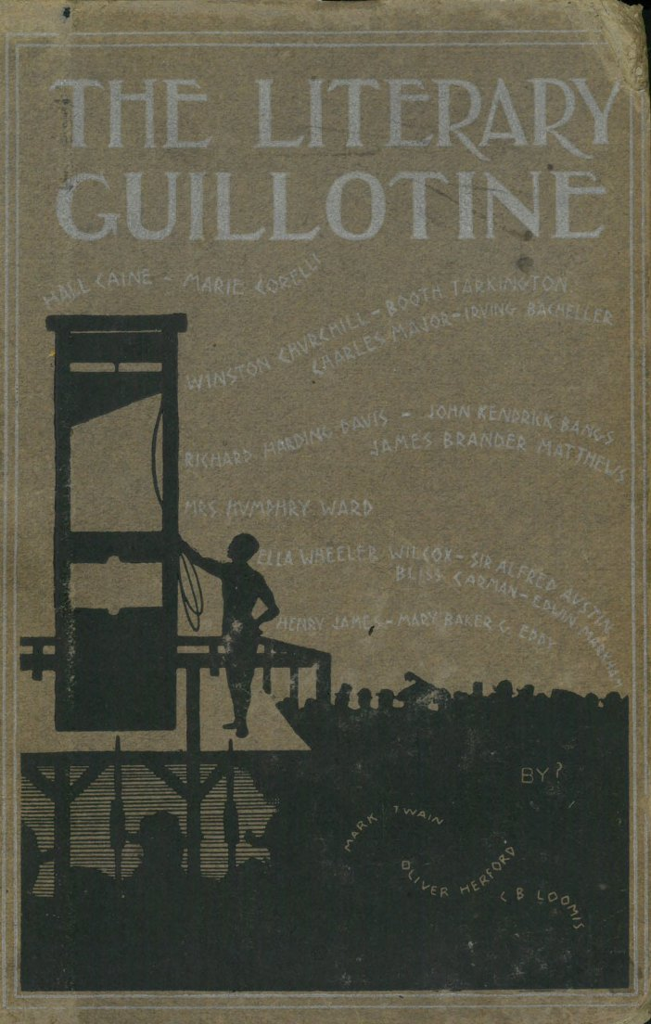
Setting Boundaries & Identifying Books
Pre-1950 Books only!
Stacks books published before 1880
Shelf reading in high provenance areas:
Poetry
Early literature
Religious Studies
Travel Journals
History
Compact Storage clear-out
Weeding project

Slide 10
Evolving Artifacts of History
Poems and Songs of Robert Burns
London: Methuen & Co., 1896

Slide 11
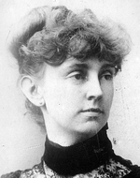
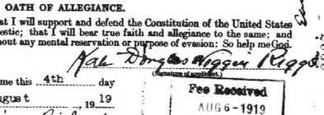
How did we get these books??
SIGNATURE in book…
…matches SIGNATURE in passport application
Ormond, A Tale, by Maria Edgeworth, 1895.
Notes:
Andrew Stauffer @ University of Virginia uses term “Medium Rare” collection… a valuable term when discussing provenance of books. These are books that might not fit into the category of “RARE” but are valuable because of their historical connection to their previous owners. Discuss “AT RISK” collection.
Maria Edgeworth- considered first “children’s author”. Kate Wiggin Riggs- child rights supporter & kindergarten educator.

Slide 12
Why now?
Re-evaluating Libraries in the Age of the Digital Book
John Wills 1807-1891

Slide 13
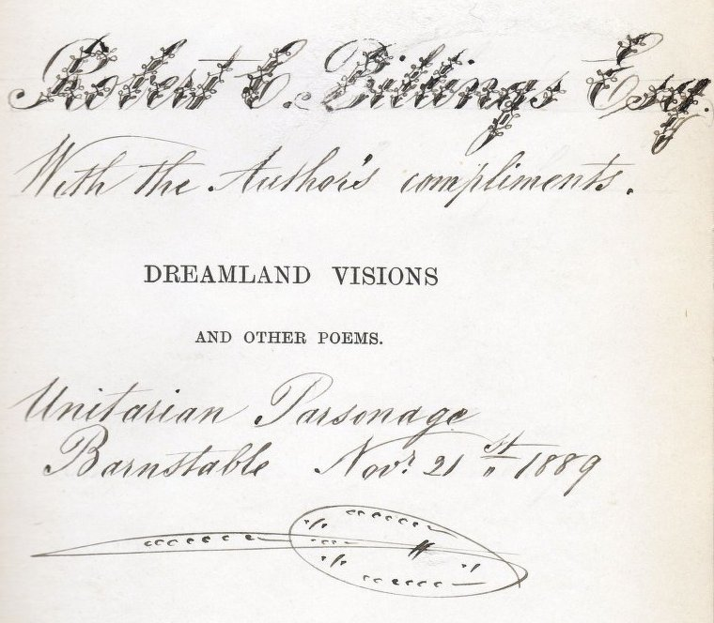
Notes:
UPEI Provenance most elaborate inscription!

Slide 14
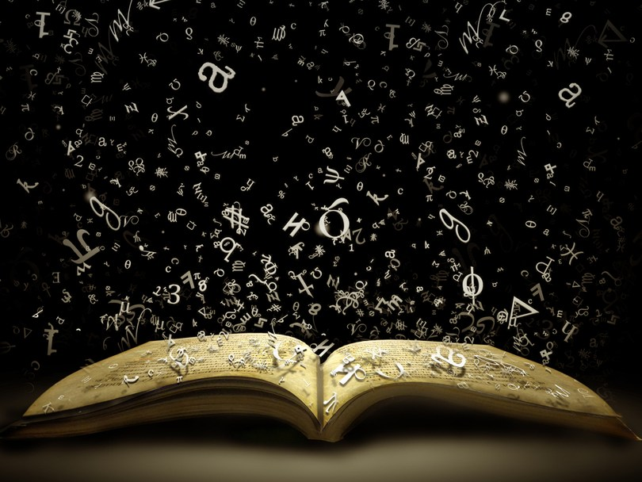
BookLives Story-telling
Photo from storify.com

Slide 15
Ethel Hodgson
England:
Clergy Daughter’s School Prize Winner

Slide 16
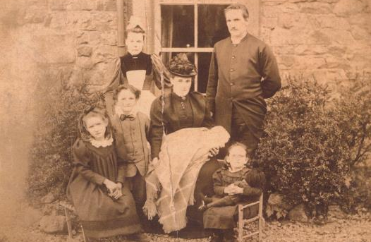
Ethel Hodgson
Ethel with her younger brother and sister, father, step-mother, baby half sister and servant.
Bookplate in The Early Days of Christianity by Frederic W. Farrar
Notes:
Tracking Christina… sent email on 14 October 2014 (old address), sent email to Oxfordshire County Council, tracked down an old address (Google-Sleuthing), Received email from Christina on 2 April 2015

Slide 17
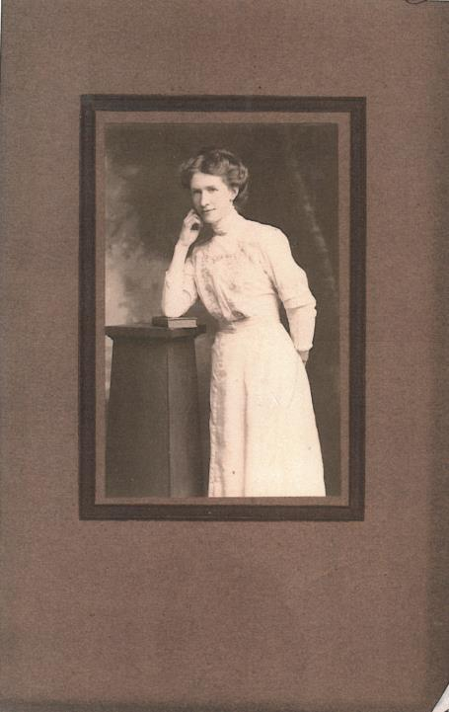
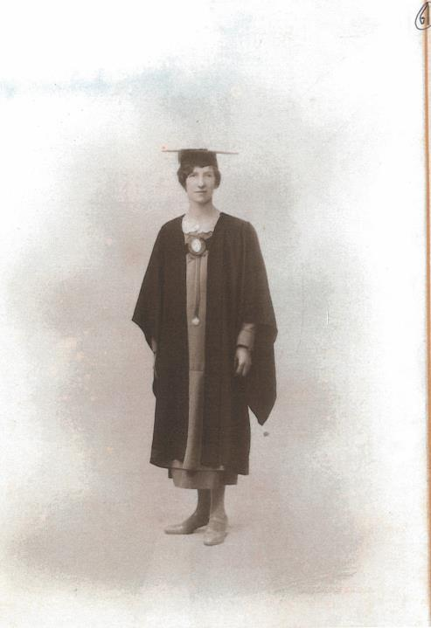

Slide 18
Meta Barnwell
South Carolina, USA:
A ‘peculiar’ Civil War Survivor

Slide 19
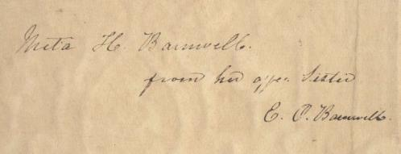
Meta Barnwell
Biographical and Critical Miscellanies by William H. Prescott, 1845.

Slide 20
Harper’s Weekly: A Journal of Civilization 18 January 1862

Slide 21
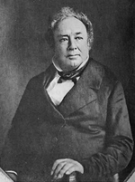
This sketch as you will perceive coincides with the description given by Tom when his party entered it and conveys in eloquent terms the old establishment and horrors entailed upon many who once enjoyed the belongings of home with all its mere refining influences.
Edward Barnwell 1785-1860

Slide 22
John N. Conroy
Prince Edward Island, Nova Scotia, Saskatchewan:
Lawyer with a Sense of Humour

Slide 23
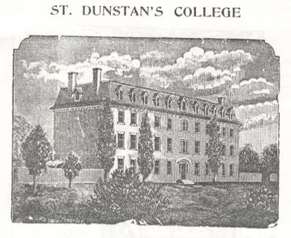
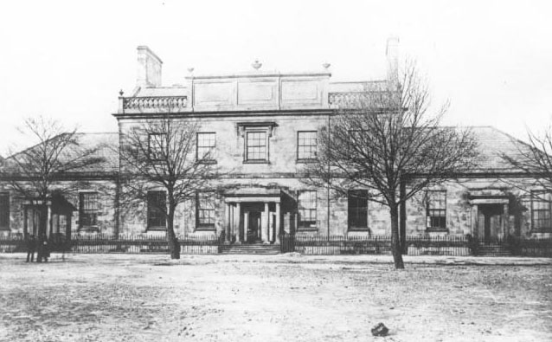
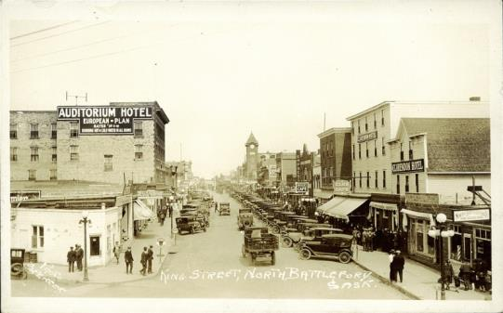
www.gov.pe.ca
Dalhousie Digital Collection
John N. Conroy:
from PEI to Nova Scotia, to Saskatchewan
From University of Alberta Libraries
Prairie Post Card Collection (Postcard #12766)

Slide 24
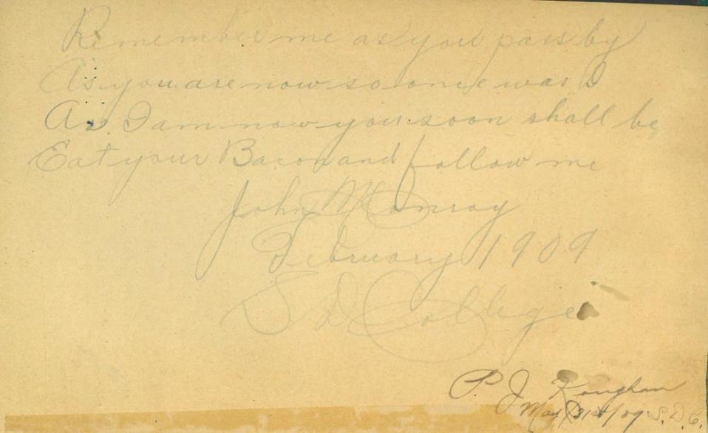
Written inside the book Lord Bacon by Lord Macaulay, 1852
The book contains numerous signatures including PEI native, John N. Conroy, “author” of this poem
which he dated February 1909, S.D. College.

Slide 25
George Egerton
Australia, Ireland, Norway, England:
Shocking Feminist of the Victorian Age

Slide 26
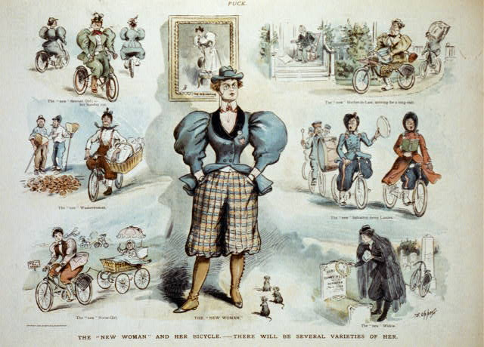
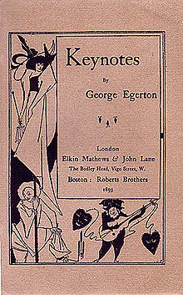
1893:
George Egerton’s “Keynotes”
1895:
The new woman- and her Bicycle-
There will be several varieties of her.
By Frederick Burr Opper

Slide 27
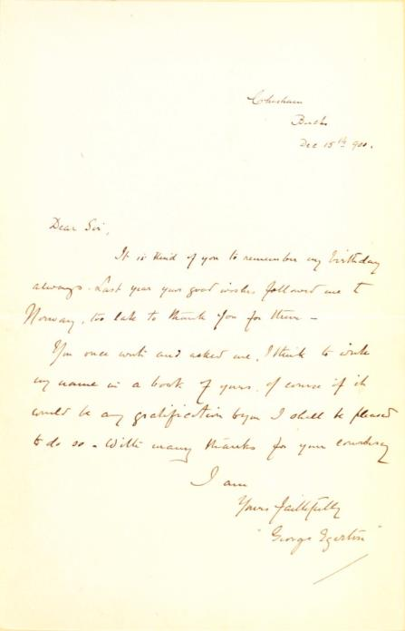
Letter found within book, Young Ofeg’s Ditties,
by Ola Hannson, 1895

Slide 28
Jean McClure
Alberta, PEI, New Brunswick, Manitoba:
Essay Prize Winner & Dietician

Slide 29
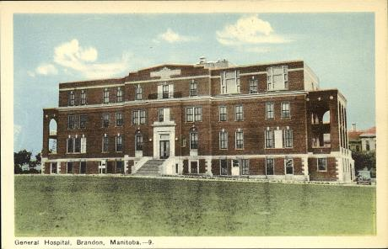
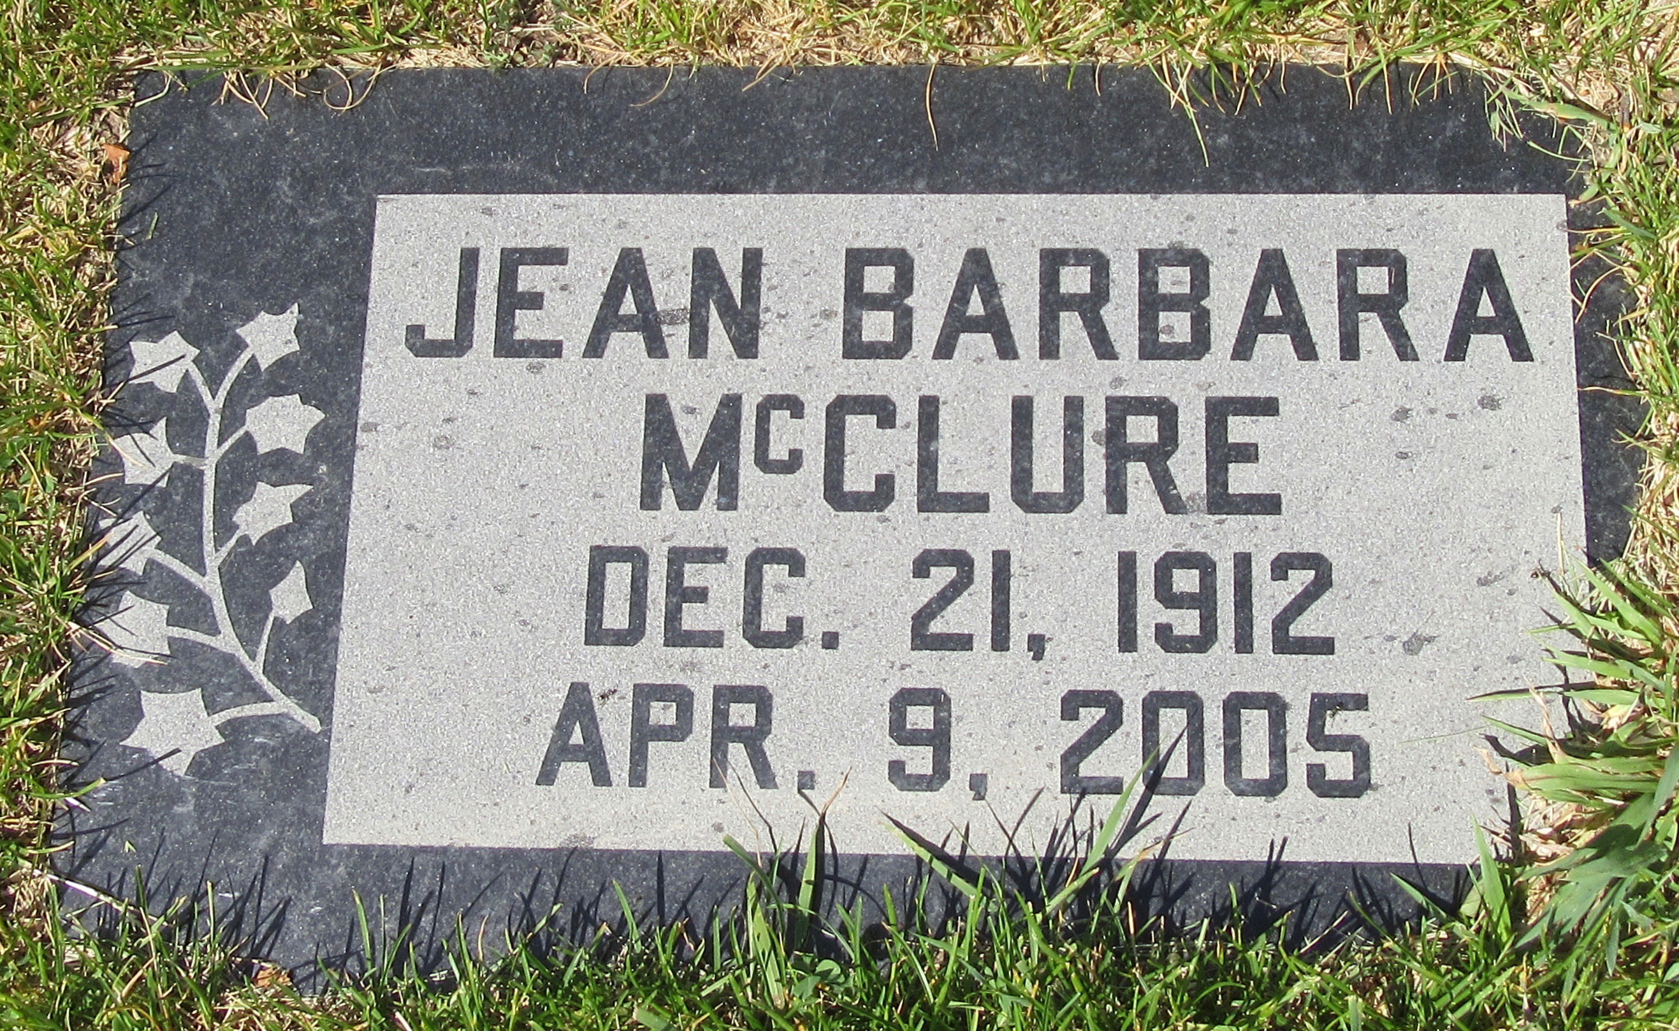
Brandon General Hospital
From University of Alberta Libraries
Prairie Post Card Collection (Postcard #13515)
Mountain View Cemetery, Lethbridge Alberta
Findagrave.com
Bookplate found in Economics of Fashion, by Paul H. Nystrom, 1928.

Slide 30
Margaret MacLean
Cornwall, Ottawa, Japan, China, Toronto:
Leading Edge Museum Educator

Slide 31
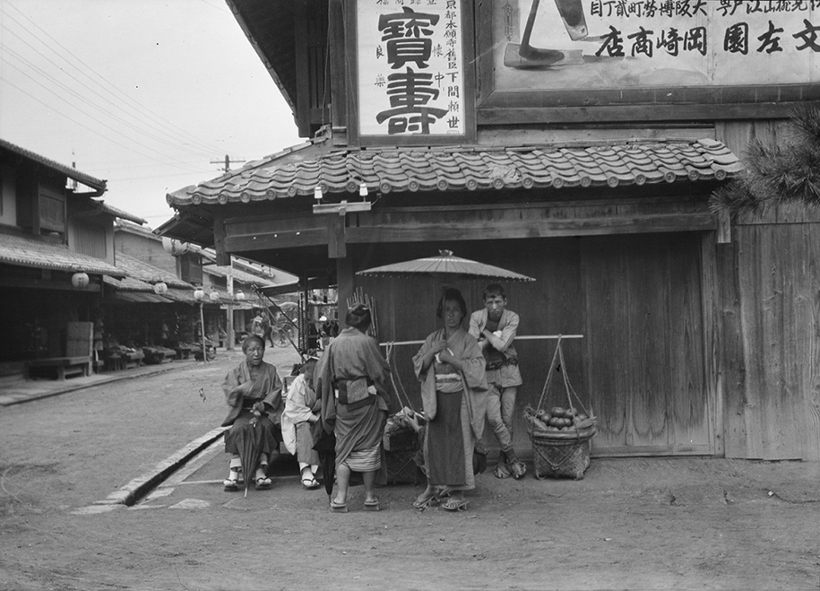
Japan circa 1908
www.demilked.com

Slide 32
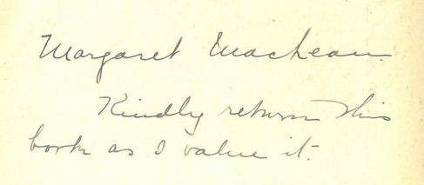
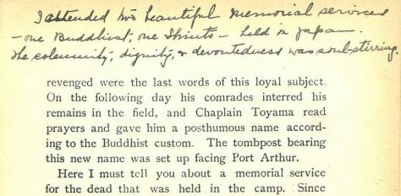

Slide 33
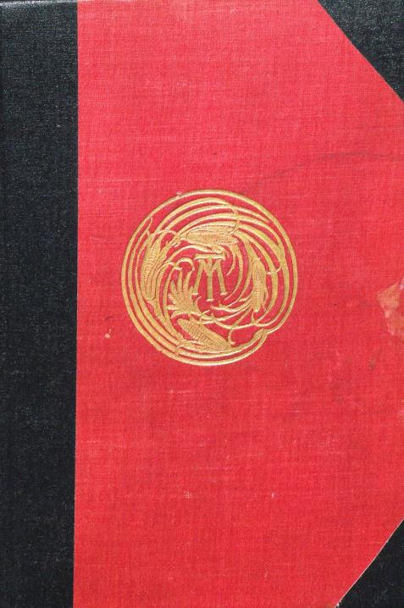
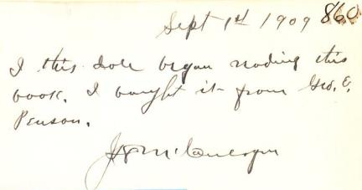
Unidentified…
Personal Recollections of Joan of Arc
by the Sieur Louis de Conte
(New York: Harper & Brothers Publisher, 1896).

Slide 34
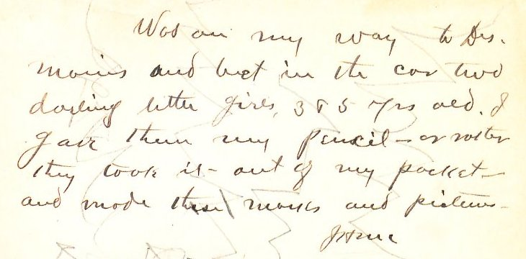
The story of two little girls…
… and their scribbles

Slide 35
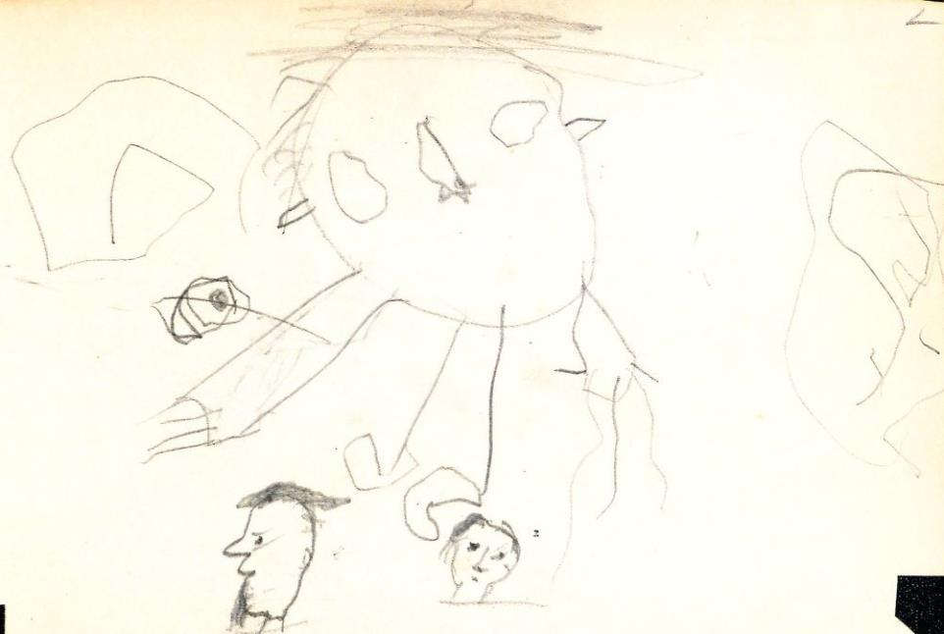
Doodles!

Slide 36
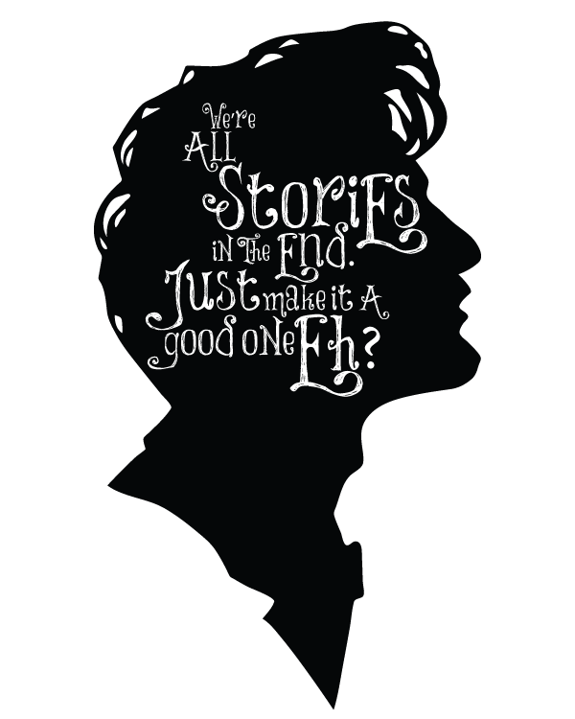
What can YOU do?
Keep an eye out for books that need rescuing!
Recognize books are evolving artifacts of history.
Collaborate with community, students, family members, historians!
Add your own signature/bookplate/gift inscription!
lumos5001.tumblr.com
Notes:
Your OWN copies… not library copies! ;)

Slide 37
Feedback!
University of
Prince Edward Island
BookLives Team
(Past & Present):
Research, Writing, Editing
Sarah Fisher
Robyn Thomson
Samara Hartling
Kate McClintock
Fabienne Bub
Designer:
Rob Drew
Tech Support:
Rosie Le Faive
Donald Moses
Peter Lux
Paul Pound
Cataloguing:
Wendy Collett
booklives@upei.ca

