Slide 1
Big Ideas for Little Libraries

Slide 2
Welcome!
We are… Stettler Public Library
Jane Skocdopole LIT, (SAIT) Chair, ALTA Alternate (Zone 3)
Rhonda O’Neill MLIS, (Dal) Library Manager
Notes:
Thank-you for coming to our session! We did not anticipate such an amazing turn out.
Jane has been a trustee for over 12 years, sitting a chair for about 10 of those years. She has sat on ALTA’s board as an alternate for Area 3 (Parkland) about 3 years. She served as a middle school librarian for 15 years. Retiring in 2015. She is a second generation librarian.
Rhonda has extensive library management experience; including being the driving force behind the set up of the judicial library in the amazingly beautiful Calgary Courthouse. Hoping to find a place in public libraries Rhonda became a consultant for Parkland Regional Library in Lacombe. But she still wanted her OWN library, so after 5 years she left Parkland for the bright lights of Stettler! Joining us last August.
We both love libraries. So you are getting two perspectives today, one from the Library manager aspect and one that will hopefully be helpful to trustees.

Slide 3
Who are you?
How many here are:
Library Staff?
Trustees?
From under population 10,000 libraries?
From under Population 5,000 libraries?
Notes:
Rural Library people think they are the “minority” when they come to this conference. But they certainly are not a minority in Alberta. AND they are very, very important in Alberta’s library scene.
Majority of Alberta’s libraries are rural. And most rural communities have a library.

Slide 4
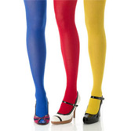
Alberta’s Libraries are…
A lot like Pantyhose…
One size DOES NOT fit all!!
We have diverse client needs,
Different Budgets,
Geographic Locations,
But, we are VITAL to our communities, no matter our differences,
No library has “too much money.”
Notes:
Our aim today is give you some ideas, and perhaps alert you to some resources that you are not familiar with, in the hopes of giving you a bit of “support” we will offer you some Lycra for your library, in its budget, and in its programming and administration.

Slide 5
Bright Spots Report - Manitoba
Used 2015 Manitoba Library Statistics
Looked at:
1.Visits per capita
2.Circulation per capita
3.Turnover of collection
Narrowed it down to the top 10 performing libraries and then visited those locations to see what, if anything, they were doing differently.
Anthony Woodward, PLSB Manitoba
(now with Regina Public Library)
Notes:
The Bright Spots Study happened in Manitoba and a report was presented at a conference in Manitoba in 2018. The study was very interesting to me because as a consultant, I noticed that some libraries were doing very well with really limited resources, while other similarly resourced libraries were floundering. Libraries have their own personalities and energy, some were high energy and interesting things were happening for them, others were very low energy for a variety of reasons. Anthony uploaded his report and presentation to the Toolshed, so you can find it there.
When he was a consultant with the Manitoba PLSB he noticed the same thing – some libraries were doing very well as compared to other libraries.
He used circulation statistics to identify the libraries that were doing well and then visited the top 10 performing libraries to see what they were doing differently.

Slide 6
Positive Deviance or Bright Spots
What’s working and how can we do more of it?
Notes:
Anthony was inspired to do this study by two books, “Switch” and “The Power of Positive Deviance” – the ideas in these books can be summed up as:
When everyone is facing a challenging issue, with the same resources, there are usually some people in that community who have already solved the problem. Sometimes you just need to find those examples and share with the group.

Slide 7
Findings of the Bright Spots Report
Notes:
What Anthony found was that the Head Librarian had a big impact on the success of the library. We would go further and say the administrative group (Board) needs to have a growth mindset as well, in order to support via policy and vision, a positive direction for the library.
Anthony found that a growth mindset led Library Managers to enable best practices in four key areas:
1. Building & Space: building is highly recognizable and easy to access, it is both relaxing and exciting, purpose built, ample parking, next to green space or recreation space, clear signage outside “Library”, ample natural light inside, space to spend time and relax, tidy and well organized, extensive and consistent opening hours (+45 per week on average).
2. Community buy in: Library has close and ongoing ties with local community groups and business. They participate in cross promotion; Community displays within library, regular visits from groups in town, large annual events, a good and ongoing relationship with local media
3. Welcoming & Barrier free: customer service is paramount, easy to sign up and renew card, flexible and community tailored fine policies, lots of waiving and 3 locations had no fines, minimal and friendly signage, helpful staff who never turn people away
4. Responsive Collection: Frequent and extensive weeding; extremely responsive to patron requests, not crowded, visibly current, face out displays throughout, meets the needs of the community

Slide 8
Finding Albertan “Bright Spots”
2016 Statistics
Looked at communities with populations under 10,000.
Did not include municipalities operating multiple locations.
Grouped into population sets: 0-500, 501-1000, 1001-3000, 3001-5000, 5001-10,000

Slide 9
Using the Data to Identify “Bright Spots”
Notes:
Scatter charts enable you to quickly identify the outliers.
Looked at Hours open per year (to see how available the libraries were to their community members)
Program Participants – to see who was engaging their communities in programming most effectively.
Also looked at circulation, annual visitors and cardholders.

Slide 10
The Interviews
Identified 39 libraries
Sent an email asking for interviews
Called and spoke with 14 libraries
Received a further 7 interviews via email
Did not speak to all 39 due to time constraints on both sides
Notes:
This was an awesome experience for me as a new public library manager. I was able to speak with so many incredible managers and hear what they were doing and the successes and challenges they were experiencing. I wish we could do this on a larger scale – perhaps as a panel discussion at a conference down the road with managers from bright spot locations leading the discussion?

Slide 11
The Interview Questions
General opening questions
Relationships and communication
Services and Programming
Marketing
Collections
Closing questions
Notes:
General questions: How many board members, volunteers, friends and how actively involved these groups were. How they keep current with library trends, library location and accessibility, funding situation.
Relationships – were they partnering with other organizations. How they communicated with funding stakeholders, staff, board and volunteers.
Services & Programming: how they decide what programs to offer and who does the programing (them, others, combination), for the littlest libraries – if a program was running, who was minding the desk? How they responded if no one came to a program. (resilience/mind-set).
Marketing – how they do it, what channels they use, how they promote memberships and process for issuing cards.
Collection – how they decide what to purchase, was there a formula to determine amount spent in each area? How was the collection promoted.
Closing questions: Challenges they have faced and how they approach them, what they think is the secret of their success, what advice they would offer libraries wishing to make a bigger impact.

Slide 12
What We Learned from the 21
Vast majority had 7+ board members.
Most also had a Friend’s group or planned to establish/re-establish one.
Many had other volunteers working in the library.
They valued continuing education for all team members, and shared what they learned.
They were always gathering information and shared it freely and frequently with one another through a variety of channels.
Many were located in accessible downtown locations. Being located outside of the downtown core was not a deal breaker and many small communities had libraries located in schools.
Most locations were physically accessible for those with mobility issues. Flexible spaces with mobile shelving helped where space was a concern.
Most libraries described a stable budget situation. No one had too much money.
Many libraries made efforts to raise funds or obtain grants so they could do more.
Notes:
Board Members – Involved, not micromanagers, supportive, visionary.
Friends - running casinos and other fundraisers (garden tours, big book sales, silent auctions, sale tables at markets, bingos, garage sales, pancake breakfasts, grant applications).
Volunteers - (shelf reading, shelving, programming, cleaning toys, delivering books - outreach, photocopying, shredding, dusting, helping with events)
They valued continuing education - (conferences, workshops, webinars, websites, online courses, PLSB symposium, Board Basics, the SAIT library operations diploma, regional libraries and ALTA memberships were important)

Slide 13
What We Learned…
They partnered with others on programming.
They tended to communicate with funding stakeholders several times a year and through different channels, not just at budget time.
They were resilient, if a program failed they looked at what may have been the issue. They didn’t take it personally.
They promoted the library through word-of-mouth, posters, websites, social media (Buffer and Hootsuite for scheduling), signage, brochures, local media, notice boards, radio, community events (registration nights, parent council meetings, farmer’s markets) and more.
They were responsive to their communities when it came to collection development. They watched what was going out and what was being brought in. They mentioned tools like Collection HQ, Regional Libraries, forthcoming lists, hotlists, bestseller lists.

Slide 14
Identifying Partnerships
Look for organizations with similar goals
Look for duplication of efforts
Find partners to join forces with for grant funding projects
Develop a Memorandum of Understanding (Partnership agreement) with partners.

Slide 15
Programming
Align with Plan of Service
What do members of the community want?
What are other organizations doing in the community?
Get ideas from other libraries and recreation organizations
What about passive programs?

Slide 16
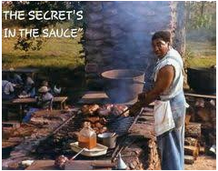
What is the secret of their success?
Everyone who walks through our doors is greeted with a friendly hello, we have frequent short conversations. We are happy to order items for patrons and ensure they know it isn’t any trouble to do so.
Get rid of negative signage, make patrons feel comfortable and valued, go above and beyond.
Connect newcomers with events and groups in the community.
Never put off today what you could have done yesterday.
Support community organizations. If they don’t see you support them, why are they going to support you?
Give staff the tools they need to thrive, send them out into the community, make sure to provide them with PD opportunities.
Know your community, embrace your community, try to say yes first.
Notes:
So I asked them all what they thought was the secret of their success and received a number of answers, some were very similar to others so here we have grouped them together along the same themes.

Slide 17
What advice would you offer other libraries?
Don’t assume you know what the community wants, ask.
Keep an open mind, be flexible, be friendly, invite people in.
Community partnerships are a great way to spread awareness of everything that the library offers.
Know your community, be sensitive to local conversations,
Get out into the community, participate in local events, act as a connector.
Grow your support network beyond your board members, find mentors, people you trust.
Dream big, you might not meet your goal, but you might meet a lot of it.
Notes:
So when you are the library manager in a rural library how do you maximize your time to accomplish the never ending list of things that need to be done?
Remember you don’t have to do it all (delegate, delegate)

Slide 18
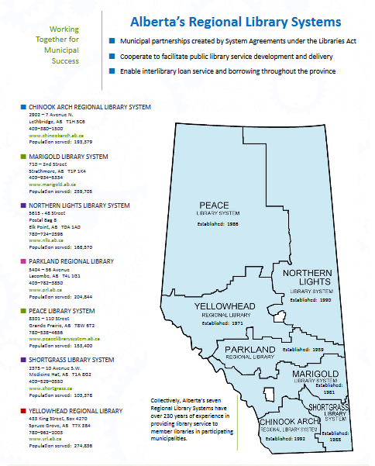
Regional Libraries – you are not alone
Become a super user of their services!
Collections support
Programming support
Continuing Education & information sharing
Research
Resource sharing (equipment & collections)
Board support
Support during plan of service preparation
Customized statistical reports
Notes:
Use your regional library as often as possible. Become a super user of their services!
Sometimes we feel that we need to do it all, sometimes we are not comfortable if we are not behind the wheel, sometimes we worry that others will come in and take over on us. We need to fight these fears so that we can take advantage of everything that is offered to us, to free up our time to do the work that only we can do in our communities with our community members.
Programming boxes at Parkland - LEGO Mindstorms – sitting in Parkland unused – travesty!
Tell them how they can help you further.
Show up to events – often the libraries that need it most don’t come out to meetings and continuing education opportunities. Boards must support attendance at these events and find ways to do it economically. As lovely as ALC is, not many little libraries can afford to attend – how can we make all of this information available to them?

Slide 19
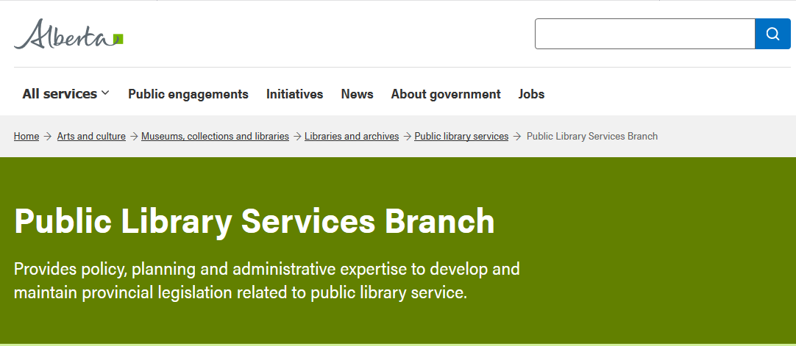
Public Library Services Branch (PLSB)
Legislation
Policy & Bylaws
Plan of Service
Board Basics
Continuing Education
E-Resources
Annual Report, Statistics and Directory
NNELS/CELA
Indigenous

Slide 20
APLAC, TAL, LAA and other networks
Alberta Public Library Administrators’ Council (APLAC)
The Alberta Library (TAL)
Library Association of Alberta (LAA)
Facebook and LinkedIn groups as well as websites aimed at areas of interest
Associations outside of Alberta (Association for Rural and Small Libraries, Pacific Northwest Libraries Association, American Library Association, Ontario Library Association, IFLA etc.)

Slide 21
The Library Toolshed – https://librarytoolshed.ca
Notes:
I would encourage us all to be more diligent in uploading materials to the Library Toolshed. Before you create something, look to the toolshed to see if someone has already created it. Upload it in an editable format – please, save us from needing to recreate it.
Program plans – planning documents – brochures and pamphlets. Perhaps this is something the regional libraries can take an active role in – gathering this information from their member libraries and uploading it to the toolshed (because managers in little libraries are often super busy and we want to work together to lighten the load not increase it.

Slide 22
Trustees: Know Your Place
You are Coach, Team Captain, and Cheerleader!
LEAD YOUR TEAM !
You sit in a position of oversight, but you do not run the library, the budget is not your money, it is community money.
Like any good coach you lead from the sidelines,
Trust that your team has the skills to win!
Give your team a great set of “rules” - (Policy) to work from,
Notes:
The importance of policy cannot be overstated. Up-to-date polices make everyone’s jobs easier. They give guidance to your team when they need to handle everyday and extraordinary situations. Good polices help your board when you are considering agenda items, or the ever-changing issues facing libraries today. Good policies give structure to how your library will function. They are literally a living document that is a gift to your staff, your library, and your community. Overwhelming? Your policies do not all have to be renewed at once. And you have many resources that you can access for ideas, and sample policies. E.g. your regional library system, ALTA, other libraries of similar size and region.

Slide 23
Trustees: Know Your Neighbours
BE NOSEY!
Who’s who?
Who does what?
What do we have in common? Do we overlap?
What can we do for you? What can you do for us?
AHA!! Can we form a partnership?
Open up your community,
Always Advocate for your library!
Notes:
A lot answers when you do your Plan of Service consultations.
When searching for partners, or help with programming, or funding, don’t be shy, ask everyone you can think of. You never know what they have to offer.
People of community often have similar interests and will be come out.
Some ideas are local schools, teachers, RCMP, Artists, weavers, potters, storytellers, businesses, fitness, yoga, lawyers (wills & estates), employment centre, theatre group, sports groups, health nurse, .
If you don’t know what everyone does, your patrons probably don’t either.

Slide 24
What’s Happening in Stettler?
Some of our successful partnerships/programs/fundraisers:
- Candidates’ Forum w/ Board of Trade
- New Authors - Beer Tasting - Wine Survivor - Cooking Club
- International Suppers - Reptiles
- Genealogy - Writer’s Group
- Quilting - Animal Rescue Group
- Toy Library w/ ECDC - Mayhem and Murder
- Historic Ghost walk w/ Friends and local Hotel
Notes:
Our most successful? Robert Raymond Cook
Ideas do not have to be big to be successful

Slide 25
Trustees: Know You Are Not Alone
Alberta Library Trustees Association www.librarytrustees.ab.ca
Public Library Services Branch
www.alberta.ca/public-library-services-branch
The Library Toolshed
https://librarytoolshed.ca
Your Regional Library
Your Municipal Partners
Search “rural libraries,”
NETWORK, NETWORK, NETWORK!
Notes:
Suddenly becoming a library trustee can be daunting but know you are not alone; stumbling about in the dark.
As well as your local partners there’s so many more places you can go for ideas, help, and knowledge here’s a few.
Alberta Library Trustees Association: Check out their Website. Trustee Education, Advocacy ideas, tools and contacts.
Trustee Link – Q & A’s.

Slide 26
The BIG Finish!
Now, go out there and make your
“Little Library”
“Big,” and busy, and a happening place in your community!!

