Slide 1
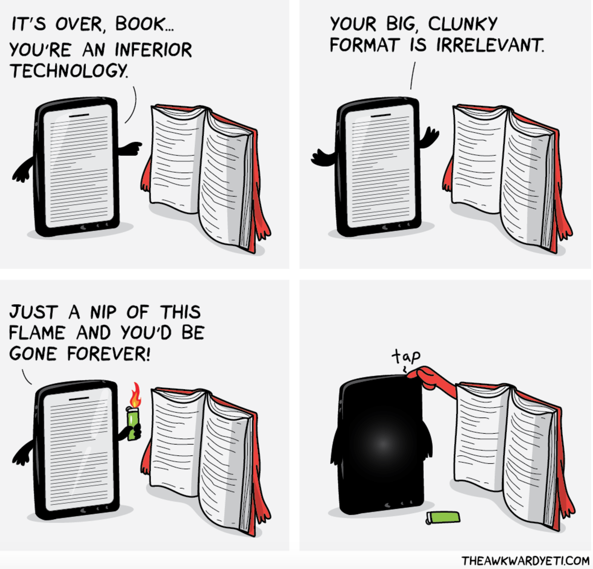
Notes:
http://theawkwardyeti.com/comic/books/
Raise your hand if you owned an Amazon first generation Kindle in 2007
Raise your hand if you own some sort of e-book reading device or tablet today (not just a regular PC)
I started Library School at UBC 10 years ago - the same year that Amazon released their first generation Kindle. So the emergence of e-books on the market, and all of the resulting questions about the impact of new digital formats have been part of the background for the entirety of my career as an academic librarian.
I won’t say I didn’t share in plenty of hand wringing when some of my favorite brick and mortar book stores went out of business.

Slide 2
http://www.huffingtonpost.com/2015/02/27/print-ebooks-studies_n_6762674.html
Notes:
http://www.huffingtonpost.com/2015/02/27/print-ebooks-studies_n_6762674.html
And I won’t say I haven’t loved seeing headlines like this one in recent years. But the truth is that I enjoy reading both e-books and print books. I have an iPad; active accounts at multiple libraries and last week I bought Paul Auster’s new book in hard cover. What I’m trying to say is that the research I’m about to share with you wasn’t motivated by anything resembling a personal bias against either e- or print books.

Slide 3
Notes:
In fact, the seeds of this inquiry were sown at a Physics Department meeting I happened to be attending as our library’s liaison to the colleges of science and engineering. Physics faculty, I learned, were upset about plans to relocate some of the library’s science collection offsite. Even though this plug had been pulled on this plan, Physics faculty - who, at Seattle U happen to be very invested in their book collection - remained on high alert. At this meeting, they were … highly assertive about letting me know that their students don’t like e-books - that they much prefered to use print.
I’ll confess, this was news to me. I’ll confess I wasn’t sure if I believed them ...
It was 2015; I hadn’t been a science liaison librarian for long, and I was operating under the assumption that 1-students in STEM are generally pretty technology-forward, and 2-this made them automatically more receptive to e-books than, perhaps, their counterparts in the humanities and social sciences.
By Icely88 (Own work) [CC BY-SA 3.0 (http://creativecommons.org/licenses/by-sa/3.0)], via Wikimedia Commons

Slide 4
Notes:
https://www.flickr.com/photos/cactus22minus1/24510574494/in/photolist-kuQdj6-PK4u9r-HGDYYZ-ByTkXp-DRwa3j-E8coWL-DK9Yvp-DRw9Jy-DRwbJL-BxeVq8-DRwbof-EgjuuS-DkV6RY-xJ1dpU-yE4uR9-CkcPfm-SkVHpZ
AND 3- It’s Seattle - you know, home of Amazon… tech-landia … (And that’s their new Biodome in construction in the downtown area).
But Let me pile on … by describing one of the senior design projects a team of students in electrical and computer engineering completed last year: they built a working model of the Engineering building with lighting controls for specific rooms on each floor, controlled by a Raspberry Pi (everybody here knows what that is, right?) with an interface to a Android or Apple iWatch. It incorporated actual mini wind turbines stimulated with fans and solar panels (possibly stimulated with an artificial light that might actually move in an arc across the ‘sky’. … Heard enough?
I assumed it was the faculty, not the students who didn’t much like e-books. So I decided to ask them - the students, that is.

Slide 5
Do undergraduate engineering and environmental science majors prefer reading print or e-books?
…and why
Notes:
The purpose of my study was to investigate whether undergraduate students in two engineering departments at Seattle U prefer reading print versus e-books, and to understand their reasons for these preferences.
As an aside: I “prototyped” this study in Physics and Chemistry before it occurred to me that it might be interesting to be able to share my findings. But because I hadn’t gone through the IRB application process for approval for human subjects research, I can’t share those findings. But I smartened up a little and got IRB approval before surveying our engineering students, and those are the findings I’ll be sharing today.
During the 2016 fall quarter, 145 students in seven courses offered by the departments of mechanical, and civil & environmental engineering were surveyed. And because some of the classes in the department of civil and environmental engineering include environmental science majors as well as engineering majors, I was able to do some comparison between engineering and environmental science majors.

Slide 6
Participating classes
Course | # of Completed Surveys
CEEGR1050: Civil Engineering Graphics and Communication | 25
CEEGR3310: Fluid Mechanics | 20
CEEGR4730: Principles of Environmental Engineering | 25
ENSC1000: Introduction to Environmental Science | 9
ENSC3250: Environmental Geology | 14
MEGR2100: Statics | 17
MEGR3210: Thermodynamics | 35
Total | 145
Notes:
How did this actually work? I approached the chairs and library representatives from the Departments of Mechanical Engineering and the Civil / Environmental Engineering; they were interested in the investigation and agreed to participate; specific courses were selected for inclusion by the departments themselves based on availability and willingness of individual instructors to give up 10-15 minutes of class time for survey administration.
This turned out to have unintended consequences as a means of faculty outreach and collaboration, since I got feedback from faculty on the survey questions, met some faculty face-to-face who I hadn’t had a chance to meet, and got facetime with students and faculty in engineering - this is unusual as I don’t tend to have many opportunities to connect face to face with our engineering programs.

Slide 7
No one wants to take your stupid survey.
Notes:
I used paper instead of web-based surveys. This allowed me to deliver and collect the surveys in-person to students during class time, which contributed to a very high response rate and helped me dodge the growing problem of survey fatigue. The downside of using a paper survey is that you have to do a lot of data-entry and transcription, but thankfully, I was able to delegate this to a work-study student.

Slide 8
Notes:
The survey itself contained multiple choice questions about book format preferences as well as open-ended comment response type questions that asked students to explain their reasons for their preferences. And while it had too many questions to show it on a slide today, I’d be happy to share it with anyone offline.

Slide 9
In general, which type of book do you prefer to read: print or electronic? [print/electronic/no preference]
Please explain your response to the above question by providing at least one reason for your preference [comment field]
For Engineering [sub Environmental Science] topics in particular, which type of book do you prefer to read: print or electronic? [print/electronic/no preference]
From your personal experience, what are some of the pros and cons of print books [sub eBooks] (either for school, work or pleasure)? [comment field]
Notes:
The questions from the survey I’ll be looking at responses from today.

Slide 10
Study participants
Notes:
So: who were my study participants?
56% of civil and environmental engineering majors, 39.5% of mechanical engineering majors, and 96% of environmental science majors participated in the study.

Slide 11
Study participants by class standing
 | # of participants | % of participants
Freshman (Year 1) | 12 | 8%
Sophomore ( Year 2) | 30 | 21%
Junior (Year 3) | 63 | 43%
Senior (Year 4) | 40 | 28%
Total | 145 | 100%
Notes:
By undergraduate class standing, 8% of participants were freshmen, 21% sophomores, 43% juniors and 27% seniors.

Slide 12
In general, what type of book do you prefer to read: print or electronic?
N=143
Notes:
Results show a strong overall preference for reading print over e-books. When asked, “In general, which type of book do you prefer to read: print or electronic?” 74.1% of respondents (N=143) indicated that they prefer print, 14% indicated that they prefer e-books, and 11.9% had no preference.

Slide 13
Book format preference by major
N=143
Notes:
While overall results demonstrate a clear preference for print over e-books, disciplinary differences are also evident. Too few environmental science majors participated in the study to analyze the statistical significance of the relationship between major and general book preference for each major individually. Nevertheless, you can see disciplinary variation.

Slide 14
Overall book format preferences: Engineering vs. Environmental Science majors
X² (2, N=143)=9.063, p=.011
Notes:
However, when the engineering majors were grouped together and compared to all others, (26 ensc plus 8 unknown others), a strong statistical relationship between major and book preference WAS found, with engineering majors expressing a much stronger preference for print over e-books than the other group.

Slide 15
Book format preference by subject
Notes:
In addition to their general book format preferences, engineering majors were asked the following question: “For engineering topics in particular, which type of book do you prefer to read: print or electronic?” Environmental Science majors were asked a parallel question. Here, too, disciplinary differences were evident, with more engineering majors indicating a preference for print over e-books, and more environmental science majors indicating a preference for e-books over print.

Slide 16
Print Books: the “Pros”
Readability
Tangibility
Navigability
Annotating
Easier on eyes
Bookmarking
Connectivity
Portability
Focus/Attention
Notes:
http://res.publicdomainfiles.com/pdf_view/65/13550802017232.png
The survey also included open-ended comment response-type questions in which students were asked to explain their reasons for their format preference, in addition to questions in which they were asked to identify the pros and cons of both print and e-books based on their own experiences.
Here are the most frequently given “pros” of print books from these comments

Slide 17
Usability
The utility and ease with which “user interfaces” are used (including the pleasure or satisfaction associated with using a tool).
Nielsen, Jakob. (2012). Usability 101: Introduction to usability. Retrieved from https://www.nngroup.com/articles/usability-101-introduction-to-usability/
Notes:
As you can see, usability-related reasons dominate here - using Jakob Neilsen’s definition of usability as:
the utility and ease with which “user interfaces” are used (including the pleasure or satisfaction associated with using a tool).

Slide 18
Readability
“It’s easier for me to read printed books.”
Notes:
Readability This code was given to comments that referred to how ‘easy’ it is to read one or the other format. For example,

Slide 19
Tangibility
“I prefer to have a tangible item in my hand when
I am researching. I focus more easily rather
than looking on a computer screen."
Notes:
Tangibility -- these comments referred to the tactile experience of reading print books and sometimes made connections between tangibility and focusing, retention, and learning

Slide 20
Tangibility
“I find the tactile experience is helpful
in the recall of what was read.”

Slide 21
Tangibility
“Something about having it physically helps
my understanding.”

Slide 22
Navigability
“I prefer to be able to flip back to a page with ease, this is not present with
electronic books.”
Notes:
Navigability -- these comments were about navigating between parts of a book, and frequently mentioned flipping back and forth between pages. For example:

Slide 23
Navigability
“Navigating to appendices/tables is infinitely easier in print than online. Comparing values
is also more straightforward.”

Slide 24
Annotating
[Print books make it] “Easier to track important info via highlighter and underlining .”
Notes:
Annotations - these were comments about highlighting, underlining, or making notes of any sort on a text. For example:

Slide 25
Annotating
“Easier to make margin notes.”

Slide 26
Eyes
“My eyes get tired when I use e-books”.
Notes:
Eyes - this category of comment included anything where eyes were mentioned, most of which identified tired eyes or eyestrain as an issue associated with reading from screens. For example:

Slide 27
Bookmarking
“Pros: dogearing pages.”
Notes:
Bookmarking - these comments didn’t always use the word bookmark, but referred to making place markers in texts. For example:

Slide 28
Bookmarking
“I like being able to mark pages with tabs.”

Slide 29
Connectivity
“don't need internet/power to access.”
Notes:
Connectivity - included comments about Internet access or Power. For example:

Slide 30
Portability
“I like that they are portable, do not depend
on technology, wifi, batteries, etc.”
Notes:
Portability - while most comments about portability identified this as an attribute of e-books, for obvious reasons since they’re not exactly heavy in the way that print books can sometimes be, this was ALSO identified as a “pro” of print books.

Slide 31
Portability
“They are much easier to read on a bus.”

Slide 32
Focus & Attention
“I think I pay more attention when I read
a printed book.”
Notes:
Focus/Attention -- these comments referred to the perception that format impacts the ability to stay focussed, to not be distracted, and to pay attention. For example:

Slide 33
Focus & Attention
“I’m less likely to get distracted.”

Slide 34
Print Books: the “Cons”
Weight
Cost
Portability
Accessibility
Space
Searchability
Environment (sustainability)
Convenience
Damage

Slide 35
Weight
“heavy, waste of paper”

Slide 36
Cost
“expensive”

Slide 37
Portability
“It's easier to bring my laptop with two books for two classes than bring two huge books.”

Slide 38
Accessibility
“Easy access 24/7. Whereas print can sometimes not be available.”

Slide 39
Space
“They can be heavy or bulky. They use a lot of paper and take up a lot more space (as I'm sure is an issue in the library).”

Slide 40
Searchability
“requires searching through
chapter manually”

Slide 41
Environment (sustainability)
“Though I actually prefer reading print materials,
the environmental benefit of electronic sources
is more important to me personally.”

Slide 42
Environment (sustainability)
“Paper comes from trees.”

Slide 43
Damage & loss
“Easy to lose or damage.”

Slide 44
Poll
Based on your personal experience, do you feel that the tangibility of a printed book contributes to learning (reading comprehension/memory etc.)?

Slide 45
Notes:
Based on your personal experience, do you feel that the tangibility of a printed book contributes to learning (reading comprehension/memory etc.)?
https://www.polleverywhere.com/multiple_choice_polls/sE4FNKJu1EH8ozA

Slide 46
E-books: the “Pros”
Portability
Accessibility
Cost
Searchability
Convenience
Environment (sustainability)
Weight
Notes:
http://res.publicdomainfiles.com/pdf_view/65/13550802017232.png

Slide 47
Portability
“I prefer electronic books because they are easy
to access and it means there is less to carry.
It is more convenient.”

Slide 48
Accessibility
“Easy access 24/7. Whereas print can sometimes
not be available.”

Slide 49
Cost
“E-books are cheaper so I usually get those.”

Slide 50
Cost
“I can torrent/download many books
for free.”

Slide 51
Cost
“Easy to access, cheaper or free if illegally obtained (nearly all e-books are obtained
in sci & engr.)”

Slide 52
Searchability
“It is easier to search for what you need
in an ebook.”

Slide 53
Convenience
“Easier and more convenient accessibility.”

Slide 54
E-books: the “Cons”
Eyestrain
Navigability
Device reliance
Annotating
Readability
Connectivity
Focus/Attention
Usability
Intangibility

Slide 55
Device reliance
“If your device dies then you’re SOL.”

Slide 56
Does the medium matter?
https://giphy.com/gifs/cat-book-reading-LkjlH3rVETgsg
Notes:
Play Cat Giphy

Slide 57
Christina Nilsen
Research Services Librarian
Seattle University
nilsenc@seattleu.edu

Slide 58
Image & Video Attributions
Book love by Icely88 is licensed under CC BY-SA 3.0. https://upload.wikimedia.org/wikipedia/commons/e/ee/Book_lover.jpg
Books by Nick Seluk, http://theawkwardyeti.com/comic/books/
Photo of the Amazon Biodome by Jeffrey Scott Will is licensed under CC BY-NC-ND 2.0
Reading Cat GIF by Unknown Author https://giphy.com/gifs/cat-book-reading-LkjlH3rVETgsg

