Slide 1
Rhymes, Rhythm and Relationships: A Model of Community Collaboration between a Public Library and an Organization Serving Aboriginal Families
British Columbia Library Association Conference
April 20, 2017

Slide 2
Session Outline
Acknowledgement & Introductions
Rhymes, Rhythm & Read: Our Story
Guided Discussion of Policies & Values
Q&A
Closing Statement

Slide 3
Rhymes, Rhythm, & Read:
Our Story

Slide 4
Rhymes, Rhythm & Read Goals
Encourage, support and validate best early literacy practices among Aboriginal parents of young children aged 0-3
Affirm participants' cultural identity through song and story
Foster connections between participating families and the library, in anticipation of the opening of the nə́c̓aʔmat ct Strathcona branch

Slide 5
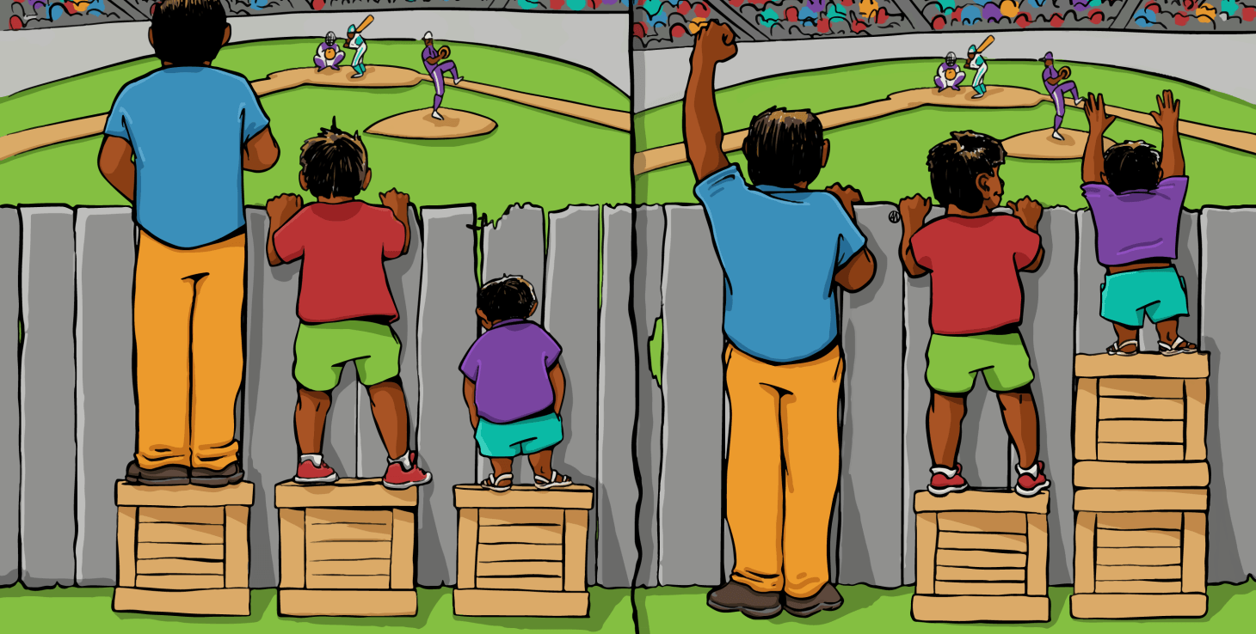
Guided Discussion: Values & Policies
Interaction Institute for Social Change | Artist: Angus Maguire

Slide 6
Handout/Links
Aboriginal Infant Development Program site
Connecting the Dots: A Guidebook for Working With Community [VPL]
Truth and Reconciliation Report
“All My Relations” by Richard Wagamese
“Slow Ideas” by Atul Gawande

Slide 7
Contact Information
Robyn Lean
Aboriginal Infant Development Consultant & Regional Advisor
YWCA Crabtree Corner Community Program
(604) 216-1674
rlean@ywcavan.org
Els Kushner
Children's Librarian
nə́c̓aʔmat ct Strathcona Branch, Vancouver Public Library
604-665-3516
els.kushner@vpl.ca

