Slide 1
All Sorts of Authority:
Guiding Students Over the Threshold in Information Literacy
Manitoba Libraries Conference
June 1, 2018
Ian Fraser, MLIS
i.fraser@uwinnipeg.ca

Slide 2
Original Activity
Process Cards
Five groups are given a stack of cards. The stacks are identical except for the top card, which names a “formative process”.
Ease
Time
Research
Editing
Length
(Seeber, 2015)

Slide 3
Original Activity
Groups are asked to sort the following types of information by the formative process named on the top card.
Tweet
Blog Entry
Wikipedia Entry
News Article
Scholarly Article
Scholarly Book
(Seeber, 2015)

Slide 4
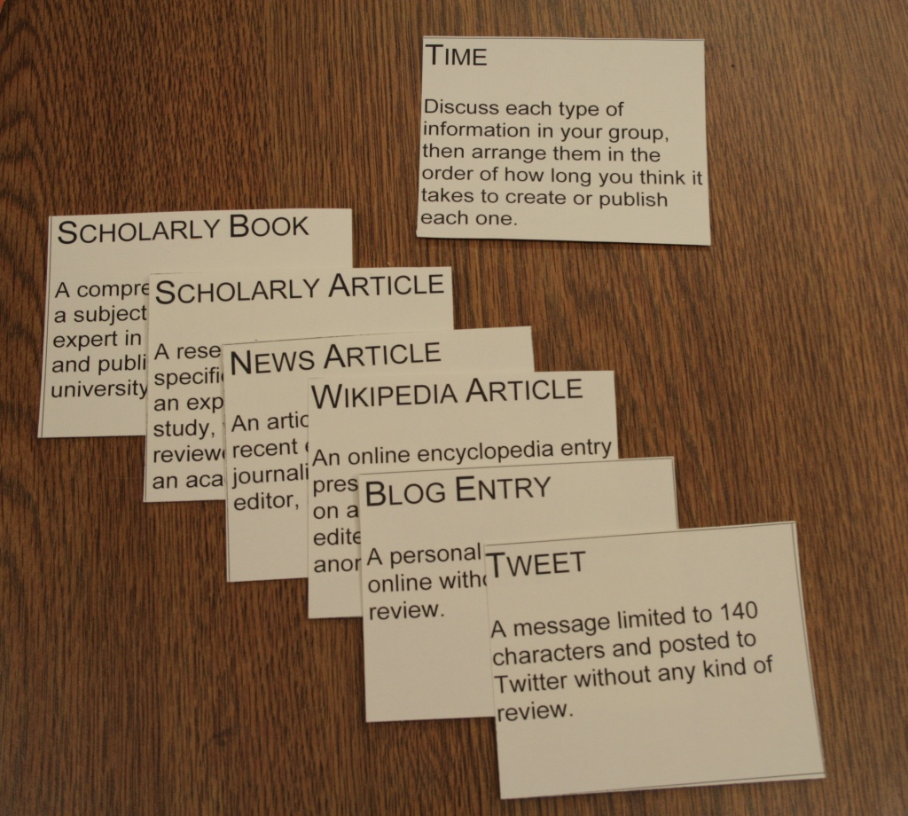

Slide 5
Disappointment
The formative processes actually weren’t all that interesting.
There wasn’t any diversity between the groups. All groups had basically the same order, or the inverted order.
The premise of the activity was still the same good v. bad sources discussion, which runs contrary to the ACRL Framework on which it was based.
Notes:
”Time” is a relatively static dimension. Something takes long or doesn’t and the implications don’t really generate much discussion. “Length” is even more static.
“Ease” was the only formative process that generated a different order, and that was simply an inversion of the others.

Slide 6
“The unique capabilities and constraints of each creation process as well as the specific information need determine how the product is used.”
“[Learners]… resist the tendency to equate format with the underlying creation process.”
(ACRL, 2015)
Notes:
”Time” is a relatively static dimension. Something takes long or doesn’t and the implications don’t really generate much discussion. “Length” is even more static.
“Ease” was the only formative process that generated a different order, and that was simply an inversion of the others.

Slide 7
Adapted Activity
Authority Cards
Five groups are given a stack of cards. The stacks are identical except for the top card, which names an “evaluative criteria”.
Scholarly
Experienced
Entertaining
Powerful
Sceptical

Slide 8
Adapted Activity
Groups are asked to sort the following types of authors by the evaluative criteria named on the top card.
Academic
Activist
Celebrity
Journalist
Politician
Witness

Slide 9
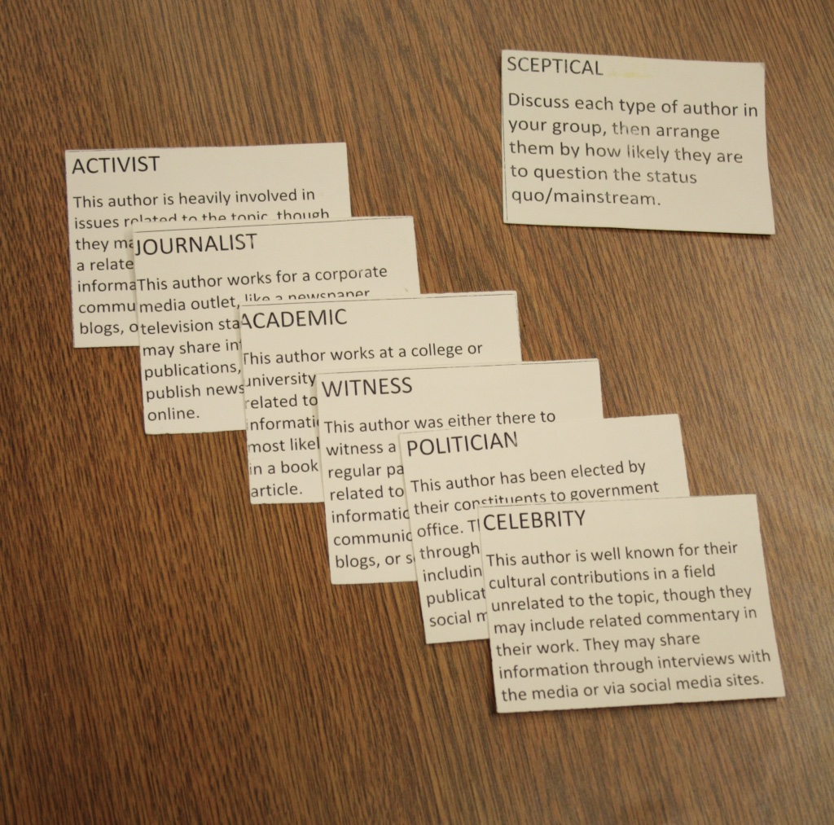

Slide 10
Observations
Generally, more interest in the activity.
Wider variety of responses and perspectives.
The openness of the activity makes for some engaging and transformative moments, for both students and librarians.
Demonstrates the subjectivity of information and reframes the common “good v. bad sources” evaluation methods.
Notes:
The evaluative criteria result in a range of orderings.
Has helped me to connect with my Students (perspectives of the average undergraduate)

Slide 11
Observations
This activity works for chatty groups but also can quickly be repurposed into a more lecture/presentation style workshop if students aren’t ready to speak up.
While the focus is on dimensions of authority, the activity usually points to elements of other threshold concepts, like process, conversation, value, etc.
Notes:
The evaluative criteria result in a range of orderings.

Slide 12
Observations
Instructors often want me to “show them the databases”, which is not accomplished in this activity.
Students frequently underestimate themselves, or think that I’m looking for a specific, right answer.
It’s important to clearly establish the premise of the activity beforehand.
Notes:
Expectations of instructors are usually not information literacy instruction but more guided demos of technology
I had one group change their responses after hearing the first group talk about scholarly sources, thinking that was the dimension they were supposed to work with.
If students don’t understand the main premise (that certain types of information are better suited to certain contexts or uses) then they may struggle with the activity.

Slide 13
References
Association of College and Research Libraries. (2015). ACRL Framework for Information Literacy for Higher Education. Retrieved from ala.org/acrl/standards/ilframework
Seeber, K. P. (n.d.). Process Cards [PDF Document]. Retrieved from kevinseeber.com/processcards.pdf
Seeber, K. P. (2015). Teaching "format as a process" in an era of web-scale discovery. Reference Services Review, 43(1), 19-30.

