Slide 1
In your feelings: Let’s talk about emotional labour in public libraries
By Kyla Lee
Alberta Library Conference 2019

Slide 2
Learning objectives
Understand what emotional labour is
Discover how emotional labour manifests in frontline public library workers’ interactions with difficult patrons
Learn how organizational issues play a role in emotional labour
Notes:
I will start by defining emotional labour, and going through a literature review on the topic.
This leads to my research question, and I will go over my study design and the findings.
Finally, I want to really look at the ways in which emotional labour is affected by what I termed “organizational issues” because these are things which can be changed.

Slide 3
Introduction

Slide 4
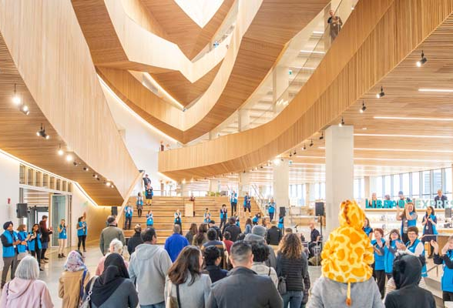
Why am I so exhausted?
Expectations vs. reality
Notes:
Working in a frontline public library position throughout my MLIS
Emotional labour not discussed in my MLIS education
Emotional labour not discussed in my training at work
As someone who loves stories, I knew I wanted to conduct a qualitative research for my final course in my MLIS
LIS 597 - Advanced Research with Tami Oliphant
https://calgarylibrary.ca/blogs/post/take-a-look-inside-your-new-central-library/
https://www.pexels.com/photo/assorted-books-on-shelf-1290141/

Slide 5
Literature Review

Slide 6
What is emotional labour?
Labour that “requires one to induce or suppress feeling in order to sustain the outward countenance that produces the proper state of mind in others” (Hochschild 1983, 7).
Notes:
Over thirty years ago, the sociologist Arlie Hochschild (1983) introduced the concept of emotional labour (EL) to the world by examining the work of flight attendants.
She defined it as a labour that “requires one to induce or suppress feeling in order to sustain the outward countenance that produces the proper state of mind in others” (7).

Slide 7
Work of managing emotions for your job.
Notes:
More simply put it is the work of managing emotions for your job.

Slide 8
Notes:
So instead of reacting like this when a patron tells you about their family being tortured in their home country while filling out immigration forms...

Slide 9
Notes:
Or like this when someone cuts in line to demand you help them immediately...

Slide 10
Notes:
You just keep that smile on your face!

Slide 11
How can emotional labour be performed?
Surface acting: displaying the emotions expected of you to fulfill job requirements.
Notes:
E.g. when workers provide service with a smile despite feeling frustrated

Slide 12
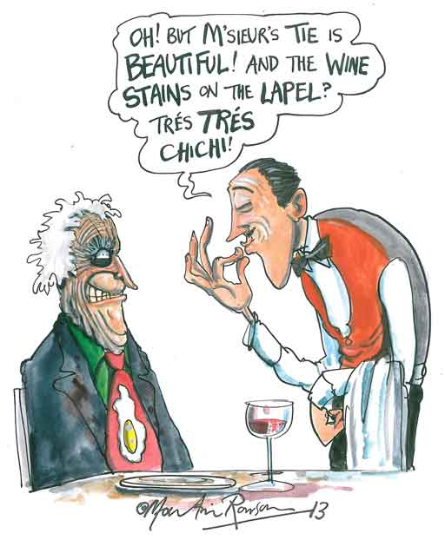
Notes:
https://newhumanist.org.uk/articles/4163/emotional-labour-pains

Slide 13
How can emotional labour be performed?
Deep acting: when workers strive to actually change their feelings to match what is being expressed
(Grandey and Gabriel 2015)
Notes:
Empathizing with a patron so your displayed emotions match your actual emotions.

Slide 14
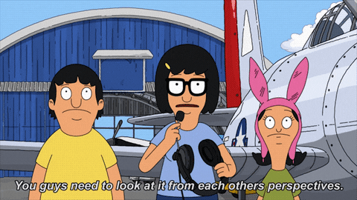

Slide 15
Robust research outside of LIS
Psychology
Grandey, Diefendorff, and Ruppand 2013
Sociology
Wharton 2009
Teachers
Philipp and Schüpbach 2010
Zhang and Zhu 2008
Mental health workers
Mancini and Lawson 2009
Hotel workers
Kim 2008
Sex workers
Hoang 2010
Nurses
Edward, Hercelinskyj and Giandinoto 2017
Smith 1992
Theodosius 2008
Notes:
Interestingly, many of these occupations are also feminized like library work

Slide 16
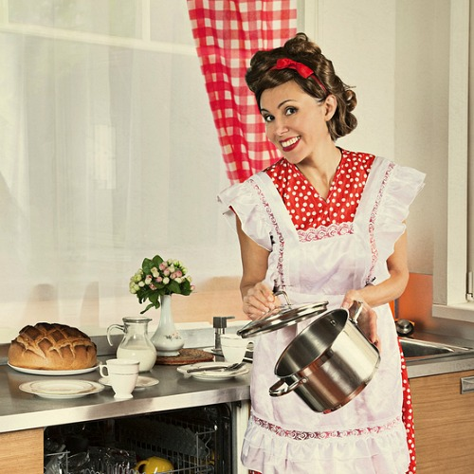
“Pink-collar” labour
Feminized labour so it is often invisible (Hochschild 1983)
Academic library work is undervalued
Sloniowski (2016)
Douglas and Gadsby (2017)
Gendered expectations
Emmelhainz, Pappas, and Seale (2017)
Notes:
It is critical to note that emotional labour is a form of feminized or “pink-collar” labour, and is therefore often invisible (Hochschild 1983).
Sloniowski (2016) argues that in academic librarianship affective labour, another term used for emotional labour, is undervalued because of its feminized nature.
This is supported by Douglas and Gadsby (2017) who argue that academic librarianship consists of work that is “coded as feminine labor” and that the role is “subject to many of the gendered expectations associated with women”, which results in the work being undervalued (266).
Similarly, Emmelhainz, Pappas, and Seale (2017) argue that librarians are taught to prioritize performing emotional labour in reference transactions, and these expectations are gendered.
https://acultivatednest.com/should-you-be-like-an-old-fashioned-1950s-housewife/

Slide 17
LIS research
Matteson, Chittock, and Mease
EL exists when interacting with patrons, coworkers, and management
Difficult and aggressive patrons in Chinese academic libraries
Sheih
Lack of research on EL
Arbuckle
Sheih
Sheih
2008
2009
2010
2011
2012
2013
2014
2015
Julien and Genuis
EL is part of instructional work in academic & public libraries
Shuler and Morgan
Qualitative study on academic libraries
Fourie and Julien
Research agenda
Matteson and Miller
Empirically found EL present;
Advice to library managers
Matteson and Miller
Research agenda
Notes:
Despite being a service-oriented feminized profession, the literature on emotional labour in library work is still only slowly developing.
The discussion really only began a little over ten years ago...
2008 - Arbuckle - Lack of research on emotional labour in libraries
2009 - Julien and Genuis - Emotional labour is an intrinsic part of instructional work in both academic and public libraries.
Many other studies have since demonstrated that EL exists in academic library work (Sheih 2010; Sheih 2012; Sheih 2013; Shuler and Morgan 2013).
2010-2013 - Sheih (2010), Sheih (2012), Sheih (2013) - All conducted in Chinese academic libraries. Sheih (2010) found that the most pronounced effect of EL was a negative impact on mental and physical well-being.
2012 - Matteson amd Miller - Research agenda
2013 - Matteson and Miller - First large-scale study that empirically found EL to be present in library work in academic, public, and special libraries.
They found both positive and negative outcomes. For example, they found that surface acting led to negative outcomes such as job burnout, and decreased job satisfaction which is in line with previous studies outside of librarianship. However, mixed results were found when workers employed deep acting. Positive outcomes for deep acting were only found for professional efficacy. The negative outcome of emotional exhaustion was also associated with deep acting.
2014 - Matteson and Miller - Followed up their 2013 study with advice on how library managers can minimize the effects of emotional labour.
2014 - Fourie and Julien - Another research agenda.
2015 - Matteson, Chittock, and Mease - Mixed methods study which found that EL exists primarily when interacting with patrons, coworkers, and management. They also found that librarians performed more surface acting than deep acting

Slide 18
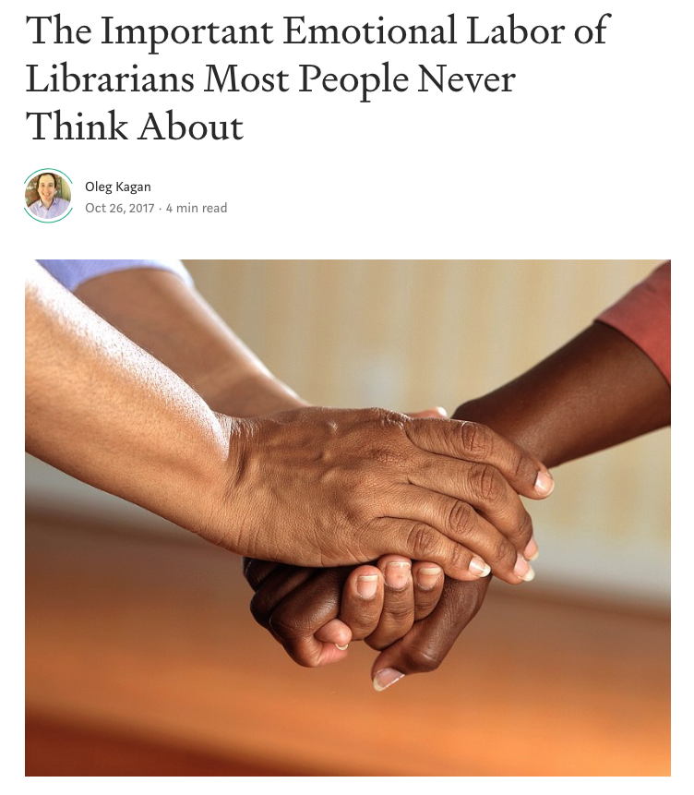
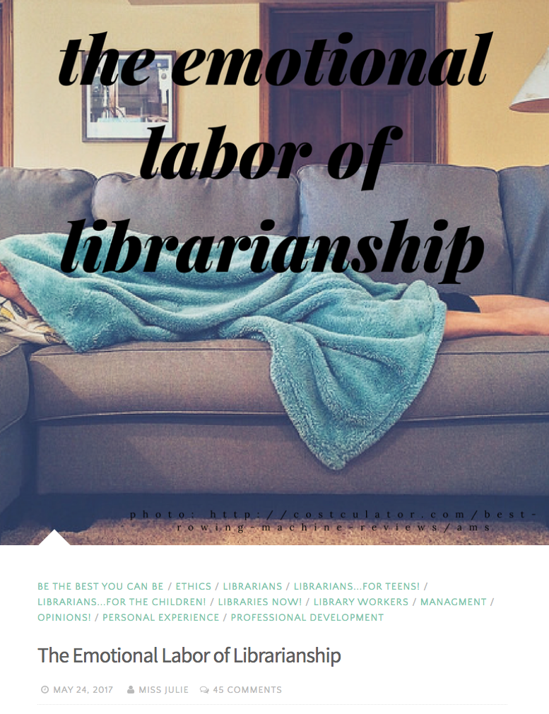
Growing interest
Blogs
Notes:
Unfortunately, research has stalled since then.
Yet Informal discussion abounds in blogs (Kagan 2017; Miss Julie 2017; Maria 2015)

Slide 19
Growing interest
Opinion piece in Los Angeles Times
Notes:
This article was being shared in my circle of libraryland last week, and I thought it was interesting that it seems to touch on the rich emotion work being done in libraries without naming it EL.
It actually highlights some very similar themes found in my research so I thought it was interesting to see that this sentiment exists in libraries outside of Western Canada as well.

Slide 20
Gap in the literature
Rich emotion work being done in public libraries
Participants always librarians
Broaden our understanding of how emotional labour impacts public library workers
Notes:
Still little research which closely examines the rich emotion work being done in public libraries
Although Julien and Genuis (2009), Matteson and Miller (2013), and Matteson, Chittock, and Mease (2015) included public library workers in their sample, all of their participants were working as librarians
Excludes many other library workers who do a great deal of frontline work with the public
The goal of this study is to broaden our understanding of how emotional labour impacts public library workers more generally, which includes library assistants

Slide 21
Research question:
How does emotional labour manifest in public library workers’ interactions with patrons they perceive to be difficult?
Notes:
This gap in the literature led to my research question.

Slide 22
Research Design

Slide 23
Methodology
Experience sampling method
Collects information about daily life experiences
Participants kept an electronic journal
After any interaction with a difficult patron they responded to six provided prompts
Participants journalled for 1-4 weeks
Notes:
This study employed the experience sampling method (ESM), which asks participants to reflect on what they are doing, thinking, or feeling at specific times determined by the researcher (Vogt 2005).
In this case, participants were asked to reflect on their experiences after each encounter with a patron they perceive to be difficult in journals, which are “one of the most effective research tools to mine the rich personal experiences and emotions of participants’ inner lives” (Given 2005).
Journals are particularly useful when participants discuss sensitive topics (Given 2005).
Thus, this method was carefully selected as it collects rich information about individuals’ daily life experiences (Salkind 2010), and allows the participants to feel comfortable reflecting on challenging scenarios with patrons.

Slide 24
Journal prompts
What happened in this interaction?
How did you feel throughout the interaction?
Did you show the patron how you felt?
How do you feel after the interaction?
Would you do anything differently next time?
Is there anything else you want to share about the interaction?
Notes:
What happened in this interaction?
How did you feel throughout the interaction?
Did you show the patron how you felt?
How do you feel after the interaction?
Would you do anything differently next time?
Is there anything else you want to share about the interaction?

Slide 25
Recruitment
Ethics approval granted by University of Alberta’s Research and Ethics Board
Participants had to be over the age of 18, and working in a public library role where they regularly interact with patrons
Notes:
Prior to beginning recruitment, ethics approval was received from the University of Alberta’s Research and Ethics Board.

Slide 26
Recruitment
Convenience sampling
Send a poster to western Canada library listervs
Notes:
Participants were recruited through convenience sampling.
The initial plan for recruitment was to send a poster with study information to various western Canada library listervs such as Jerome-L and BCLA.

Slide 27
Recruitment
Word of mouth generated enough participants
Quick response rate
11 people expressed interested
5 people completed the study
Notes:
However, as this was only a small-scale pilot study, more than enough participants were quickly recruited through word-of-mouth alone.
In fact, the extremely quick response rate from participants demonstrates that this is an important topic many library workers want to discuss.
It should also be noted that I was able to recruit participants quickly due to my experience working in a public library, which means I had access to a network of public library employees.
I shared the study poster through private personal messages with other library workers, and they then shared this information with their networks.
Within a few days I had more than enough participants. In total, eleven library workers expressed interest in participating, and in the end five completed the study.

Slide 28
Sample
4 out of 5 participants provided demographic information. Participants were:
Female
Library assistants working in public libraries in Alberta & BC
3 full-time employees, 1 part-time
Between 35-64 years old
No one identified as a visible minority or Indigenous
?
Notes:
Participants were asked to complete an optional demographics questionnaire, and four out of five participants completed it.
Of those, all were females working as Library Assistants in public libraries throughout western Canada. One was between the age of 35-44, two were aged 45-54, and one was 55-64 years old.
Three participants worked full-time, and one worked part-time.
None identified as visible minorities, or First Nations, Inuit, or Métis.

Slide 29
Data analysis
Open-coded, iterative analysis
Coded four times
Coded based on
who the difficult patron was
when the event occured
where the event occured
what the staff member felt
why they felt that way
how they performed emotional labour
Notes:
Open-coded, iterative analysis which incorporates emergent themes from the data as well as existing models and theories (Tracy 2013).
Coded four times (though I wish I was able to code it more!).
Coded based on who the difficult patron was, when the event occured, where the event occured, what the staff member felt, why they felt that way, and how they performed emotional labour

Slide 30
Findings

Slide 31
When do these events occur?
Diverse range of work
Traditional library work (readers’ advisory, placing holds, etc.)
Technology help (computers, cell phones, etc.)
Social work (unattended children, sleeping patrons, etc.)
Notes:
The fewest events occurred during traditional library work, which includes putting items on hold, checking out items, reader’s advisory, and programs. For example, one participant reported feeling shocked and shaken while discussing a teen program with a mother.
More events took place when patrons were using technology in the branch. Only one event occured when a patron was using his personal laptop, and the rest occured when patrons were using the public computers. Most involved the patron requesting assistance from library staff. For example, one participant described helping an immigrant to Canada type up a document about his brother-in-law being tortured, and feeling emotionally drained afterwards.
And the overwhelming amount of events took place while the library workers engaged in social work, which encompasses all events that are neither traditional library work or technology-related, and instead focuses on strictly social interactions with patrons. This includes dealing with unattended children, theft, sleeping patrons, youth skipping school, swearing, trespassing, phone use, and patrons bringing bikes or scooters into library. One participant often labelled these encounters as social work, and expressed exasperation at not having the right training or skills to handle these interactions well. The implications of this unclear job role are discussed more in another section.

Slide 32
Staff feelings
Notes:
The most common feeling cited by participants was being annoyed, which was following by feeling frustrated, angry, nervous, and drained. As you can see from this word cloyudhe overwhelming majority of emotions elicited by difficult patrons were negative.

Slide 33
Staff feelings
Physical response
“I could feel my breathing change the more nervous I got and my adrenaline level increase.”
Lingering negative effects
“In fact I still feel bad about the way I had to turn into a very negative person at that moment. I am going to have to and want to resolve this with the patron.”
Notes:
Two participants also reported physical effects in response to the incidents.
One wrote, “I could feel my breathing change the more nervous I got and my adrenaline level increase”.
She also noted that she felt her blood pressure rising in two different scenarios.
Similarly, another participant experienced a physical response to strong emotions elicited by a difficult patron.
After one event, she left work crying because she was so frustrated. The provided prompts did not request information about physical changes, but it is interesting to note that these scenarios had more than an emotional impact on participants.
Two participants reported that the incidents negatively affected them after leaving work. For instance, one reported still feeling bothered by an incident hours after it occured. Similarly, another wrote about feeling bad about an incident hours later, and wanting to find the patron they were harsh with to make things right.

Slide 34
Why did they feel that way?
Patron behaviour
Organizational issues
Unclear job role
Lack of management support
Notes:
The data was also coded to try to understand the cause of the emotions which participants had to manage. I have broken this down into two main categories, which have some sub-categories.
The area I really want to focus on is the last one, because this is something that library management can actually work towards changing.

Slide 35
Patron behaviour
Often described as angry, agitated, defiant, rude, entitled, aggressive, and intimidating.
One participant was was told that she “should be shot on the spot [and] that [she] was a fucking lying bitch" when she could not find a patron’s library card in the system.
Negative
Notes:
Unsurprisingly, many of the participants noted feeling negative feelings directly related to the patron’s behaviour, which was mostly negative.
Patrons were often described as angry, agitated, defiant, rude, entitled, aggressive, and intimidating. Staff were often sworn at by angry patrons.
For example, one participant was was told that she “should be shot on the spot [and] that [she] was a fucking lying bitch" when she could not find a patron’s library card in the system.

Slide 36
Patron behaviour
“It can be nerve wracking as you don’t know how the customers are going to react. I do tend to stand a bit further back. Some staff don’t like any confrontation so don’t say anything to the customers. That means the rest of us have to pick up the slack. It is also emotionally draining. I feel like I should be wearing a uniform as I have to enforce so many policies, putting myself at risk every day.”
Physical safety

Slide 37
Patron behaviour
When one participant’s colleague asked how she could help a patron, he responded that he just needed her name and phone number. The participant demanded he repeat what he said, and when he told her he was joking she told him that was harassment. She wrote, “it is tiring always having to stand up for yourself and others”.
Sexual harassment
Notes:
Negative behaviour also took the form of sexual harassment of staff, which I thought was interesting to note considering the presentation by Dr. Oliphant, Dr. Allard, and Angela Lieu this morning.
When one participant’s colleague asked how she could help a patron, he responded that he just needed her name and phone number. she demanded he repeat what he said, and when he told her he was joking she told him that was harassment. She wrote, “it is tiring always having to stand up for yourself and others”.

Slide 38
Patron behaviour
One participant reported feeling tired and “going through the motions” while helping a regular patron with a disability who was “sweet and polite”. The patron wanted book adaptations of her favourite television shows, which she knew did not exist. This made the process tedious.
Not necessarily negative
Notes:
However, it is interesting to note that participants also reported negative feelings due to patron behaviour which was not necessarily negative.
For example, one participant reported feeling tired and “going through the motions” while helping a regular patron with a disability who is “sweet and polite”. The patron wanted book adaptations of her favourite television shows, which she knew did not exist. This made the process tedious.

Slide 39
Organizational issues
“Afterwards I was just questioning what my role is as a library worker. We are meant to be able to enforce policies, help drunk customers, homeless customers, customers who are high, customers who need assistance finding someplace to live, while also helping other customers with regular customer enquiries.”
Unclear job role
Notes:
Participants also noted several organizational factors which caused them to perform emotional labour.
Two participants often noted that they were unsure what their role as a library worker was. For example, one wrote:
Afterwards I was just questioning what my role is as a library worker. We are meant to be able to enforce policies, help drunk customers, homeless customers, customers who are high, customers who need assistance finding someplace to live, while also helping other customers with regular customer enquiries.
This demonstrates that she does not see this type of social work as “regular” library work, yet it constitutes a large part of her job. This uncertainty of what is expected of her as a library worker is noted three more times by Margaret who notes she is “not a trained social worker” and “not a counsellor”, despite the social work that often arises in her role working in a public library.

Slide 40
Organizational issues
“Am I even working in a library? It is a library by title, but if you observe what occurs inside this ‘library’ you will see it is not a library, but rather a centre of crime, degradation, and other troubles to the surrounding community. Although it doesn’t feel shameful, by fact it is a shameful institution as it serves as the congregation place for much violence, incivilty [sic], and criminal acts in the community.”
Unclear job role
Notes:
Similarly, another participant expressed concern for the type of incidents occurring in the library:
Am I even working in a library? It is a library by title, but if you observe what occurs inside this “library” you will see it is not a library, but rather a centre of crime, depredation, and other troubles to the surrounding community. Although it doesn’t feel shameful, by fact it is a shameful institution as it serves as the congregation place for much violence, incivilty [sic], and criminal acts in the community.
This illustrates that the library does not meet their expectations for the type of events that should occur there, and as a result the type of incidents they are required to deal with.

Slide 41
Organizational issues
“[My manager] made the decision to let him stay because he ‘seemed to be calming down’. I was annoyed with that decision as I felt his behaviour was inappropriate.”
Lack of management support
Notes:
Another commonly mentioned trigger for negative emotions was a lack of management support.
This was cited by four out of five participants as a regular concern.
At times, this was an in-the-moment desire for management to support them in the difficult situation.
For example, one participant wrote, “I felt helpless because there were no leadership team members working that evening to support me.” In other situations, staff did not agree with how management decided to handle the difficult patron.
For instance, another wrote:
[My manager] made the decision to let him stay because he ‘seemed to be calming down’. I was annoyed with that decision as I felt his behaviour was inappropriate.
In another event, this participant wrote, “I did not feel supported by my [supervisor] in this situation” which caused her to feel frustrated.

Slide 42
Organizational issues
“It is not a fun place to work. I just try and go in and do my job and keep below the manager’s radar. This tends to affect my customer service skills because if I am frustrated with the manager or something she has said to me then I go out on the desk and am not as helpful as I could be. There are ripple effects.”
Lack of management support
Notes:
Similarly, a participant wrote about how her poor relationship with her manager affects her daily work:
It is not a fun place to work. I just try and go in and do my job and keep below the manager’s radar. This tends to affect my customer service skills because if I am frustrated with the manager or something she has said to me then I go out on the desk and am not as helpful as I could be. There are ripple effects.
This tension often caused additional work stress for her.

Slide 43
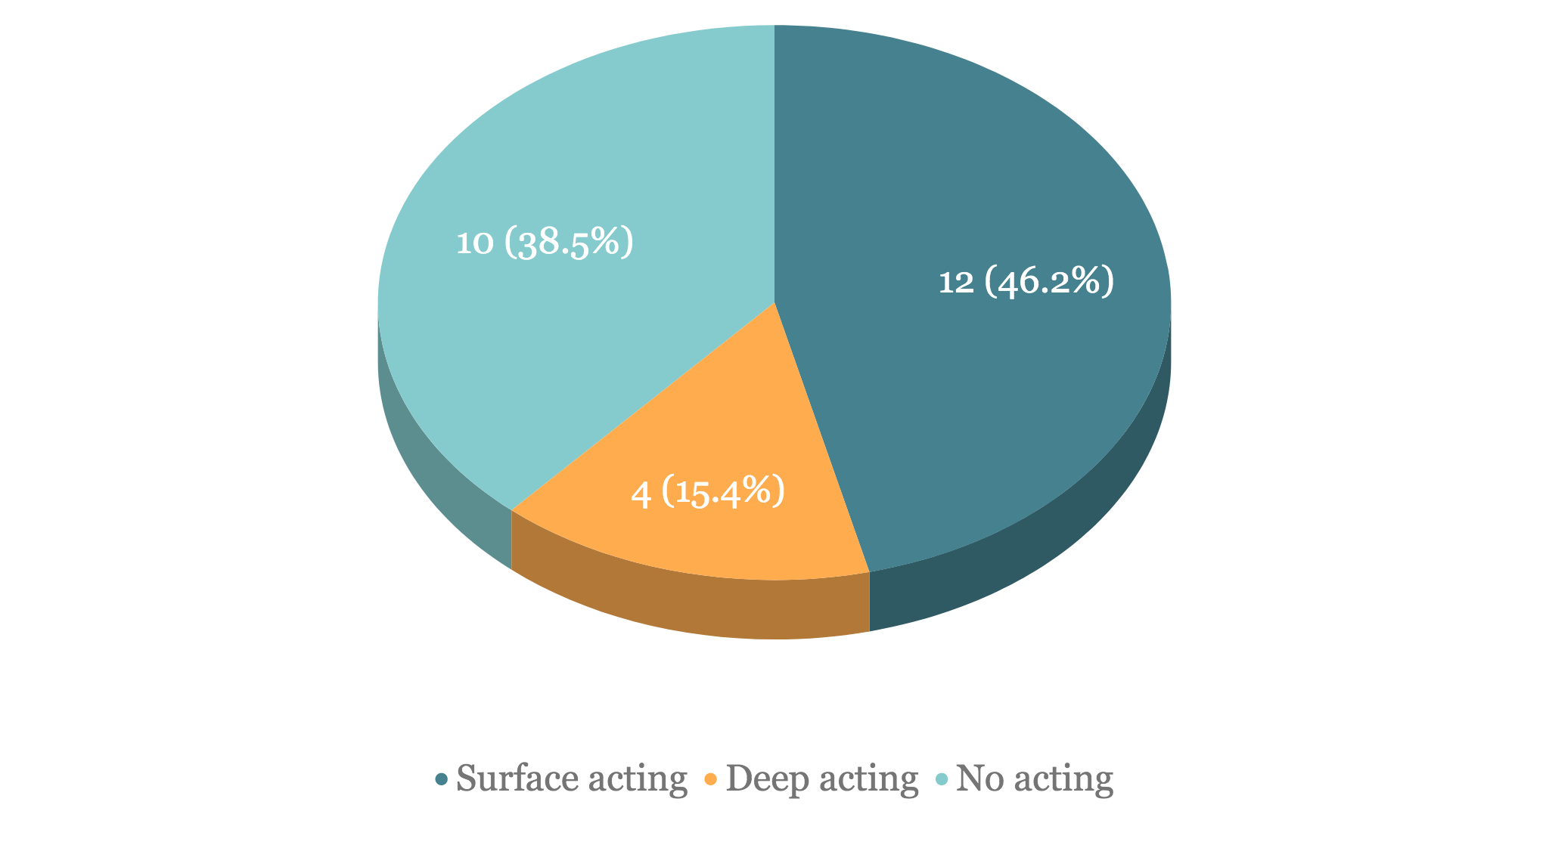
How is emotional labour performed?
Notes:
In line with other LIS studies, surface acting was the most commonly used technique to manage emotional labour. Similarly, deep acting was used infrequently.
Interestingly, participants also note that they WERE NOT performing emotional labour almost as often as they were, which I’ve termed “no acting”.

Slide 44
Discussion & Implications

Slide 45
Acknowledge that emotional labour is inherent in public library work.

Slide 46
Value the work
Emotional labour will never disappear from service work.
Can we find a way to value it?
Performance appraisals
Verbal praise
Notes:
These vivid stories help illustrate how much emotional labour public library staff are required to perform.
As the first study which includes library assistants, these findings have could have implications for public library systems which employ library assistants to do the bulk of the work with the public.
First and foremost, we must simply acknowledge that emotional labour is inherent in public library work, and that frontline library workers like library assistants are doing a large amount of this work.
The data demonstrates that emotional labour can take place anywhere that library staff interact with patrons, and it often occurs during routine tasks such as helping patrons check items out, or assisting them on the computers.
However, there is also an overwhelming amount of social work being done by public library workers, and some do not see this as part of their job.
This sense of doing work outside of their job role, and not having the proper skills puts a great deal of added stressed on the workers.
Public libraries need to consider job expectations, and clarify this in the job description. This will also help with both staff recruitment and retention. If there is an expectation for staff to perform social work, this needs to be explicitly communicated to staff, and robust training must be offered to enhance staff confidence. Libraries might also consider hiring more skilled social workers to work in branches with the highest need.

Slide 47
Unclear job role
Social work being done, which many do not see as part of their job.
Clarify job descriptions
Staff training to increase confidence
Hire more experts
Notes:
However, there is also an overwhelming amount of social work being done by public library workers, and some do not see this as part of their job.
This sense of doing work outside of their job role, and not having the proper skills puts a great deal of added stressed on the workers.
Public libraries need to consider job expectations, and clarify this in the job description. This will also help with both staff recruitment and retention.
If there is an expectation for staff to perform social work, this needs to be explicitly communicated to staff, and robust training must be offered to enhance staff confidence.
Libraries might also consider hiring more skilled social workers to work in branches with the highest need.

Slide 48
Lack of management support
Creates added stress that library workers must manage.
Strive to have management regularly in branch
Provide opportunities for staff to debrief with management
Notes:
In addition to an unclear job role, lack of management support often causes added stress which workers must manage.
Libraries could strive to have at least one member of the management team of a branch always working to ensure staff feel that they are there to support them if necessary.
Taking the time to listen to staff vent will also help prevent stronger negative reactions.

Slide 49
Lingering effects
Negatively affects staff after work.
All staff have access to counselling
Notes:
As in Sheih (2010), this study shows that emotional labour has a negative impact mental and physical well-being.
It also shows that these effects sometimes follow workers home.
Management should ensure all staff, whether temporary or permanent, benefitted or not, should have access to counselling in order to manage these lingering negative effects.

Slide 50
Limitations

Slide 51
Limitations
Qualitative research so the findings may not be transferable
Very small scale pilot study conducted in a short period
One method used by a single researcher
No triangulation
Notes:
This study has several limitations to acknowledge.
Although the study produced a great deal of data for a pilot study, it is still a qualitative study which can only speak to the specific experiences of a small group of people.
As a result, findings may not be transferable to different library workers.
Furthermore, as a pilot study conducted for a research class, the data was only coded by the author, and due to time constraints a single method was used.
This means triangulation could not be done.

Slide 52
References
Arbuckle, Kathryn. 2008. “Emotion and Knowledge: Partners in Library Service?” Feliciter 54 (5): 219-221.
Bono, Joyce E., and Meredith A. Vey. 2007. “Personality and Emotional Performance: Extraversion, Neuroticism, and Self-monitoring.” Journal of
Occupational and Organizational Psychology 12 (2): 177–192. doi: 10.1037/1076-8998.12.2.177
Douglas, Veronica Arellano, and Joanna Gadsby. 2017. “Gendered Labor and Library Instruction Coordinators: The Undervaluing of Feminized Work.”
Paper presented at Association of College & Research Libraries Conference, Baltimore, March 2017.
http://www.ala.org/acrl/sites/ala.org.acrl/files/content/conferences/confsandpreconfs/2017/GenderedLaborandLibraryInstructionCoordinators.pdf
Emmelhainz, Celia, Erin Pappas, and Maura Seale. 2017. “Behavioral Expectations for the Mommy Librarian: The Successful Reference Transaction as
Emotional Labor.” In The Feminist Reference Desk: Concepts, Critiques, and Conversations. Library Juice Press: Sacramento, CA.
Fourie, Ina and Heidi Julien. 2014. “Ending the Dance: A Research Agenda for Affect and Emotion in Studies of Information Behaviour.” Information
Research 19 (4): 108-124.
Given, Lisa M. 2008. The SAGE Encyclopedia of Qualitative Research Methods (Vols. 1-0). Thousand Oaks, CA: SAGE Publications, Inc. doi:
10.4135/9781412963909
Grandey, Alicia A. and Allison S. Gabriel. 2015. “Emotional Labor at a Crossroads: Where Do We Go from Here?” The Annual Review of Organizational
Psychology and Organizational Behavior 2: 323–49. doi: 10.1146/annurev-orgpsych-032414-111400
Grandey, Alicia, James Diefendorff, and Deborah E. Rupp. 2013. Emotional Labor in the 21st Century: Diverse Perspectives on the Psychology of Emotion
Regulation at Work. New York: Routledge Academic.=
Hektner, Joel M., Jennifer A. Schmidt, and Mihaly M. Csikszentmihalyi. 2007. Experience Sampling Method. Thousand Oaks, CA: SAGE Publications Ltd. doi:
10.4135/9781412984201
Hoang, Kay K. 2010. “Economies of Emotion, Familiarity, Fantasy, and Desire: Emotional Labor in Ho Chi Minh City's Sex Industry.” Sexualities 13 (2):
255–272. doi: 10.1177/1363460709359224
Hochschild, Arlie Russell. 1983. The Managed Heart : Commercialization of Human Feeling. 20th anniversary, with a new afterword ed. Berkeley: University
of California Press.

Slide 53
References
Judge, Timothy A., Erin Fluegge Woolf, and Charlice Hurst. 2009. “Is Emotional Labor More Difficult for Some Than for Others? A Multilevel,
Experience-Sampling Study.” Personnel Psychology 62: 57–88. doi: 10.1111/j.1744-6570.2008.01129.x
Julien, Heidi and Shelagh K. Genuis. 2009. “Emotional Labour in Librarians' Instructional Work.” Journal of Documentation 65 (6): 926-937.
doi:10.1108/00220410910998924.
Kagan, Oleg. 2017. “The Important Emotional Labor of Librarians Most People Never Think About.” Medium.com. October 26, 2017.
https://medium.com/everylibrary/the-important-emotional-labor-of-librarians-most-people-never-think-about-6f4a2cba178e
Kim, Hyun Jeong. 2008. “Hotel Service Providers’ Emotional Labor: The Antecedents and Effects on Burnout.” International Journal of Hospitality
Management 27 (2): 151–161.
Mancini, Michael A. and Hal A. Lawson. 2009. “Facilitating Positive Emotional Labor in Peer-Providers of Mental Health Services.” Administration in Social
Work 33 (1): 3–22. https://doi.org/10.1080/03643100802508619
Maria. 2015. “Emotional Labor and Library Instruction.” LibrarianBurnout.com. April 23, 2015.
https://librarianburnout.com/2015/04/23/emotional-labor-and-library-instruction/
Matteson, Miriam L., Sharon Chittock, and David Mease. 2015. “In their Own Words: Stories of Emotional Labor from the Library Workforce.” The Library
Quarterly: Information, Community, Policy 85 (1): 85-105. doi:10.1086/679027.
Matteson, Miriam L. and Shelly S. Miller. 2012. “Emotional Labor in Librarianship: A Research Agenda.” Library and Information Science Research 34 (3):
176-183. doi:10.1016/j.lisr.2012.02.003.
———. 2013. “A Study of Emotional Labor in Librarianship.” Library and Information Science Research 35 (1): 54-62.
Miss Julie. 2017. “The Emotional Labor of Librarianship.” HiMissJulie.com. May 24, 2017.
https://himissjulie.com/2017/05/24/the-emotional-labor-of-librarianship/
Peng, Yu-Ping. 2015. “Buffering the Negative Effects of Surface Acting: The Moderating Role of Supervisor Support in Librarianship.” The Journal of
Academic Librarianship 41 (1): 37-46. https://doi.org/10.1016/j.acalib.2014.10.009
Philipp, Anja and Heinz Schüpbach. 2010. “Longitudinal Effects of Emotional Labour on Emotional Exhaustion and Dedication of Teachers.” Journal of
Occupational Health Psychology 15 (4): 494–504.

Slide 54
References
Salkind, Neil J. 2010. “Experience Sampling Method.” Encyclopedia of Research Design. Thousand Oaks, CA: SAGE Publications Ltd.
doi:10.4135/9781412961288
Sheih, Chen Su-May. 2010. “An Empirical Study of Public Service Librarians’ Perceptions and Causes of Negative Emotions in Taiwan’s Public Libraries.”
Journal of Library and Information Studies 8 (1): 59-96.
Shuler, Sherianne and Nathan Morgan. 2013. “Emotional Labor in the Academic Library: When Being Friendly Feels Like Work.” Reference Librarian
54 (2): 118-133. doi:10.1080/02763877.2013.756684
Smith, Pam. 1992. The Emotional Labour of Nursing: Its Impact on Interpersonal Relations, Management, and the Educational Environment in Nursing.
Houndsmills, Basingstoke: Macmillan Education.
Theodosius, Catherine. 2008. Emotional Labour in Health Care: The Unmanaged Heart of Nursing. London: Routledge.
Tracy, Sarah J. 2013. Qualitative Research Methods. Chichester, UK: Wiley-Blackwell.
Vogt, W. Paul. 2005. Dictionary of Statistics & Methodology. 3rd ed. Thousand Oaks, CA: SAGE Publications, Inc. doi: 10.4135/9781412983907
Wharton, Amy S. 2009. “The Sociology of Emotional Labor.” Annual Review of Sociology 35 (1): 147-165. doi:10.1146/annurev-soc-070308-115944.
Zhang, Qin, and Weihong Zhu. 2008. “Exploring Emotion in Teaching: Emotional Labor, Burnout, and Satisfaction in Chinese Higher Education.”
Communication Education 57 (1): 105–122. https://doi.org/10.1080/03634520701586310

Slide 55
Acknowledgments
This research could not have been conducted without the participants generously donating their time and sharing their experiences. Deepest thank yous to them!
Thank you to Dr. Tami Oliphant for her support and guidance while conducting my first ever research project.

Slide 56
Questions, comments, stories?

Slide 57
Contact
kalee@ualberta.ca
linkedin.com/in/kyla-lee
@kylaleela

