Slide 1
Great ideas from the Minister’s Awards
Ken Feser
Ken Allan
Public Library Services Branch
Municipal Affairs
Public Library Services Branch

Slide 2
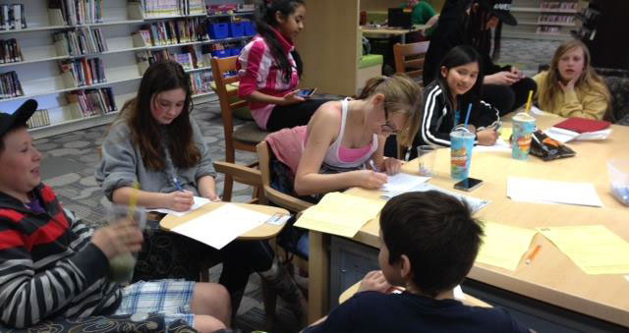
Pen Friends (Fort Saskatchewan)
Notes:
International Pen Friends (IPF) is a global organization that allows people of all ages the chance to write to pen friends (“pen pals”) in other countries. It hopes to “promote world peace and understanding through sincere correspondence” (from their website).
Fort Saskatchewan Library became involved with pen friends after a library assistant’s young daughter became involved in the program. That library assistant then recommended it to the library as a new youth program.
Currently, there are 41 participants in the program, between the ages of 8 and 14. There is a registration fee for the program that is covered by the library.
Participants register online and state which countries they are interested in writing to, and some information about themselves and their interests. They then receive a list of potential pen friends, and can write to whoever they want from that list.
Monthly meetings are held at the library on Wednesdays when the schools dismiss early. Participants exchange stories about their friends and get help with their writing. However, these sessions are optional, and children from as far away from Medicine Hat are currently participating in the program.
This program ties into FSPL’s current Plan of Service, where Early Literacy has been identified as a primary service response. This program gives participants the opportunity to strengthen written literacy skills, and possibly practice a second language.
Fort Saskatchewan recognized that it was welcoming many newcomers to Canada during its last Community Needs Assessment. This program allows participants to become more aware of international cultures, and lets them gather at the library to share ideas and explore creativity.
This is a great example of how a local library can take an existing program and make it into something that suits local need.

Slide 3
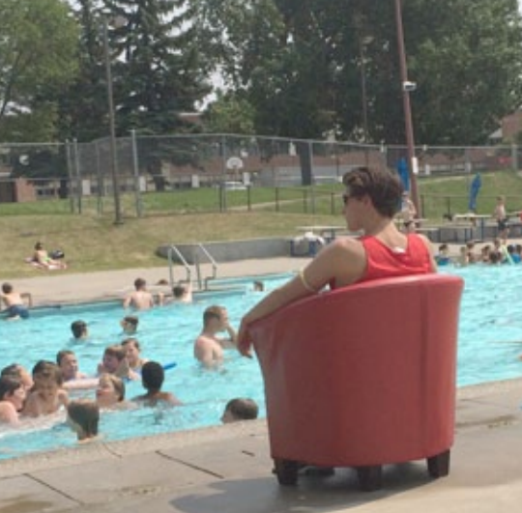
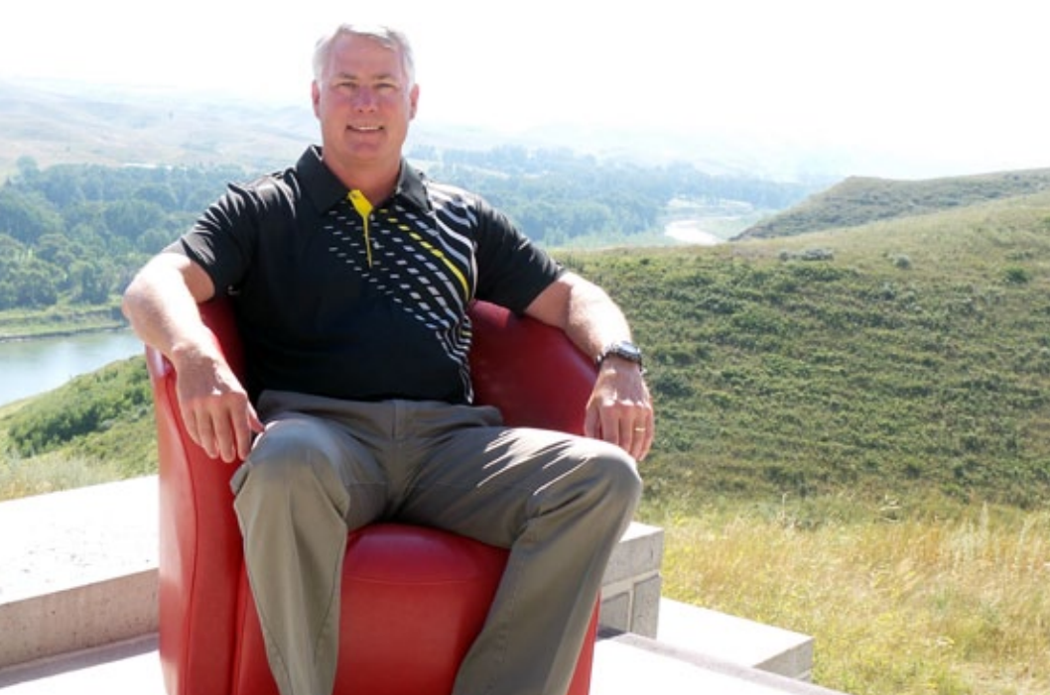
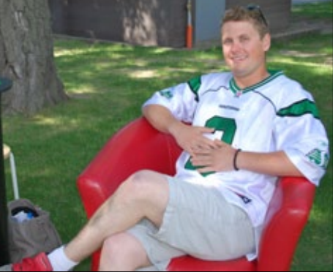
Red Chair (Lethbridge)

Slide 4
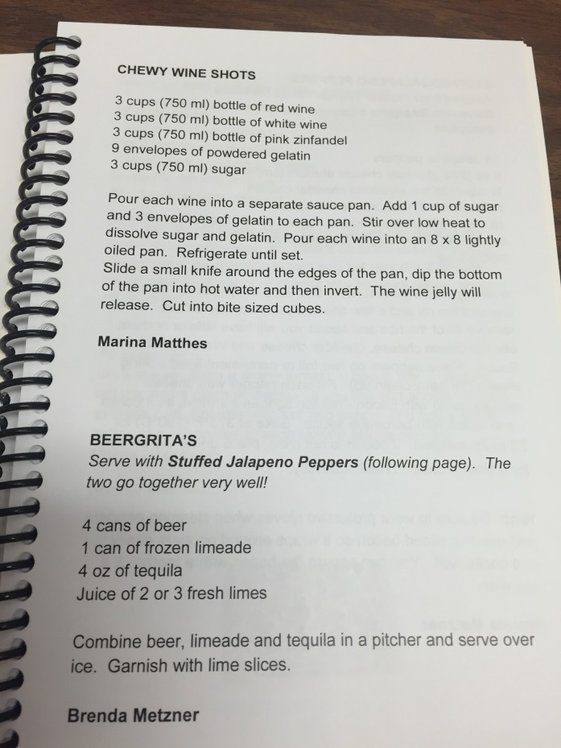
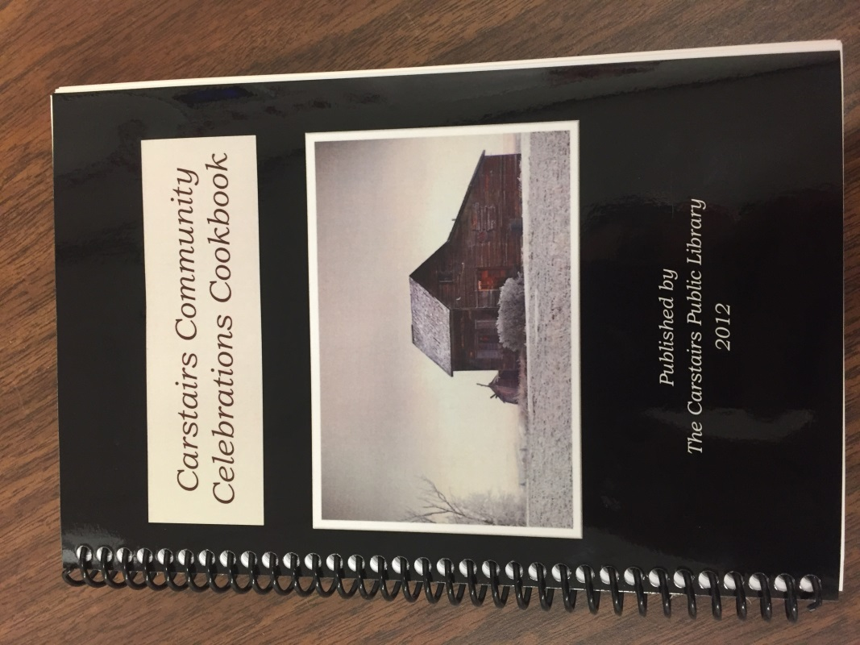
Community Cookbook (Carstairs)

Slide 5
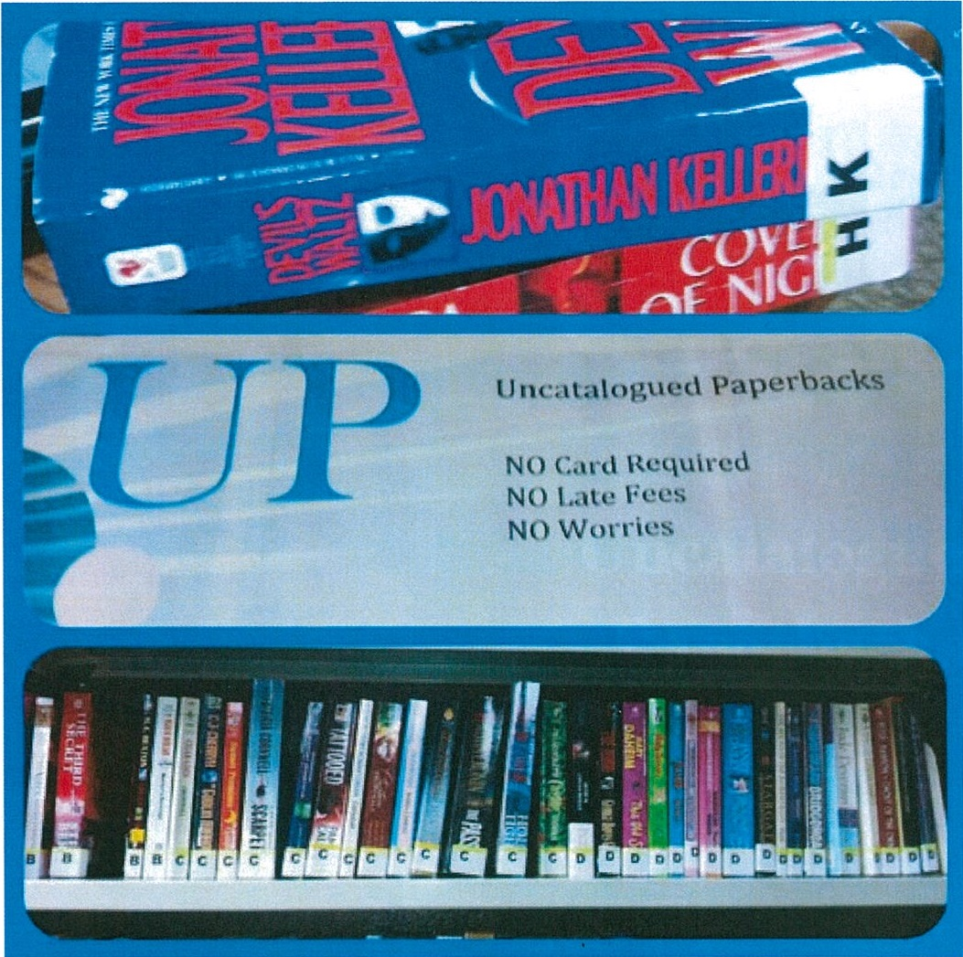
Uncatalogued paperbacks, outreach services (Westlock)
Notes:
Uncatalogued Paperback (UP) Books from Westlock Intermunicipal Library are donated paperbacks that are made available to anyone with or without a library card to take out of the library. They have no due date, no fines, and no damage fees.
This program was created after a staff member saw a similar program in a small rural US library. They are spine labelled with the first letter of the author’s last name, and tracked using a special barcode.
60 items per month circulated during the first few months of the program in late 2011. This doubled to 120 items per month by April 2012.
Based on usage patterns by patrons, this program was incorporated into an existing Summer Reading Program outreach to area campgrounds. The program was also incorporated into seniors outreach programs.
This is an very replicable program. Most libraries have a collection of used paperbacks in good condition.
This program can easily be incorporated into other existing programs.
This reduces barriers to access to those who are visiting from other areas and do not have a TRAC card, those who are geographically isolated (campgrounds) or those who have limited mobility (seniors homes).
This program incorporates a tracking element that allows the library to track the use of the program and use it as an example of reduced access to community members and stakeholders.

Slide 6
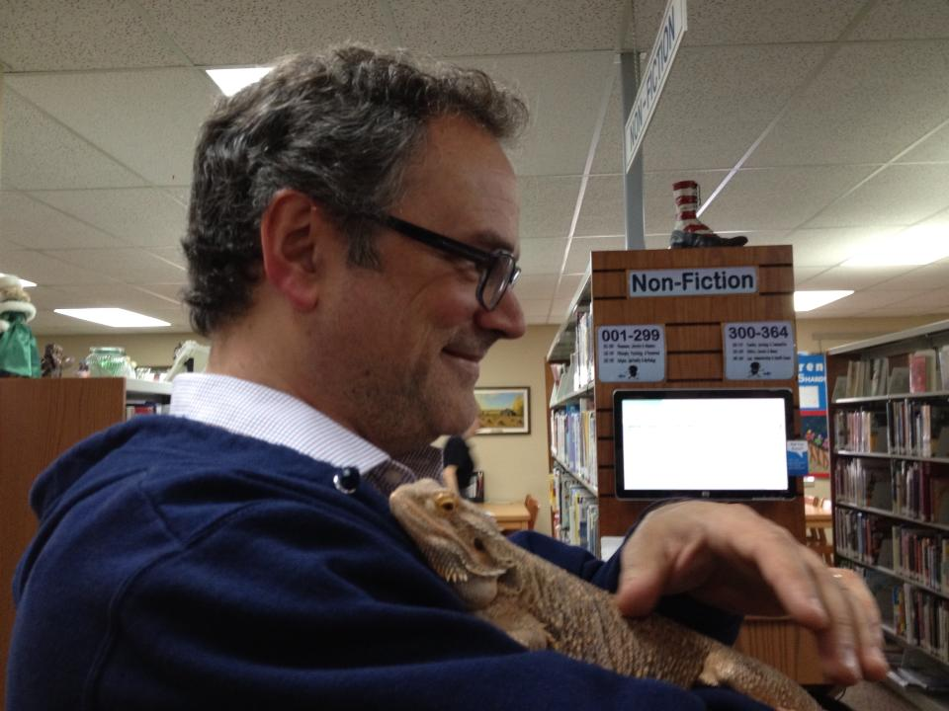
Pets at the Library (Westlock)

Slide 7
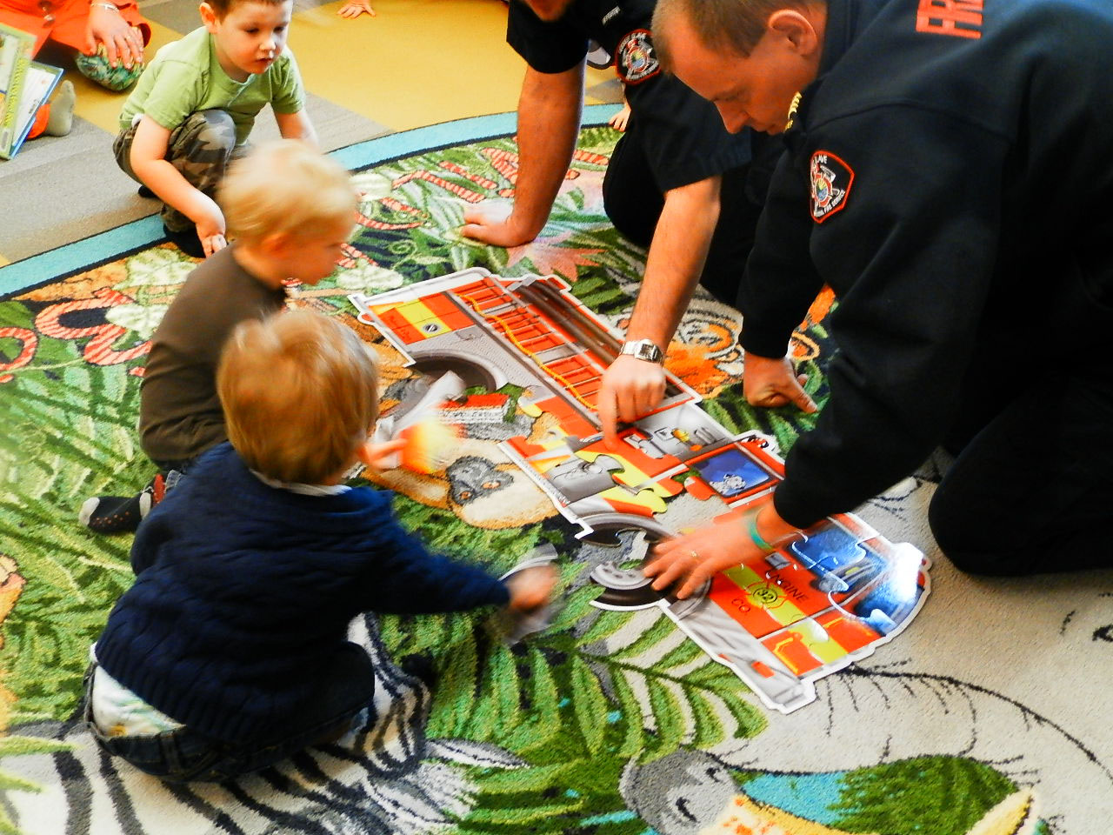
Professionals Talk to Tots (Slave Lake)
Notes:
In this program, professionals from the community come in to speak to children from the community.
Held once a month, marketed separately from other storytimes
Past professionals have included RCMP, Forestry officers, ATCO electric workers, and firefighters
Professionals read themed stories, play themed games, and answer questions from the audience
35 people attended the storytime hosted by a local firefighter in February 2015
Slave Lake plans to coordinate future sessions with local preschool and kindergarten
This is an easy program to set up
This program helps strengthen the library’s connection to the community – promotes good relations with other organizations in the community and improves knowledge of the community.
This program teaches young people about various occupations and roles within the community.

Slide 8
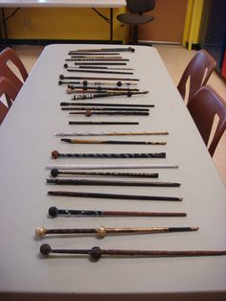
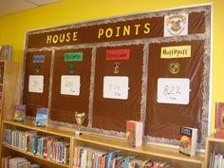
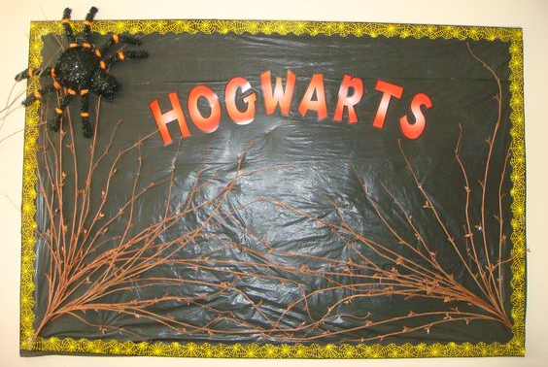
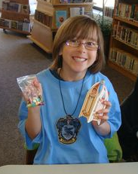
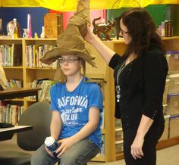
Hogwarts at the Library (Grimshaw)

Slide 9
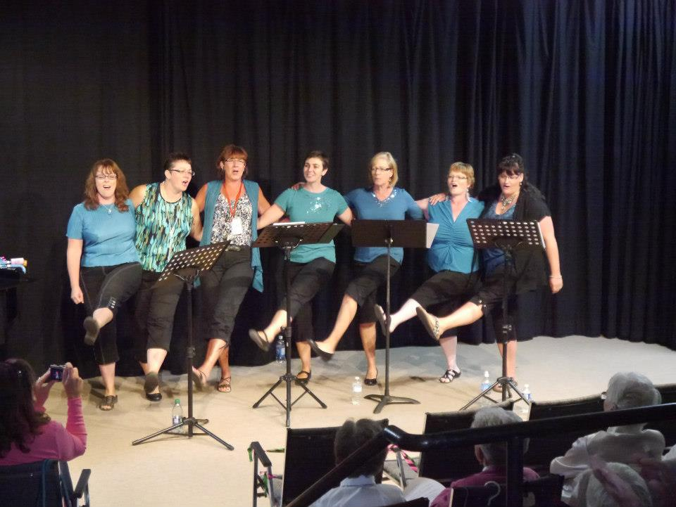
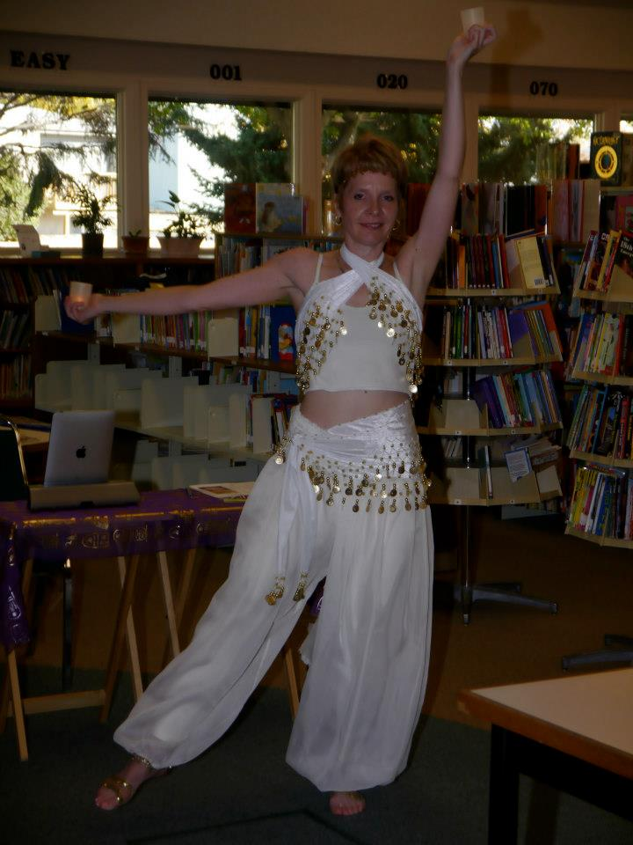
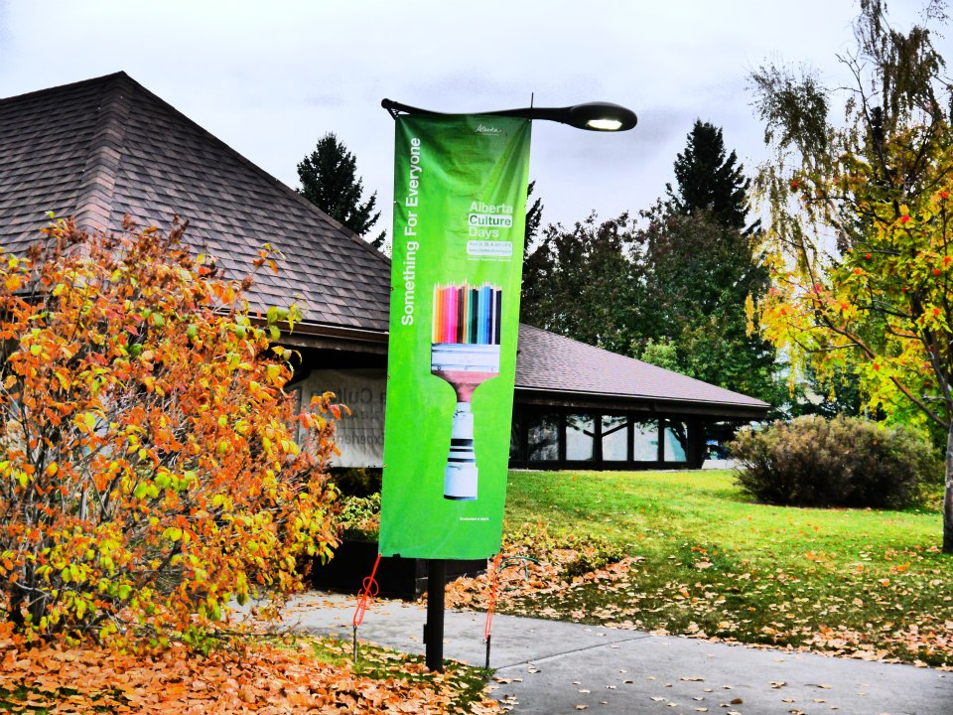
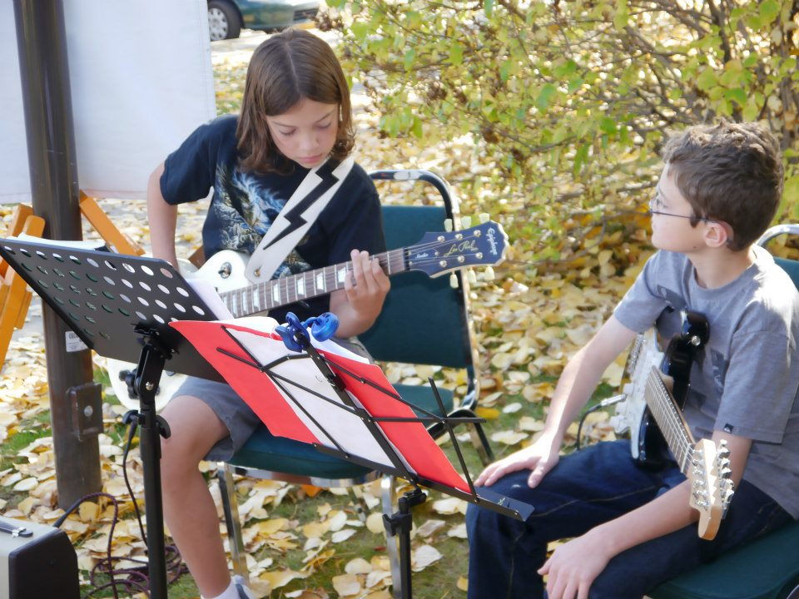
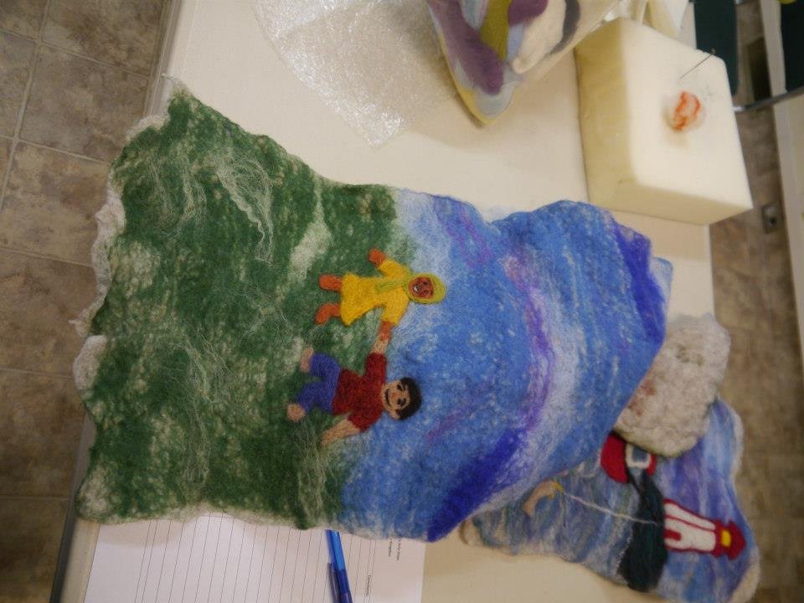
Festival of Flags (High River)
Notes:
Alberta Culture Days is a three-day provincewide celebration that raises the awareness and participation of Albertans in the cultural life of their communities
In 2012 (before the flood), High River celebrated Alberta Culture Days with a Festival of Flags.
The Festival of Flags was a town-wide celebration of arts at various venues throughout the town. 25 events were hosted over the three days including an art show, screenings of Alberta films, musical performances, dancers, poets, theatre arts, and belly dancers.
Children in the community made small flags at summer programs, the Summer Reading Club, and in schools that celebrated arts and culture in High River. These flags decorated the library foyer and a local park during Alberta Culture Days.
This event brought together various artists and volunteers in the community who are now sharing expertise on a regular basis e.g. through a monthly Music showcase.
This event supported the library’s stated goals of allowing patrons to explore topics of personal interest and enhance their leisure time, and to be a safe attractive and welcoming place to interact in the community. It also supports the library’s ongoing commitment to the arts through their art gallery and theatre.
A good example of how the library can be a community leader in cultural events. – led a broad coalition of community members and fostered new relationships between those community members.

Slide 10
Thanks for your interest and attention! Questions? Comments?
Ken Feser
Ken Allan
Public Library Services Branch

