Slide 1
2018 State of Ebooks
BC Libraries Coop Friday, June 22

Slide 2
3 Things
Insights from BC libraries and collections
The Ebook Reader
Audiobooks Ascendant
Notes:
Good afternoon everyone, my name is Sarah Felkar and I am the Digital Experience Coordinator at the West Vancouver Memorial Library.
I have about 15 minutes to talk to you today about the state of ebooks! Which I am very excited about. I am going to cover three areas of Ebooks - a general BC stats update, provide a general “who is the ebook reader” profile, and touch on the rise of downloadable audiobooks.

Slide 3
2016 Provincial Statistics Insights
40% of libraries circulated 1 ebook or more per capita
89% of libraries saw a positive increase in circulation over 2015
50% saw a 30% increase or higher
Collection sizes shrank last year by an average of -14%
Notes:
I want to talk about a couple things around local trends.
First, provincial trends from the 2016 statistics
29 libraries (40%) circulated at least 1 ebook/audiobook per capita. With the highest per capita circulation in Pender Island, Kaslo, and Rossland
89% of libraries saw a positive increase in ebook circulation
Collection size grew by an average of -14% (I am very curious about this!)

Slide 4
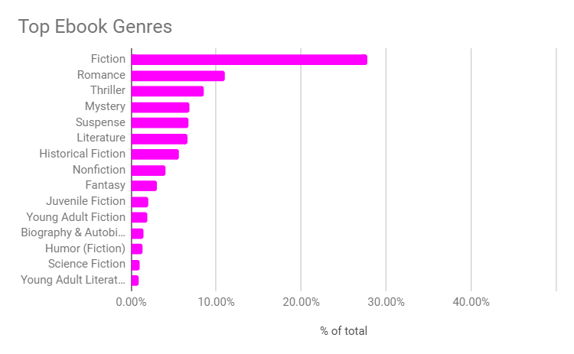
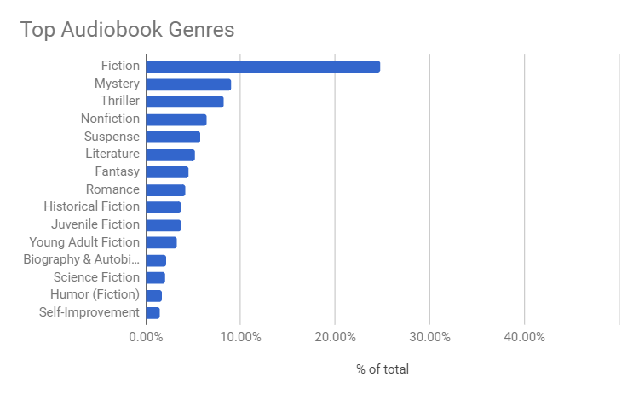
Library2go Insights
Notes:
Second, a deeper dive on the libraries who are part of the consortial Library2go collection:
Top titles, are still best sellers, but as the breadth of the collection grows, we see that the top genres for ebooks are: Romance, Thriller/Mystery/Suspense, Literature
And the top genres for audiobooks are: Mystery/Thriller, Non-fiction, Literature

Slide 5
2017 Stats from Local Libraries
Ebooks Downloadable Audiobooks
VIRL + 24% | + 28%
NVCL + 18% | + 100%
SPL + 16% | + 26%
NWPL + 15% | + 20%
VPL + 13% | + 34%
WVML + 12% | + 21%
GVPL + 7% | + 25%
BPL 0% | + 14%
Notes:
And finally, I also asked a number of libraries to share some of their 2017 numbers with me, on pretty short notice.(Thank you!)
Now these number definitely do not tell the whole story - were the budgets stable? Increasing, decreasing? Was there a platform change? Was there any publicity? But an interesting snapshot to have.
What do these three pieces of information tell us? Things are still changing, we haven’t plateaued in interest yet, and we might want to talk more as a large group about what we’re reporting, where, and how we might best

Slide 6
The Ebook Reader
Is reading genre fiction:
90% of Romance sales are ebooks
75% of Sci-Fi/Fantasy sales are ebooks or audio
Buys ebooks consistently throughout the year.
Spending money on:
Literature & Fiction
Mystery, Thriller, Suspense
Romance
Sci-Fi and Fantasy
Business & Money
Is reading more on their phone than before. But mostly on Tablets (35%) or E-Readers (25%)
** Data from the 2017 Author Earnings Report and BookNet Canada research
Notes:
Profile: who is the ebook reader?
I spent some time with the 55 page “Author Earnings Report” which is a deep deep dive into US book sales data, including ebooks, audio, and print. They’ve upped their game recently, and the most recent report includes data from April through end of december 2017, with daily sales data.
It’s a lot.
This, combined with the BookNet Canada “State of Digital Publishing in Canada 2017” report (a mere 35 pages) gives us some insight into who is reading ebooks!
They are reading in similar patterns to what our community members are borrowing (yay!) the subject categories are a bit different than what we get out of OverDrive (and what can be retrieved from Cloud) but the patterns track. Ebook purchases are primarily fiction,
Some genres are being bought almost entirely as digital content- like romance and sci-fi and fantasy. 70% of online purchases of adult fiction and non-fiction were ebooks.
Ebook readers buy consistently throughout the year. This is interesting, because a lot of reports that I see reported have fluctuations related to textbook sales, and that’s not something we necessarily want to be tracking.
In the US, we see that Indie authors, and titles not tracked by the Association of American publishers now makes up 70% of the market (aka, they are only reporting on 30% of ebook sales). But we do see that sales have increased a bit, but 2.1%
52% of Canadian readers read ebooks, and of those, they are reading on their phones (23%), tablets (35%) and e-readers (25%). 23% discover their next reads at the library, but work of mouth is still the primary method (43%).
Take away - the ebook reader isn’t the same as the audiobook reader, or the print book reader, and our collection development policies should reflect that.

Slide 7
Audiobooks Ascendant
Audible has earmarked $12 million (Canadian) over the next three years to invest in Canadian writers and voices
In 2017, Audiobooks.com saw $2.5 billion in sales
Notes:
The rise of audiobooks
2017 was a big year for Canadian audiobooks. In mid-September Audible launched its Canadian store (you could still subscribe before, but with an USD price)
Kobo launched their audiobook subscription service in september of last year as well. They noted at the New York Book Fair that there is a lot of interest in middle grade books (an area where they haven't seen ebook sales).
And anyone who attended the RBdigital session a few weeks ago would have heard about how proud they are of producing Canadian ebooks. RBmedia (RBdigital’s parent company) also owns Audiobooks.com which reported United States – the largest market for audio – saw $2.5 billion in sales in 2017, up from $2.1 billion in 2016.
In 2017 there were 80,000 audiobooks produced in the US, and the UK publishers association has reported that spending on audiobooks jumped 21.5% in 2017. And locally, “Audible has earmarked $12 million (Canadian) over the next three years to invest in Canadian writers and voices,” - said Audible founder and CEO Don Katz
One of the reasons behind the audiobook boom I’ve speculated (and we touched on last year) is the continued saturation of the smartphone market, and the increased download speeds, and storage sizes. You can listen anytime, anywhere.
What to take from this? Audiobooks are big! They are also typically more expensive - because they cost more to produce. So when planning for the future, allocating more $ to audiobooks, or re-allocating for CD audiobooks.

Slide 8
Midwest Tapes MP3, $39.99
Whitehots Hardcover, $23.99
OverDrive MP3, $83.99
OverDrive EPUB (26 CKOs) $18.99
Chapters / Kobo
Downloadable Audio: $34.63
(or free with a subscription trial)
Ebook, $10.99
Hardcover, $23.99 (or $12.73 on sale)
Notes:
Here’s a cost comparison of a recent Audie award winner (among other awards) for Angie Thomas’ The Hate U Give. Note that like the difference between the cost of print and ebook, there is a price difference between CD and MP3 cost. One benefit that we have seen with audiobook licensing is that through RBdigital, and OverDrive, there are still options for simultaneous use titles or “always available” titles.
And for those that are curious, your subscription options as a Canadian are:
Audiobooks.com $15 USD / month
Audible $15 CAD / month
Kobo $13 CAD / month

Slide 9
Thank you!
Want to get the monthly Ebook & E-Reader Newsletter?
Email: sfelkar@westvanlibrary.ca
Notes:
Thank you and e-newsletter
That’s all we have time for today! Digital content continues to a complex and changing field to look into, and every bit of information I know helps me and my library better support our community.
If you are interested (and not already subscribed) I send out a monthly “ebook and e-reader news” email to folks with links to articles and some summary/commentary.
Thank you so much for your time!

