Slide 1
Literacy in the making
Bookbinding that builds literacy

Slide 2
creation, play, discovery
Bookbinding for Kids in local schools
Each kid makes and decorates a book
several workshops per year, 10-20 kids per, about 90 minutes
Collaborating with teachers and volunteers
In short:
bookbinding is a very rewarding way for kids to engage with books and print culture

Slide 3
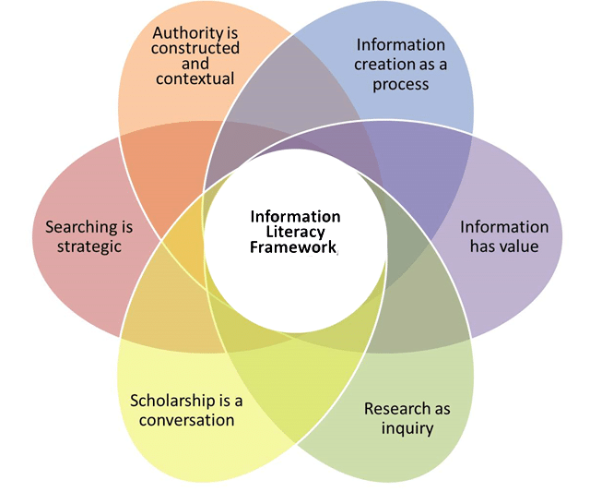
Structure, substance

Slide 4
ACRL Frames for grades 3-6
Frame | Basic expression
Authority Is Constructed and Contextual | Anyone can make a book
Information Creation as a Process | Authors and illustrators work together
Information Has Value | Books are valuable
Research as Inquiry | Books answer questions
Scholarship as Conversation | Different books say different things
Searching as Strategic Exploration | You can find books in a library

Slide 5
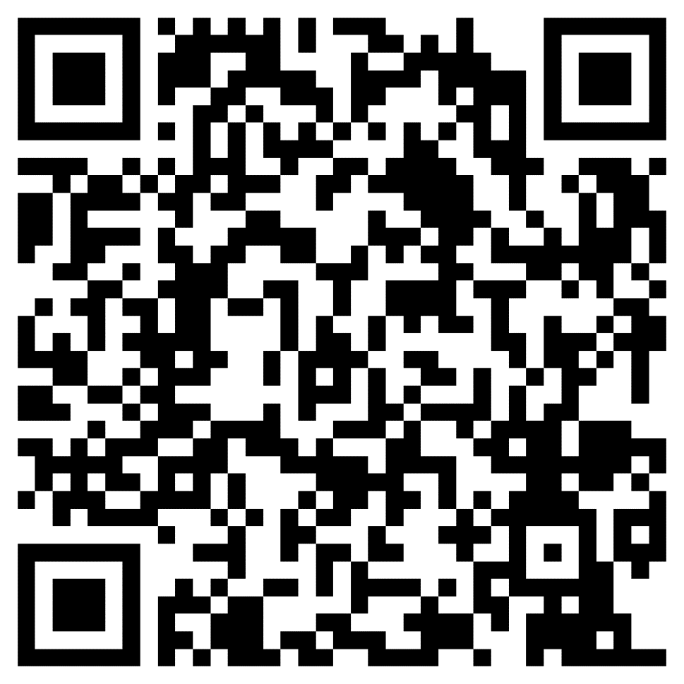
Materials sheet
http://surl.li/gnojk

Slide 6
Further discussion
Interested in working on a lesson plan?
email me at mlines@uvic.ca

